Slide 1
How to Be a Great Consultant
OST Global Solutions

Slide 2
Why This Training
Better serve our clients
Be perceived as serving our clients better
Have returning clients
Have raving and paying clients
Have referring clients
Be more appreciated for the work we do
Understand customer service: everyone is a customer!
We can do the best work and win a lot and not be invited back! Consulting skills matter as much as the professional skills.

Slide 3
A Consultant’s Unique and Exciting Perspective of the Business and Government Worlds
Many people will enjoy career in a handful of companies
We get to work with every size companies
Across a variety of industries
Get access to leadership
Be privy to internal politics and gain insight few at the company have
The exposure to business world is enormous and it makes us grow as professionals

Slide 4
Training Structure
Representing OST
OST Teamwork and Resources
Ethics as OST Consultant
Consultant Mindset and Psychology
Managing Client Relationship
Managing Difficult Client Behaviors
Avoiding Costly Mistakes
Money Matters and Risk Management

Slide 5
Representing OST Module 1

Slide 6
OST’s Core Values Directly Apply to Consultant Work
1. ENGAGE WITH CONTENT
Put in effort to fully understand our clients’ business and solutions
5. DO WHATEVER IT TAKES
Summon grit and tenacity to get the work done, no matter what.
GETTING IT DONE
CONTENT
We are in the business of winning, rather than just completing proposals
CORE VALUES
THE LOAD
DETAILS
4. SHARE AND CARRY THE LOAD
Be a good team player
LEARNING
2. OBSESS ABOUT THE DETAILS
Always submit meticulously accurate and compliant work products
3. LEARN CONTINUOUSLY AND STRIVE FOR PROFESSIONAL EXCELLENCE
Strive to constantly improve professional knowledge

Slide 7
Exercise
In a group, provide examples of the assigned core value recently applied in the company
Discuss a situation where we have seen this value NOT being applied by our clients internally and where we make a difference

Slide 8
OST’s One-Phrase Strategy (How We Make Money)
Keep Adding Value

Slide 9
Presentation Matters
Perception = Reality
All major consulting companies spend a tremendous amount of time and attention on polish of:
Client deliverables
Reports
Presentations
There is always a team of people on client meetings, conveying numbers of people working on the project, and commitment to client success
This formal process is there for a reason

Slide 10
We Need to Be the “Supers” of Consulting

Slide 11
Humans Are Flawed
Clients judge the book by the cover
They don’t look as much at WHAT is done, they instead pay attention at the HOW – all the external trappings of the job
You must look the part, sounds the part, act the part
When you don’t, it doesn’t even matter if your proposals win
You won’t be invited back or the client will be always shopping for someone better
The client will feel like they are overpaying or getting bad value
Few clients will recognize greatness if you don’t dress it up

Slide 12
A Musician Was Playing at the DC Metro Station…
Played six Bach pieces for about 45 minutes
Nearly 2000 people went through the station
7 people stopped and listened
20 gave money but continued to walk (the musician collected $32)
No one applauded

Slide 13
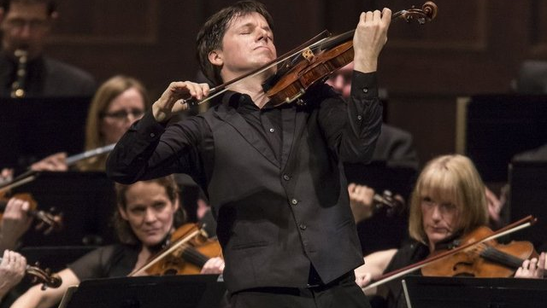
No One Recognized Joshua Bell
Social experiment organized by the Washington Post, telling a lot about perception
Grammy-winning violinist, one of the greatest musicians in the world
Played one of the most intricate pieces ever written
With a violin worth $3.5 million dollars
Two days before, Joshua Bell sold out a theater in Boston where the seats averaged $100 each

Slide 14
Present a Single, United Front
To the client, you are OST
Not an individual
Not another consultant or consulting company
Communicate any client issues proactively to the OST management team to ensure we are all on the same page and brainstorm on how to navigate through the issues and prevent them from becoming problems
Coordinate ahead of time across the team to send a consistent message to the client
We all sound similar and come across the same way as competent and confident
We have already discussed and agree on solutions to the client issues
Help the client see the entire OST team as helpful and useful and we will all reap the benefits of repeat business

Slide 15
Client Deliverables
Learn
Learn how to use PowerPoint correctly – Mike Parkinson’s book and training in our Library
Use
Use Presentation Load for source of templates and professional graphics
Take
Take our Desktop Publishing class
Format
Format Word Documents properly, even if it’s work in progress
Header with document name and logo(s) (our logo if internal document, client’s logo if for the client)
Footer with page numbers and disclaimers
Styles
Cover and TOC

Slide 16
Articulate the Full OST Capabilities
Listen for client needs
Know what OST offers and be able to relay this to client
Refer clients to our blog posts to be helpful – you should read and know our newsletters and blogs
Understand company discriminators and differentiators and plug them in at every opportunity
Say how much OST helps our clients and makes a difference
What areas we consult in (BD (WinMoreBD), Capture, Proposals, Cost Proposals, Orals)
What specific classes and self-study products we offer
Apprenticeship and Veterans Apprenticeship
The GovCon Incubator’s SBIR/STTR Proposal Lab

Slide 17
Exercise
Search OST’s Blog for helpful articles on:
Win strategy development
Defeating an incumbent
Test your knowledge:
What are OST’s discriminators?

Slide 18
Dress Like a Successful Consultant
Create a “signature look”
Invest in statement pieces for your wardrobe – your “work uniform”
Research “capsule wardrobe” if unfamiliar with the term
Keep shoes clean and shiny and avoid open-toed ones
Keep makeup natural-looking and hairstyle polished
Choose your power colors – the ones that make you look sharp
Avoid dangling earrings, multiple necklaces and rings, funky jewelry, and loud nail art
Pearls for women are an equivalent of a tie for men
Remove facial and body piercings and cover visible tattoos; cover body hair
Keep clothes conservative: no tight-fitting short outfits, low necklines, revealing details, open shoulders, or mesh shirts
Clothes set the tone
A General in a uniform is a mighty force, the same General in a bathhouse is a shriveled grandpa

Slide 19
Always Speak Positively About Our Work
Projects are difficult, and issues arise – almost nothing ever goes off without a glitch
Own the mistake if one was made and it is mainly your fault
HOWEVER:
Don’t be self-deprecating, overly apologetic, and self-flagellating – the client may just believe you
Reduce the drama; focus on lessons learned and repair going forward rather than dwelling on fault finding
Don’t make the client feel like they are overpaying, and you are doing something wrong
Don’t fall on the proverbial sword for client’s own staff who may be at fault (while trying not to throw them under the bus either)
Don’t be critical of OST’s work; we don’t want to get fired because you needlessly panicked the client and undermined their confidence in our company
In a study of over 10,640 projects, only 2.5% of companies complete their projects 100% successfully.”
PWC

Slide 20
Convey Confidence with Your Voice
Don’t show or sound uncertain or tentative in the responses to client questions (intonation goes down with certainty, up with uncertainty)
Do your homework so you speak with authority
Slow down in your speech and say things deliberately
Don’t sound out the pauses such as “um” to fill spaces between thoughts
Get rid of parasite words such as “like”
Off with the monotone delivery; use inflection to show enthusiasm, which means confidence
Speak loudly – project your voice and don’t mumble
Speak while pressing down firmly on your abdominal muscles, because you'll have a more confident, lower, more powerful voice
Practice the “late night DJ” voice

Slide 21
Body Language
Maintain good posture for authority and poise – slumping posture equals lack of confidence
Mirror the client’s body position
Keep your chin and head up, leaning slightly towards the client, with feet slightly open towards them
Two feet firmly planted on the ground in wider stance implies physical balance – showing more confidence than if your legs are crossed or together
Don’t fidget or touch your face, hair, or neck, which betrays anxiety – deliberately slow down your breathing and movement
Gesturing with your palms up implies honesty, which makes you appear more confident
Keep your hands out of your pockets and always visible
Hiding hands betrays lack of self-confidence
Crossing your arms has a similar negative effect, making you appear closed off and unreceptive
Maintain eye contact; if struggling, try looking at the other person's eyes for two seconds, looking at their nose for two seconds, looking at their mouth for two seconds, and then looking at their face as a whole for two seconds

Slide 22
Being Articulate
Treat every client presentation like a show
Be interested, not interesting – focus on the client and comprehending what they are versus focusing on yourself and your self-consciousness
Listen to understand, not to respond
Practice reading out loud (do it while editing your emails and text)
Rehearse presentations, and practice saying things you find smart or hilarious
Read more

Slide 23
Writing for Success
People equate typos with lack of intelligence and literacy
Literate and articulate writing comes across as professional and confident
Take our Writing Persuasive Federal Proposals class
Always Quadruple-check your work before sending to the client – emails, presentations, drafts
Always have important deliverables edited by someone else

Slide 24
High-Value Consultants Talk Less and Listen More
Creating lasting connections not only results in more business, but makes our jobs enjoyable
Saying the wrong thing may cost you reputation and money – work friendships take special care to develop
When we relax with the client and get used to each other, the slow bonding process begins
Focus on getting to know the client versus seeking approval from them by oversharing personal facts about you
Don’t share about all the topics people are typically discriminated against or judged with (politics, religion, sexual orientation and practices, non-traditional lifestyle, mental disorders or disabilities, illness that could be perceived as impacting productivity, personal drama, addiction, difficult childhood and other trauma, how poor you were when you grew up, transformation stories, etc.)
Only reveal personal facts that you have in common with your client, and not the ones that would potentially antagonize them or take a sheen off of you
Read your client – what DISC personality are they? Use www.crystalknows.com with your LinkedIn. Is sharing appropriate or could be regarded as non-productive time?
Don’t rush with personal facts – they may want to know you, just not all of you all at once
Show vulnerability and friendliness through professional and emotional honesty, not by spilling the guts

Slide 25
TMI is a Real Problem
Don’t share facts about fellow coworkers who are: at lunch, sick today, recovering from a proposal all-nighter or a hangover, on a smoke break, on holidays, with another customer, working on another proposal, etc.
Simply tell the customer that the person is unavailable or out of the office until a certain time or day and offer to take a message
When customers ask how we are, they don’t want to hear lamentations about our physical or mental state or how anxious we are for this proposal to be over and the weekend or holidays to be there
Clients aren’t there to hear whining as it instantly diminishes the customer experience
Just remain positive and focus on helping the customer

Slide 26
Rate Confidentiality
Labor Hour Charge Breakdown
External 1099 Consultant
Internal W-2 Consultant
Do not ever reveal what OST pays you – this information is confidential and you signed an agreement
Many clients don’t get why consulting companies charge anything but a tiny profit on top of labor cost, and don’t understand all the costs that go into running a business
They also don’t understand how much their own employees truly cost them when they compare just their Labor cost to consultant’s prices
They will then try to go around us or undercut us, hire internal staff or use freelancers, feeling like they are getting hosed while in reality they are not
By revealing rate information, you hurt yourself, OST, and the client
Labor Cost
(Consultant covers their own taxes, fringe, non-billable time, internal OH, G&A)
Labor Cost
(Salary)
Non-Billable Time
Fringe
(Taxes, Benefits)
Marketing, sales, QA, support
Overhead
G&A
G&A
Profit
Profit

Slide 27
Avoid Alienating the Client by Referring to Your Other Customers
Don’t mention other customers, other than maybe name-dropping some big names for small business confidence boosting early on
Customers like to feel that they are your only and most valued customer, especially if they do a lot of business with OST
When you’re busy working on projects or orders for other customers, keep that fact to yourself (especially when your schedule is busy and you may be thinking out loud regarding how to accommodate time with this client)
Explain to the customer the steps you’re taking to keep things on schedule for them versus mentioning other customers or projects that also require your attention
If you are not available on a certain day, you could possibly mention public speaking or training that you will be doing as it raises your status as an expert – but not when you are running a big proposal – this will only annoy the client
As far as the client is concerned, they are the one and only important and valued client on the face of the Earth, with their pursuit being the most important goal on your agenda

Slide 28
Don’t Discuss OST’s Internal Affairs
Don’t discuss OST’s internal affairs such as:
Staffing shortages
Labor performance issues
Unanticipated obstacles
Cybersecurity breaches
Equipment or internet failures
Use judgement: most issues that arise will not affect client’s project but will needlessly alarm them
Clients don’t need nor want to hear about these problems unless they’ll impact the overall outcome
More important than hearing about obstacles, what the client really wants to know is our plan get the project back on track
Perception is Reality
Your job is not to worry the client needlessly – most projects face difficulties .
The only people without problems are buried in the cemetery. The only perfect proposals are those completed and won.
As problems are part of life – handle them like a mature professional.

Slide 29
Don’t Discuss How the Client’s Needs Compare to Ours
When clients share details about themselves that you can relate to, there’s a temptation to jump in and share your similar experiences
But that’s not why the customer is there
It’s fine to be able to connect at a personal level, but your personal experiences can come later
In the early stage of the engagement, it’s more important to dig deeper to find out what’s really behind their needs
It’s OK for customers to like you as a friend when you have lots in common
But it’s more important for them to value you as their Trusted Advisor
Friends compare and overshare.
Advisors ask and stay on task.
Jeff Mowatt
on Becoming a Trusted Advisor

Slide 30
End of Module 1
What are your questions?
What are your biggest takeaways from this module?

Slide 31
OST Teamwork and Resources Module 2

Slide 32
Winning Proposals is a Team Sport
If the client asks you for work you don’t know how to do, or more work than you can do, ask for help
Also look for an opportunity to help a client that’s struggling with their own tasks
Contact OST management at any time with help requests, questions, issues, and status updates
Asking for help is way better than risk missing the deadline
Asking for help will lessen your stress
Offer help and remind others to ask for help
Getting the insane amount of work done by the deadline because you got help will make you look like a miracle worker in the client’s eyes, and someone they’ll want to work with again on future projects
DISCUSSION
How do you overcome barriers to delegation?
Not on this project
Not with this client
Too much to explain, easier to get it done myself

Slide 33
Upsell, Cross-Sell, Down-Sell
If you see other opportunities for OST to help (such as any need for additional proposal professionals, training, or other business development services), please let us know quickly
We are always looking for other opportunities and appreciate (and tend to reward) any help those on our team can give us

Slide 34
OST’s Toolkit Is a Force Multiplier
OST PROCESS LIBRARY
SUPPORT FROM SENIOR OST CONSULTANTS
SUBSCRIPTIONS, SOFTWARE TOOLS
OST
TOOLKIT
TEMPLATES
YOU ARE NEVER ALONE
We have your back, offering help, advice, templates, tools and reach-back support
.
REAL-LIFE EXAMPLES
TUTORIALS
TRAINING COURSES

Slide 35
Respect OST Intellectual Property
Because we aim to support our consultants with best practices, we make our tools and templates available to you
Do not provide this toolset to our clients or anyone else outside OST – this is OST’s proprietary material
OST's material is copyrighted and is protected under law
We put a tremendous amount of work and sacrifice into developing this material
Please, share only the products of your work for this client and not the checklists and the templates you used to produce it
Only use our toolset when working with OST clients, and not at any other times

Slide 36
Ethics as OST Consultant

Slide 37
Follow a Consultant Code of Conduct
Account for your time accurately and honestly – don’t bloat your hours
Don't make promises you can't keep while selling, and then set up yourself or others for failure
Keep your promises – do what you said you would do – and if you can’t, inform OST and client in advance
Don't recommend OST products or services that clients don't need, and address with the OST management when our client has a low win probability, so we can tactfully and honestly address it with the client
Be candid and honest with clients – act with integrity
Bring up to OST management any conflicts of interest you may have
Don’t do anything illegal

Slide 38
Non-Competes and Non-Solicitation
Our clients sign 2 years of non-solicitation – they cannot “poach” our employees and consultants (i.e. use us as a recruiting service without paying the fee)
Our consultants and employees sign agreements where they cannot accept a job from our clients directly for 1 year after OST employment or assignment end
Our employees privy to OST’s way of operations and business assets cannot accept a job from one of our competitors (another BD, capture, or proposal consulting company) for a year after OST employment ends
It’s okay to work for another government contractor that’s not on our client list
For businesses such as ours to exist, everyone must play by the rules and not create a negative situation tough for everyone to navigate
OST takes violation of these clauses as an existential threat
Generally companies that try to do the poaching are unethical and will display other negative behaviors – they are not a good place to work

Slide 39
Protect Clients’ Confidentiality, and Don’t Misuse Their Proprietary Information
Keep client names private
Do not ever show anything from another consulting assignment or offer another client's confidential information to the new client
If they ask (as they sometimes do), tell them that you are prevented from doing anything like that because you preserve your other clients' confidentiality the same way you will preserve theirs
Don’t reuse other clients’ proposals to write a new client’s proposal

Slide 40
Consultant Mindset and Psychology

Slide 41
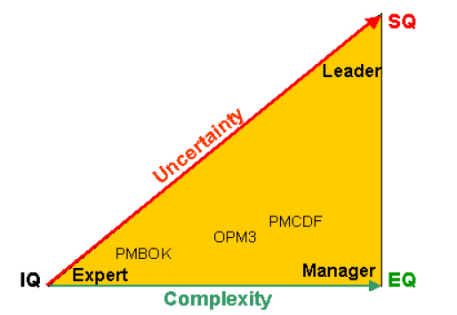
IQ – EQ – SQ
IQ: cognitive intelligence combined with expert knowledge
The “smarts” of project management
Enables us to manage BD, capture, and proposal projects within a controllable environment of limited complexity and low uncertainty
EQ: emotional intelligence combined with management knowledge helps deal with increasingly complex projects
Elements of EQ are being incorporated into PMI standards
SQ: spiritual intelligence needed to provide leadership in highly complex and uncertain project environments and is expressed in:
Leadership of people
Leadership over the content
The SQ capabilities are yet to be woven into a more comprehensive body of project management knowledge
Increase your EQ and SQ as your professional growth goals
SQ is connected to leadership
https://www.pmi.org/learning/library/concepts-intelligence-emotional-spiritual-knowledge-8247
OPM3 = Organizational Project Management Maturity Model PMCDF = Project Manager Competency Development Framework

Slide 42
Leadership appears to be the art of getting others to want to do something you are convinced should be done
Vance Packard (American journalist and author)

Slide 43
DISC Helps with EQ
The golden rule: treating others the way you want to be treated
The platinum rule: treat others the way THEY want to be treated
DISC is the best researched framework with strong impact on business communications
Tool when dealing with clients that will tell you how they like to be treated: Crystal Knows (www.crystalknows.com)
CONSCIENCIOUSNESS
Precise and data-oriented – scientific, engineering, finance
Accurate, cautious, contemplative, systematic, private, reserved, precise
DOMINANCE
3Bs: Be bright, be brief, be gone
Direct, results-oriented, firm, strong-willed, forceful
C
D
DISC
STEADINESS
Team player, caregiver
Even-tempered, accommodating, patient, humble, tactful
INFLUENCE
Expressive communicator
Outgoing, enthusiastic, optimistic, friendly, life of the party
S
I

Slide 44
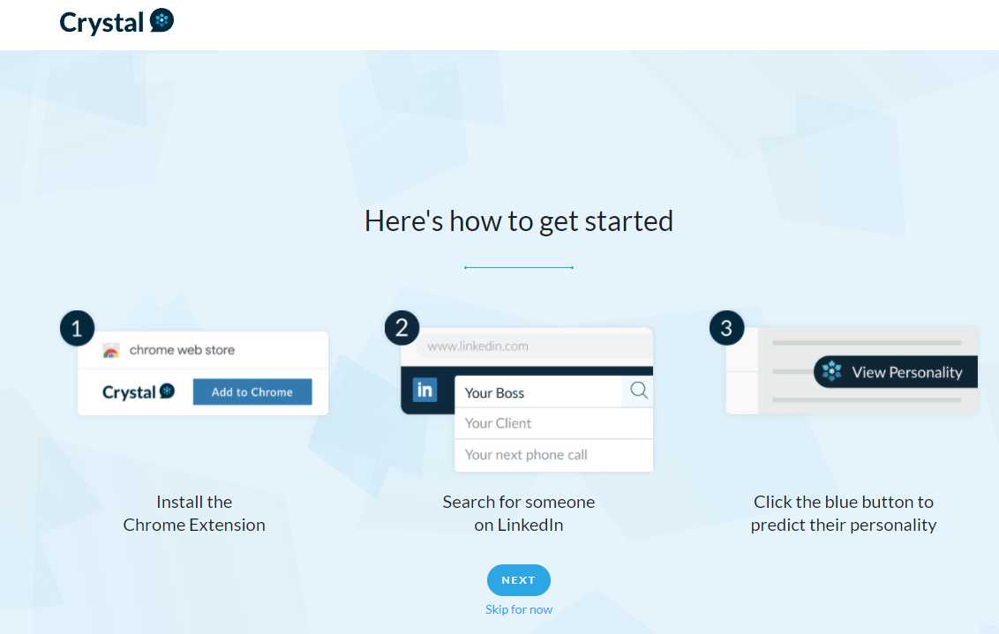
Exercise
Set up an account in Crystal Knows
Run your own DISC
Share results with your colleagues
Install the extension for your LinkedIn

Slide 45
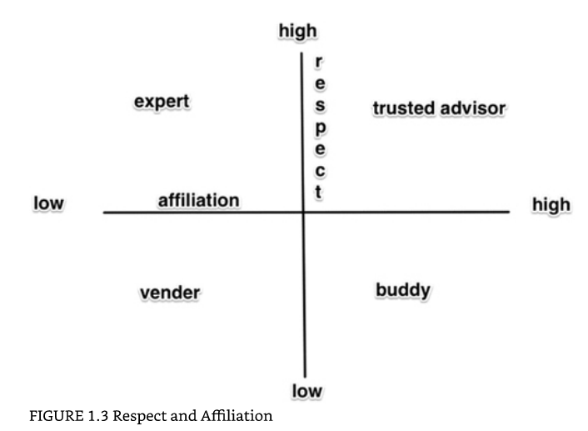
Build Client Relationships to Become Trusted Advisor
o
Alan Weiss, Masterful Marketing

Slide 46
Solve Problems
Break down challenging problems into manageable parts
Simplify complex concepts to communicate them effectively
Use sexy frameworks to solve capture and proposal problems, and apply models appropriate for the problem (e.g. OST’s proprietary frameworks, Five Forces and Four Corners for Competitive Analysis, 8D and Johari Window for problem solving, etc.) – high-end consultants know various models and use them
Use skills and knowledge from previous projects to solve new problems and challenges
Pay attention to both the big picture and the small parts
Bring a fresh perspective as an outsider, offering insights that can solve client’s problems

Slide 47
8D Problem Solving Model Example
1. Who is responsible?
2. What is the problem? Are there repetitions? What is the goal?
3. How high is the risk? How do we win time?
4. What was wrong? Why was the problem not avoided? Why was the problem not detected?
FINALIZATION
preventing reoccurrences
IMPLEMENTATION MEASURES
SELECTING MEASURES
DETECTING THE CAUSES
LIMITING THE DAMAGE
5. How can we change or improve? Can we implement it? How can we influence it effectively?
6. Is the goal reached? How is it functioning?
7. How can we maintain the new state of what has been achieved? How can we monitor the effectiveness?
8. What can we learn for the future? How can we prevent this in other processes and products?
DESCRIBING THE PROBLEM
Teamwork

Slide 48
Johari Window – Another Model
Add models to your consultant toolbox to tackle various problems
ARENA
Blind Spot
Known by Others
1.
Open Area
2.
Blind Spot
Feedback
Feedback
Known by Others
Shared Discovery
Shared Discovery
Self-Disclosure
Share
Self-Disclosure
Hidden
Unknown
Hidden
3.
Unknown
4.
Unknown by Others
Self-Discovery
Unknown by Others
Self-Discovery
I know
I don‘t know
I know
Ask
I don‘t know

Slide 49
Good management is the art of making problems so interesting and their solutions so constructive that everyone wants to get to work and deal with them.
Paul Hawken (Environmentalist)

Slide 50
Part 3
Finer Consulting Skills

Slide 51
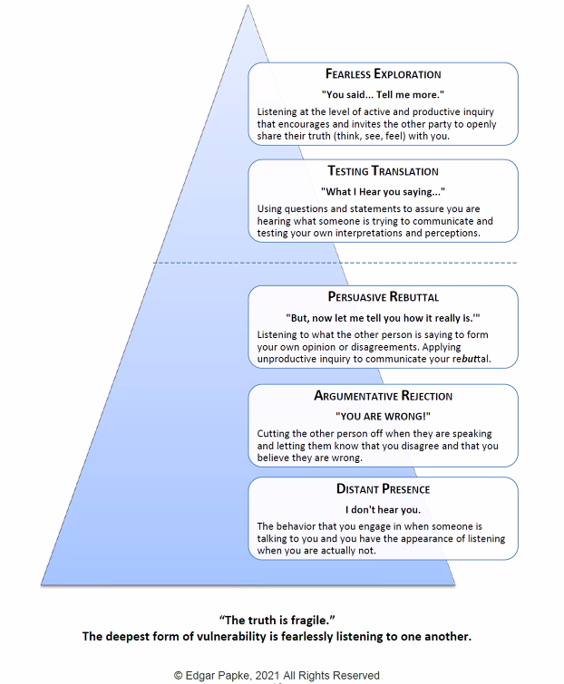
Embracing a Collaborative and Empathetic Consulting Approach
Embed Ourselves as Part of the Client Team: Use inclusive language, like "we," "our," and "us" when referencing the client team. This fosters a sense of unity and makes it evident that we see ourselves as an integral part of their team.
Share Constructive Suggestions, Not Directives: In review comments, adopt a cooperative tone by saying, "we should consider…" as opposed to "you should do this." This avoids any accusatory tone and encourages shared decision-making.
Demonstrate Shared Ownership: Our collaborative language underscores the shared ownership we take in our client's projects. It subtly communicates the message, "Your success is our success," in a genuine and non-clichéd manner.
Maintain Emotional Equilibrium: Strive to manage your emotions effectively, particularly when working under pressure. This helps ensure professionalism and keeps communication channels clear.
Foster Teamwork: Be prepared to share responsibilities and carry the load. This not only lightens the burden for everyone but also strengthens the team bond.
Build Strong Relationships: Prioritize cultivating meaningful relationships within the team and with our clients. These connections form the bedrock of successful consulting.
Pursue Fearless Exploration: Understand and apply the different levels of listening in your communications. Seek to foster an environment of fearless exploration, where all ideas are welcomed and every voice is valued.

Slide 52
Cultivate a Results-Oriented and Passionate Approach (In Contrast to Consultant Mercenaries)
Embrace Productivity: Strive to consistently deliver measurable results in the shortest amount of time. This showcases our efficiency and commitment to driving value for our clients.
Focus on Winning, Not Just Billing: Our true reward should always be our client's success. We eschew a mercenary mentality, believing that our value goes beyond billable hours to actual, tangible victories.
Strive for Continuous Improvement: Great consultants are rarely satisfied with the status quo. They're naturally skeptical, constantly seeking ways to challenge and improve existing systems and strategies.
Progress Without Disruption: Our goal is to advance projects without damaging relationships or disrupting workflows. We balance the need for progress with respect for existing structures and relationships.
Maintain a Positive Attitude: Bring energy and passion to your work that matches or exceeds that of our clients. A positive, can-do attitude is infectious, fostering an inspiring environment that propels us all forward.

Slide 53
Master Verbal and Written Communications
Select the Right Communication Medium: Adapt your communication method according to the situation. This could be verbal, written, or video-based, conducted in-person or virtually, via phone, text, email, Teams (with or without camera), with or without brainstorming tools.
Master Tools: Get fully proficient in various software applications like Word, PPT, Excel, Acrobat, ChatGPT, etc.
Employ Multiple Channels for Crucial Communications: For significant messages, consider using multiple methods of communication so that message is received and understood.
Deliver Flawless Work Products: Aim to produce consistently impeccable work, free from typos and grammatical errors, to show professionalism and attention to detail.
Write Effective Messages: Whether writing emails or developing presentations, strive to be a clear and concise communicator.
Ask Thoughtful Questions: Seek clarifications and ask questions in a way that doesn't inconvenience or annoy the client. Deciding when to ask, how to ask, whether to ask verbally or in writing, and whether to wait for a set of questions or ask immediately are all factors to consider.
Find Answers Yourself: Before asking a client a question, seek an answer through other means, like an Internet search or use of AI tools. This demonstrates respect for the client's time and our resourcefulness; confirm with the client rather than have them provide from-scratch answers.

Slide 54
Be Resourceful
Be Resourceful: Your resourcefulness is your greatest asset when tackling tough problems or challenging requirements.
Embrace Novel Challenges: In capture and proposals, you're likely to encounter problems that are either new to you or completely unprecedented; demonstrate your problem-solving skills and adaptability.
Consult the OST Management Team: When in need of advice or guidance, your first point of contact should be the OST management team. Their expertise and experience can provide valuable insights.
Leverage Our Network: If the OST internal consulting team cannot find an answer, we can tap into our extensive network.
Explore the Internet, AI, APMP, and Reference Books: Constantly educate yourself to further expand your knowledge on the subject and tackle complex problems.
Learn from Others: Someone has likely faced a similar challenge before. Seek advice or use their experiences to spark new ideas for problem-solving.
Persist and Innovate: Don't give up too quickly. Show tenacity in your research efforts, be creative, and demonstrate to the client that you're committed to doing whatever it takes to find a solution.

Slide 55
Get Rid of the “But”
“But” instantly creates conflict and negativity – that you won’t make the effort
Replace “But” with “And”

Slide 56
Know When to Speak Up and When to Be Silent
Better to remain silent and be thought a fool than to speak and to remove all doubt
Abraham Lincoln

Slide 57
Managing Client Relationship

Slide 58
Make a Positive Impression Out of the Gate
Get Names Right: Make it a priority to learn how to pronounce and spell the client's company name and personal names correctly. This shows respect and attention to detail.
Know Company’s Short Form: If there's a preferred abbreviation for the client's company, make sure you're using it correctly. This demonstrates your familiarity with their organization.
Do Your Homework: Don't ask basic questions about what their company does or its socioeconomic statuses. Your prior research should have provided this information, and asking such questions can suggest a lack of preparation.
Be Tactful in OST Personnel References: Avoid implying a hierarchy among our personnel by bragging that they got an "A team" or "the best person." Instead, refer to your assigned team members as those with the appropriate background and availability to assist the client. This approach acknowledges the unique strengths of each team member.
Ease Client Concerns: Your first task with a new client is to alleviate any concerns they may have about hiring OST or individual consultants (the “buyer’s remorse”). Instill confidence in your work plan and demonstrate quickly that the value you provide is worth their investment.

Slide 59
Adapt Approach and Processes to Client’s Organization and Circumstances
Reject the "One-Size-Fits-All" Mindset: Our processes must be flexible and adaptable to different client organizations, circumstances, and the unique needs of each client.
Understand the Context: Be mindful that strategies effective in a large business may not work in a small one, just as what works in one industry may not work in another. Similarly, approaches suitable for the Department of Defense might not be effective in civilian agencies.
Assess the Client's Culture: At the start of a project, evaluate soft factors such as the client's organizational culture, management style, business development resources, values, and behaviors. This provides invaluable insights into their expectations and modus operandi.
Embrace Adaptability: Great consultants are adaptable, able to easily adjust to new projects, work cultures, and colleagues. Their focus remains on getting the job done efficiently and effectively, regardless of the surrounding variables.
Persist and Learn: Don't be deterred by friction or unforeseen circumstances. Be resilient, learn from negative feedback, and use it as a steppingstone to improvement and success.

Slide 60
Exercise
Discuss properties of the proposal process level we need to bring as appropriate to each type of the client and assignment. Ask the right questions about each situation to come to the right answer:
Large proposal for a large client
Providing an individual proposal person (staff augmentation)
Proposal Manager
Proposal Writer
Mid-size proposal
Small business, small proposal
Small business running a team with large players trying to get large players in line

Slide 61
Build Relationship with Key Leadership and Decision-Makers
Your job is to build relationships with client employees and leaders on all levels of the organization
If anyone leaves, we’ll still have a champion inside
The tendency is to build close relationships with lower tiers of the client organization and avoid the leaders
Don’t feel equal to (outside of the comfort zone)
Don’t want to bother/don’t know what to talk about
Uncomfortable to jump over the direct interface’s head
Don’t have and don’t make time to communicate with the leadership because of focus on project delivery
Yet, these are the people who invite us back
Notice the natural tendency to avoid the higher ups; work on overcoming it

Slide 62
Elevating Your Project with Professional Touches
Initiate each project with a formal introduction call. This is separate from the actual proposal kickoff and is designed to understand expectations and requirements more comprehensively (as well as build a personal relationship).
Be responsive. Provide friendly and quick response to all customer needs, even if you are busy and think they are being needy or it’s not important.
Overcommunicate rather than undercommunicate. Proactively keep in touch with the client, consistently. Make it a routine to touch base with them at least once a week to provide updates or address any pending queries. Especially if you are working remotely, be in touch daily, at least once.
Communicate your availability. Make yourself as available as possible. However, if unavailable, check with OST management team to set expectations about absences and find backup – don’t hide and have it become a problem.
Share relevant industry updates with our clients to keep them informed. This not only shows that you're in tune with the industry, but also demonstrates that you consider them to be special.
Provide progress reports. Offer regular emails on what is completed on the project you manage. For longer capture engagements, present a monthly report detailing the work accomplished (not just detailed timesheet). Capture progress tends to feel a bit less defined than proposal deliverables. This tangible evidence of progress can be reassuring and helpful to clients.

Slide 63
Working with Difficult People; Conflict Resolution
Conflict resolution
Negotiations
That newsletter from Chris Voss - mirroring
Leading Difficult People, Part 3: The Narcissist | Dr. Gustavo
Leading Difficult People, Part 1: The Know-It-All | Dr. Gustavo
Managing conflict - Set the intention for the relationship; Edgar Papke info
https://youtu.be/uesOvmv-mFc
Bug eating video

Slide 64
Exercise
Part 5 ended here after we did this exercise
Discuss ongoing client projects and how each person could apply the learned techniques to the clients.
Take down action items to implement.

Slide 65
Managing Expectations
Over-delivering
Building confidence but not over-promising
Keeping the client happy

Slide 66
Consultant Qualities
Reality – Expectations = Happiness
Reliable in Word and Deed
Bring a “whatever it takes” mindset to engagements, and be laser-focused on delivering on expectations
Being dependable is key: communicate early and often, should a project be met with unforeseen obstacles;
A good consultant adapts to changing expectations and shifting priorities

Slide 67
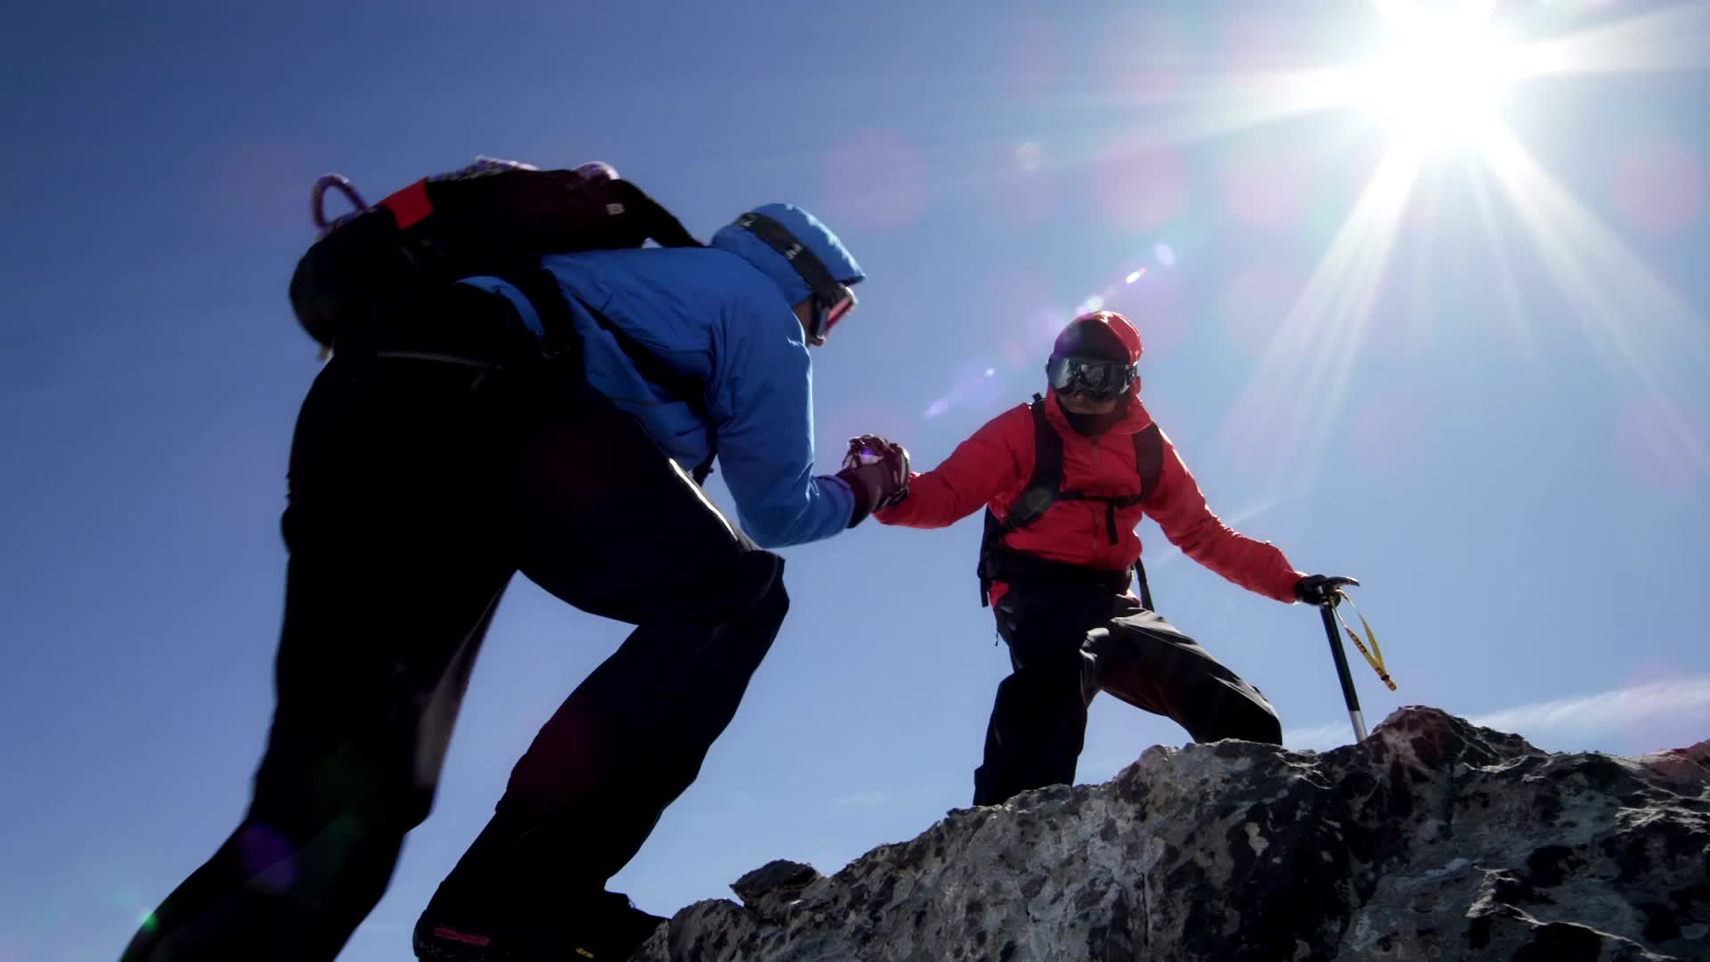
Managing Difficult Client Behaviors

Slide 68
when to CYA and document everything in email to client
Respect for Diversity - This is a profession of egos and opinions. Be accepting of certain people's need to assert themselves, be flexible, and have an open mind for an opinion or a way of doing things that may be different from yours. There is always another way to achieve a goal. · Customer Service – Communicate with the client and focus on the principles of customer service. Respectfully offer them advice (do not hold back); and in critical situations even document it in an email to us - but find a way to help them if they insist on doing it their way. It is always their proposal, and it is always their commitment. Also - remember: our jobs would be perfect if not for the clients. In the end - the client is always right, as they are the ones paying our bills. · Tact and Diplomacy – If you have a disagreement, make it constructive and respectful, especially if it occurs in front of client. If it’s a big problem, bring it back to OST to mediate. Do whatever you can to keep your cool, especially in front of the client. · Personal integrity - Admit fault when it is warranted. It is human to make a mistake. It takes an extraordinary person to own up to it then do whatever it takes to make it right.

Slide 69
Avoiding Costly Mistakes

Slide 70
Obsessively Back Up and Share Your Work
Why?
Continuity of Operations
Record of progress
Justification of billing
No work lost
How:
Save the document when you have started working in it
Set up autosave
Use SharePoint as the central location with others able to access the file
Save a local version periodically in addition to SharePoint version (beware of working in the wrong version – always refresh the page, and start fresh from SharePoint)
Email the file to yourself (and possibly another colleague) at the end of the day/before a drive
Use the folder workflow in addition to built in version control
Save the versions of the document with time stamps at the final countdown time
Save final proposal versions for liability purposes, to keep with OST on file
Account for Murphy’s Law
Understand SharePoint, SharePoint version control, and Word glitches and quirks
Know when customers use PC vs. Apple and what it can do to your documents
Know how to retrieve files when they crashed

Slide 71
Always Get Your Assignments Handled First Before Taking on Extras
Clients often have more needs than what they have agreed to pay us for and assigned to you
Quickly your workload can pile up with requests that are “urgent and important” but are not what you were brought in to do
Consultants often get sidetracked
You think the client remembers they asked more of you – but they count on you doing YOUR job and doing all other things IN ADDITION – and often believe you should be a miracle worker because they perceive they pay more to a consultant
Result usually makes us look bad and not the client – you don’t get your main work done, or overrun the budget, and while you’ve been a hero, the client is unhappy or stiffs the company

Slide 72
Client Will Remove Their Confidence in You if You Betray a Limited BD Experience
Don’t imply the junior level of experience by mistake saying how recent your work at OST or in BD is
Don’t overshare personal details that would imply how little experience you have such as:
Age (unless client bluntly asks and then you handle it the way you feel comfortable)
Your recent college experience
How much time you spent in an unrelated industry
Years as a stay-at-home parent…
Don’t muse about how much you have learned at OST in so little time, or how you started as an intern and now got a job
The client may engage biases and start dismissing your professional opinions
Client may subconsciously place value on how you look on paper vs. reality, deflating you in their mind and feeling like they overpay you, and deciding they should just hire a junior person of their own
Meanwhile, you have done disservice to client, yourself, and OST, because the value is in how smart you are amplified by the superb training, processes, tools, and management at OST

Slide 73
Instead, Share the Confidence Reinforcers
Talk about research in terms of “complex” and “variety of sources” because it is the truth
Remember of the simple – complex – simple continuum – many clients don’t understand that much simplicity comes from procedure and skill maturity, and not because something is so simple anyone could do it
Mention proprietary detailed OST processes
Mention Bid & Proposal Academy and all the courses
Plug our Apprenticeship, and that it’s the first and the only in the Nation
Talk about our success stories and your positive experiences helping clients while maintaining confidentiality
When more complex questions are asked, imply resourcefulness and reach-back by taking an action to reach out to our senior experts
Make references to our extensive connections and networks when information or teaming are needed

Slide 74
Money Matters and Risk Management

Slide 75
Be Meticulous About Timekeeping
Charging Time, Managing Scope, and Ensuring We Are Paid
Document the work completed in real time, at least daily
Keep your timesheet open and record at least every 2 hours
Don’t assume we will get paid
Manage the budget
Assistance in getting prompt payment from the client so we can pay you quicker – Precise timekeeping ensures that you will get paid quickly, and completely, for the time and effort you put forward. Document exactly what you do. We suggest going into great detail about everything you have done (i.e. “I read the RFP; shredded the RFP; edited section 1.2.”). Literally lift out things so they know exactly what you are doing. In addition to helping speed up payment and eliminating challenges to your invoice, it also helps the client recognize the contributions you are making. This is especially critical for virtual jobs. Having the invoice time log approved and signed by the client before submitting it to OST (if you are onsite and can accomplish this easily) can speed up payment to OST as well. Faster payment to OST means faster payment to you, the consultant, too. As a reminder, we only charge for productive time. We deduct time spent for lunches or interruptions you took to attend to personal matters. If you find you do not have enough work, be proactive please let the client know so their time and yours is not wasted.

Slide 76
Control Scope Creep
Understand clearly the scope we signed up for
Additional work assigned, if can’t be completed within existing budget, must be communicated to operations
Also, avoid “gold plating” – making something better for the client beyond what they asked for and that’s clearly outside their budget
They paid for a Kia, and you are trying to design and develop a Ferrari
On the other hand, don’t tell the client: NO, IT’S OUT OF SCOPE
That’s bad customer service
It upsets clients
Best way to respond: Let me speak to [Project Leadership’s Name] and ensure we can get that done within budget.
This may require a change order – but it’s not a “can’t do this” and “nickel and dime” discussion

Slide 77
Manage 11th Hour Requests
Manage expectations upfront, before you are in the weeds of the project
Make sure the client knows the team involved, where they are located (time zones)
Set expectations for working hours and response time at project launch

Slide 78
Billing with Tight Budgets
Bill the hours allotted but provide tremendous value for it
If reach the limit of the budget – important to finish the job but:
Do track the hours diligently in real time
Always, without exception, communicate if getting close to running over the budget, even during crunch times
Tricky territory is where you must finish the proposal under a tight deadline but you are completely out of hours
Likely, the client will forgive going over a tiny bit but won’t forgive shoddy or unfinished job that could cost them a multimillion or multibillion-dollar project
Don’t just stop working but send an email to the client if it’s middle of the night or weekend and OST’s leadership is not working or not responding
Client’s verbal approvals don’t count when it’s time to pay the bill – politely ask for at least a text or an email with a copy to OST management
Document hours spent painstakingly and what exactly did you do for those hours
Communication is key – giving heads up and getting approval in advance are important

Slide 79
Track Budgets Especially During Crunch Times
Budgets get out of hand during crunch times, especially at the end of the proposal
Clients issue verbal requests for work and forget about it later
Clients ask for help outside of scope and are not conscious about budget
Clients DON’T WANT TO PAY after the “storm” is over and their proposal is submitted
If you prioritize doing the work over entering hours and don’t track the budget, it causes:
Bad blood with the client
Poor perception
Money not paid or years of collections and litigation expense
Send an email to OST leadership to get more hours and approve additional scope – it is a priority
Change order/new work authorization must be completed, or at least have an email confirming the new budgetary estimate in writing

Slide 80
Ad-hoc Assignments and Verbal Promises of Budget Increase Often Backfire
Clients are human, so they forget what they told you
Clients issue direction to do something without regard for the budget – they simply don’t connect the scope creep with increase in hours and prices; then are surprised by the higher bill
Companies are imperfect communication platforms – just because someone has approved you to do more work, didn’t translate into your contract and ability to invoice for more
People forget that they don’t have authority to issue additional scope – they tell you to do something without proper approvals
People change roles or leave – now no one knows if you are telling the truth and someone has promised anything to you
Their attitude towards you or optimism for the outcome of the pursuit changes, impacting their willingness to pay later
Clients satisfy the need to get proposal work done with the intent to negotiate the invoice down later (bad faith)

Slide 81
Keep Meticulous Records and Versions
Keeping record of documents produced and emails helps getting paid
Keep versions of the document instead of saving over the same document over and over if working on your local machine
Document meta data is a lot harder to get
SharePoint keeps versions automatically so it should be as much of a concern but archive the old version and create a new version at least weekly so you have a snapshot in time
Save documents under descriptive names
Don’t ever delete a single received or sent email; archive or file as appropriate

Slide 82
Conclusion
Thank you for taking this training
The trick is implementing the lessons learned here
Use this as your desktop reference
Collect examples for lessons learned here
Keep your own log of lessons learned
Share your best practices with the team and ways to improve this course

