Slide 1
NITAAC CIO-CS “The Store” Pre-RFP Webinar
24 July 2024

Slide 2
OST Global Solutions
Full-life cycle business development consulting and training company
Home of the Bid & Proposal Academy with the only Registered Apprenticeship program in Government BD by the U.S. Department of Labor, MD, DC, and VA
Certified by Veterans Affairs to accept all GI Bill Chapters and VR&E
WinMoreBD services identifies and qualifies opportunities leaving more time for effective capture activities and positioning before the final RFP
Proven track record of supporting 18 out of the top 20 Federal Contractors and hundreds of small businesses, winning over $25 Billion in funded contracts since 2005

Slide 3
CIO-CS
History

Slide 4
NITAAC CIO-CS “The Store”
Electronic Commodities Store (ECS III):
12-year contract after 2 one-year extensions from 2002 through 2014
Over 40 prime contract holders
Chief Information Officer – Commodities And Solutions (CIO-CS) replaced ECS III and will expire in April of 2025
70 prime contract holders
Over $4.3b obligated through 2024
The Store will replace CIO-CS with the final RFP due “by end of summer 2024” and will have a 5-year base with a 5-year option
The Sources Sought says “It is anticipated that the resulting GWAC will be open to all qualified contractors. Original Equipment Manufacturers (OEMs) that qualify in one or more of the Product Groups described in the draft Product Categories and Groups List provided below and Value Added Resellers (VARs) that qualify in all of the Product Groups.”
$25b ceiling over 10 years.

Slide 5
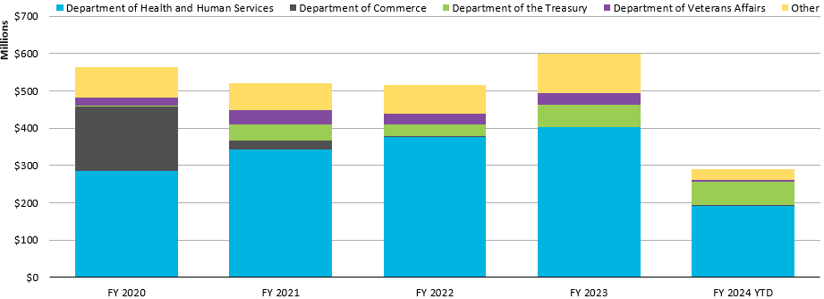
CIO-CS Spending by Agency
*Data from Bloomberg

Slide 6
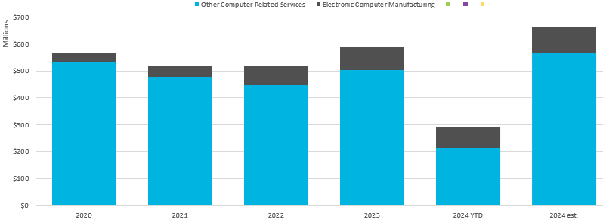
CIO-CS Spending by NAICS
*Data from Bloomberg

Slide 7
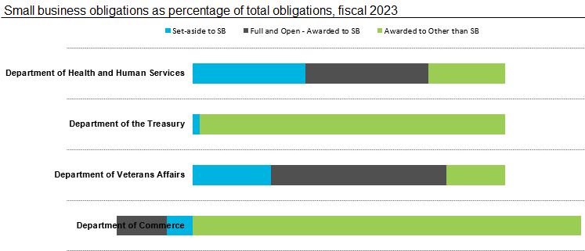
CIO-CS Spending by Set-Aside
NITAAC had a goal of 60% SB spendings on the GWAC and exceeded that goal significantly.
*Data from Bloomberg

Slide 8
The Store
Requirements

Slide 9
The Store: Basic Information
NAICS: 334111 and 541519
The small business size standards are 1000 employees (for 334111) and 150 employees (for 541519 - VARs).
Anticipated Awards: all qualified offerors
Offerors may propose under the solicitation either as an Original Equipment Manufacturer (OEM) or as a Value Added Reseller (VAR) subject to the definitions provided below.
Original Equipment Manufacturer (OEM) – A concern which, with its own facilities, performs the primary activities in transforming inorganic or organic substances, including the assembly of parts and components, into the end item being acquired.
Value Added Reseller (VAR) – Company that takes existing commodities adds its own “value” and resells it as a new product or package. An Information Technology Value Added Reseller provides a total solution to information technology commodity acquisitions along with commodity enabling services.

Slide 10
The Store: Scope
Category 1, Group A - End User Hardware Commodities, Laptops
Category 1, Group B - End User Hardware Commodities, Desktops
Category 1, Group C - End User Hardware Commodities, Printers
Category 1, Group D - End User Hardware Commodities, Monitors, TVs, Displays
Category 1, Group E - End User Hardware Commodities, Accessory (Mouse, Keyboard, etc.)
Category 2, Group A - End User Software Commodities, Operating System
Category 2, Group B - End User Software Commodities, Desktop Collaboration Suite
Category 2, Group C - End User Software Commodities, Accessory
Category 3, Group A - IT Security Software Commodities, Anti-Virus Software
Category 3, Group B - IT Security Software Commodities, Accessory
Category 4, Group A - Enterprise-Wide Software Commodities, Enterprise Database Management Systems
Category 4, Group B - Enterprise-Wide Software Commodities, Enterprise Performance Management Tools
Category 4, Group C - Enterprise-Wide Software Commodities, Subscription, Licenses, Enterprise Suite
Category 4, Group D - Enterprise-Wide Software Commodities, Accessory
Category 5, Group A - Health and Biomedical Research IT Capabilities, Laboratory Information Systems
Category 5, Group B - Health and Biomedical Research IT Capabilities, Subscription, Licenses, Enterprise
Category 5, Group C - Health and Biomedical Research IT Capabilities, Accessory
Category 6, Group A - On-Premise Infrastructure, Enterprise Servers
Category 6, Group B - On-Premises Infrastructure, Subscription, Licenses, Enterprise, Service, Maintenance
Category 6, Group C - On-Premise Infrastructure, Accessory
Category 7, Group A - Infrastructure and Platform as a Service, Computing
Category 7, Group B - Infrastructure and Platform as a Service, Enterprise Storage
Category 7, Group C - Infrastructure and Platform as a Service, Service, Maintenance
Category 7, Group D - Infrastructure and Platform as a Service, Accessory
Category 8, Group A - Telecommunications Plans, Carrier Plans
Category 8, Group B - Telecommunications Plans, Subscription, Licenses, Enterprise
Category 8, Group C - Telecommunications Plans, Accessory
Category 9, Group A - Value Added Services

Slide 11
The Store: Aniticipated Minimum Requirements
It appears that NITAAC is encouraging more OEMs to submit proposals by adding groups with categories
VARs must demonstrate capability within every category and group
CIO-CS Minimum Sales and Business Background:
Be in business for a minimum of 3 years prior to submitting its proposal
VAR: average annual sales for IT commodities are a minimum of $5,000,000 over the past 3 years
OEMs average annual sales are a minimum of $50,000,000 over the past 3 years
CIO-CS Minimum Past Performance Requirements:
The submitted past performances shall include at least 3 similar programs or contracts with a total value of over $5,000,000 for which the offeror is a prime contractor.
If the past performance cited is for an IDIQ or similar contract, the aggregate total value of the delivery/purchase orders shall be over $5,000,000.
Contracts listed shall include those entered into with the Federal Government, agencies of state and local Governments or commercial customers

Slide 12
CIO-CS Proposal Requirements

Slide 13
CIO-CS Evaluation Criteria
Phase 1: Go/No-Go
General – a complete proposal consisting of all documents as listed in the Compliance Checklist (Attachment J.2).
Technical Compliance Workbook.
Minimum Sales and Business Background. The government will assess the proposal to determine whether the offeror has been in business for a minimum of three years prior to the date of submitting its proposal and that over the previous three years, the offeror's average annual sales for IT commodities were a minimum of $5,000,000 for offerors proposing as a VAR or $50,000,000 for offerors proposing as an OEM.
Phase 2: Best Value Trade Off
The Government strongly discourages use of commercially available proposal templates for preparation of a response to this solicitation. Proposals prepared from commercially available templates demonstrate a fundamental lack of understanding of the requirements of the solicitation. Proposals that are essentially duplicative of a proposal template may be determined to be unacceptable by the Government and ineligible for award.
The non-price factors are listed in descending order of importance:
a. Factor 2 (Technical Understanding and Capability)
b. Factor 1 (Management Approach)
c. Factor 3 (Past Performance)
To the extent that the factors contain subfactors, the government will consider the subfactors under each factor in equal order of importance in determining the overall rating for the applicable factor.
When combined, the non-price factors are significantly more important than price.

Slide 14
Preparing for CIO-CS Evaluation Criteria: Management Approach
M.2.1 Factor 1 – Management Approach: The government will assess the offeror’s demonstrated capability to perform delivery orders under the contract by evaluating the offeror’s management experience and capabilities.
a) Subfactor 1 – Program Management: The government will assess the extent to which the offeror demonstrates an ability to successfully manage, deploy and sustain IT commodities and solutions by evaluating the offeror’s proposed structure, quality focus and business operations.

Slide 15
Preparing for CIO-CS Evaluation Criteria: Management Approach
b) Subfactor 2– Corporate Commitment and Technology Refreshment
Element 1 – Business Development. The government will evaluate the extent to which the offeror plans to commit to the CIO-CS GWAC, specifically, the offeror’s strategy for marketing this GWAC to the NIH ICs, HHS Operational Divisions, and other eligible federal agencies during the life of the contract, participating in program improvement initiatives, training of customers, and strategy for pursuing technological innovations to include the offeror’s method of tracking and motivating success in these efforts.
Element 2 – Technology Refreshment. The government will evaluate the extent to which the proposal demonstrates a strategy for pursuing technological innovations including:
i. The feasibility of the offeror’s plan to proactively reduce costs, add value and keep the technology current on the contract.
ii. The feasibility of the offeror’s plan to keep abreast of industry trends and software licensing changes.
iii. The feasibility of the offeror’s processes and structure that are in place to support the Government.
c) Subfactor 3 – Corporate Experience
The Government will evaluate the relevancy of the offeror’s experience in providing the commodities and commodity enabling services at other Government agencies for a similar size, scope and complexity as CIO-CS.

Slide 16
Preparing for CIO-CS Evaluation Criteria: Technical Understanding and Capability
M.2.2 Factor 2 – Technical Understanding and Capability
a) Subfactor 1 – Technical Capability
(1) The government will evaluate the degree to which the offeror demonstrates relevant experience and/or qualifications in each of the specific categories proposed, as described in Article C.6, including the offeror’s proposed methodology, technical approach, and quality control process. As part of this subfactor, the government will assess whether proposals submitted by OEMs qualify in a minimum of one category as described in Article C.6 and that proposals submitted by VARs qualify in all categories except Category 8 – Telecommunication Plans.
(2) As part of this assessment, the government will evaluate:
(a) the depth and breadth of the technical capabilities proposed beyond the minimum requirements contained in the Technical Compliance Workbook (Section L.6);
(b) the scalability and extensibility of the offeror’s commodities and capabilities that demonstrates the offeror’s ability to deliver the full range of commodities as described in the solicitation where and when needed; and
(c) the extent of which the technical approach demonstrates the capability of the offeror in performing the commodity enabling services as contained in Article C.7, and the feasibility of that approach through the life of the contract.
(3) In addition, for VARs, the government will verify that the products proposed to be resold under the contract are authorized by evidence of authorization certificates and/or letters of supply from the manufacturer.

Slide 17
Preparing for CIO-CS Evaluation Criteria: Technical Understanding and Capability
b) Subfactor 2 – Strategic Sourcing: The government will evaluate the extent to which the offeror presents a sound strategy for managing the strategic sourcing initiative. The government will evaluate the extent to which the offeror describes experience in managing strategic sourcing initiatives (commercial or federal) and the extent to which the offeror describes a methodology of tracking and managing a large influx of orders that ensures availability of sufficient products to meet the demand.
c) Subfactor 3 – Domain-Specific Capability in a Health-Related Mission (applicable to VARs): The government will evaluate the extent to which the offeror demonstrates an inherent domain-specific capability in a health-related mission. Health-related missions are broadly defined as those that contribute directly to human health and may include corporate expertise in fields such as healthcare, health-related/biomedical research and health science, clinical analytics and intelligence, health policy, health-related grant making, and regulation of health industries. This capability can be demonstrated through experience examples or internal resources with substantial relevant experience. Failure to demonstrate such capability will result in an unacceptable rating.

Slide 18
Preparing for CIO-CS Evaluation Criteria: Past Performance
M.2.3 Factor 3 – Past Performance
The government will assess the quality of the offeror's performance, and capabilities by evaluating the offeror's past performance as prime in providing IT commodities and commodity enabling services.
When evaluating past performance, the Government will focus on the areas of Quality of commodity enabling services, Timeliness of Performance, Price/Cost Control, and Customer Satisfaction.
The Government will not evaluate past performance information which is deemed to be not relevant or non-conforming. Examples of non-conforming past performance information include (but are not limited to) the following:
1. Projects for which the primary purpose of the project was the delivery of services (as opposed to projects for which the primary purpose was the delivery of commodities);
2. Projects completed more than five (5) years from the date of issuance of the CIO-CS solicitation.

Slide 19
Preparing for CIO-CS Evaluation Criteria: Price
M.3 Price Evaluation (Factor 4)
Offerors will be evaluated based upon price completeness and accuracy, price realism and price reasonableness to determine the validity of the proposed price for the base period and the option period. Total Evaluated Price (TEP) will be utilized as the basis for the Best Value Trade-off and award decisions. Total Evaluated Price will be calculated on the Summary worksheet of the Pricing Workbook.

Slide 20
Next Steps
& Resources

Slide 21
Next Steps & Resources
We provide gap analysis, capture, and proposal support.
NITAAC Updates can be found here: https://nitaac.nih.gov/gwacs/cio-cs-store
We have a subcontractor portal where you can upload your capabilities for this opportunity and others:
https://www.ostglobalsolutions.com/teaming-partner-match-portal/
We are happy to schedule time to discuss your “The Store” bid:
https://calendly.com/ostglobalsolutions/bdconsulting?month=2023-09
We regularly publish updates to major contracts through our newsletter and blog:
Blog: https://www.ostglobalsolutions.com/blog/
Newsletter sign up: https://www.ostglobalsolutions.com/tag/email/

Slide 22
Let’s Partner in Winning Business
David Huff
CEO
c: 513.316.0993
o: 301.769.6602
e: dhuff@ostglobalsolutions.com
www.ostglobalsolutions.com

