Slide 1
Advanced Proposal Management
Bid & Proposal Academy Course
Day 1
www.ostglobalsolutions.com

Slide 2

Agenda
09:00 – 10:30 – Training
10:30 – 10:45 – Break
10:45 – 12:00 – Training
12:00 – 13:00 – Lunch
13:00 – 15:00 – Training
15:00 – 15:15 – Break
15:15 – 16:00 – Training
16:00 – 17:00 – Flex Time
*Please, give yourself the benefit of focus and limit the use of cellphones and emails to breaks
**Most of the artwork in this training was created with Midjourney

Slide 3

Module 1: Introduction

Slide 4
Learning Objectives
Understanding how to avoid proposal mistakes even mature companies make Mastering tools and techniques for making a bid-no-bid decision. Determining whether an RFP is wired. Planning and managing proposal budget and resources. Conducting an effective proposal kickoff. Scaling the proposal process up and down for different size pursuits. Applying the techniques to produce the most compelling proposal content that makes a winning difference. Mastering rapid learning techniques in a new subject matter to provide ample guidance to subject matter experts who develop innovative solutions. Initiating and facilitating rapid solution and section development for every part of the proposal. | Tracking volume and section progress and quality. Applying leadership and proposal team building techniques to achieve optimum performance from proposal contributors. Applying effective communication methods to the proposal team. Getting results from difficult proposal team members. Working effectively with remote participants. Getting the most useful inputs from the color reviews. Mastering techniques for quickly integrating reviewers’ input into the proposal. Managing proposal risk. Applying metrics for proposal effectiveness. Conducting an effective lessons learned session. Making use of personal and organizational proposal process optimization.

Slide 5

How to Maximize the Learning Process
How adults learn:
  Understand WHY things work a certain way
  Participate in exercises
  Ask questions
  Relate the material to your own experience
  Take notes
Bring up topics of interest to your job
Move around during exercises

Slide 6
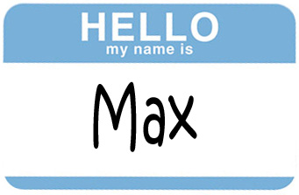
Introductions – Who is Who
Your Name and Position
An interesting fact about your life
Your experience with proposal management
What are you looking to get out of this training?

Slide 7
The “Big Picture”
Let’s recap: it takes all the steps before and after proposal development phase to produce a winning deliverable
Begin Business Development Process
Capacity building to do business with the government
Conduct Strategic Business Development Planning Session
Perform Market Research
1.0
2.0
3.0
End Business Development Process
Stand up Your Marketing Campaign to Agencies & Partners
Enough Info to Make Decisions?
Yes
No
4.0
Yes
Perform Business Development During Project Execution
Build the Opportunities Pipeline
Check for Strategic Fit
9.0
5.0
Prepare Proposal
Conduct Capture
Qualify Each Individual Opportunity
8.0
7.0
6.0

Slide 8
Module 2: Preparing for the Proposal Effort

Slide 9

Proposals Are Like a Minefield
No matter if your company is large or small, similar issues tend to arise on proposals; you should anticipate and proactively mitigate proposal risks
Proposal managers either masterfully navigate around the proposal risk “landmines,” or step on one after another
It is not enough to know the proposal process; you must anticipate proposal risks and know how to avoid them
Troubleshoot the process and apply risk avoidance or mitigation best practices at every proposal stage

Slide 10
Where We Are in the Process
Predecessor: Capture Process
Read RFP
Prepare for Kick-Off
Conduct Kick-Off to Reach 9 Goals
Develop Work Packages
Prepare Draft
1
Conduct Pink Team
Prepare Draft
2
Prepare Draft
N
Conduct Red Team
Prepare Final Draft
Read-Aloud
Print,
Check, Deliver
Implement Post-Delivery Win Strategy, Orals, FPR
Update Lessons Learned
Annotated Outline
Assignments
Work Packages
Compliance Checklist
Style Guide
Background Materials
Briefing
Pink Team Recovery
Outline Frozen
Red Team Recovery
Decision to proceed
Award
Make Bid-No-Bid Decision
Brainstorm & Research
In-Process Review(s)
In-Process Review(s)
DTP, Edit
DTP, Edit
Conduct Gold Team
Collect Lessons Learned
Attend Debrief
Integration Phase
Planning Phase
Writing Phase
Polishing Phase
Production
Phase
Post-Proposal Phase
Successor: Project Delivery Process that Includes Capture of Additional Scope and Projects

Slide 11
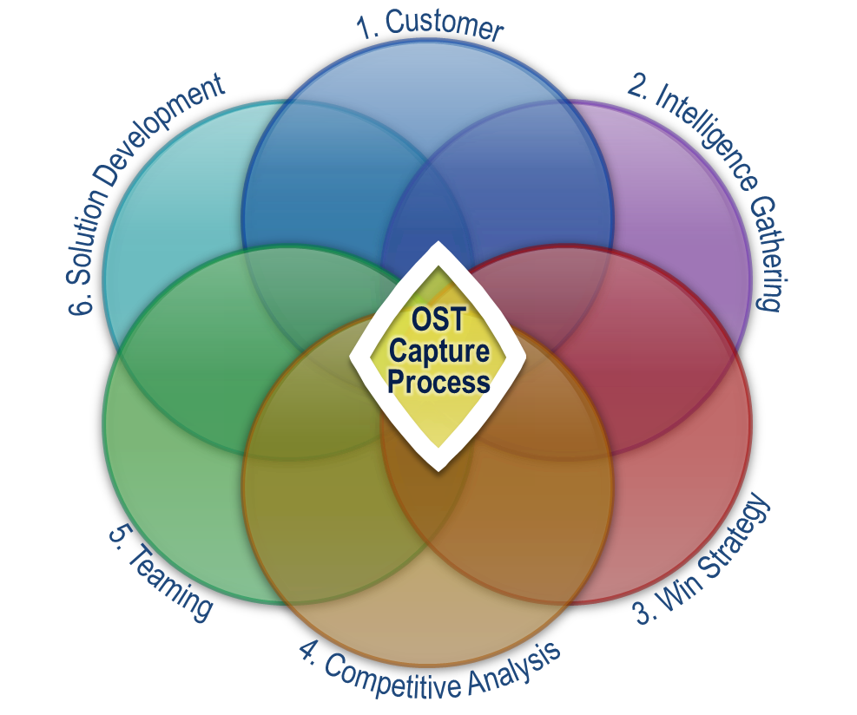
Landmine 1: Having No Capture Effort or an Illusion of a Capture Effort
Even the most sophisticated of companies fall into the mode of chasing popup opportunities and reacting, leading to lower win rates and burnout
Per the APMP survey, companies with high win rates (75% and higher) spend more than 60% of B&P budget on capture
With an average win rate of 33-36% on proposals submitted in a competitive environment for new work per the Grant Thornton report, most companies fail to realize their full potentials
Other problems:
  Staff burnout
  Lowered morale
  Impeded growth, loss of key resources, etc.
The worst pitfall of all – believing that you have conducted solid capture when in fact you have not

Slide 12

Landmine 2: Having a Flawed Bid-No-Bid Decision Process
No matter how much you have invested, have the courage to stop throwing good money after bad
  Considered one of the core areas – companies make a bid-no-bid decision usually without any outside help
  Top three problem per the international CSK/APMP proposal survey (even though it’s one of the core company expertise areas)
  If an issue, there are two scenarios:
  Your company doesn’t have a process – the reviews are done haphazardly
  There is a process but you don’t follow the best practices; the answer is always “yes”
  “Hope to win” is the win strategy

Slide 13
Making a Bid-No-Bid Decision
Bid Consideration | Rating Criteria |  |  |  |  |  |  |  |  |  |  | Consideration Rating | Consideration Weight | Net Score
 | Positive |  |  |  | Neutral |  |  |  | Negative
 | 10 | 9 | 8 | 7 | 6 | 5 | 4 | 3 | 2 | 1 | 0
Ability to Respond | Can meet/exceed every requirement |  |  |  | Understand the problem and can respond |  |  |  | Don't know or have a better idea |  |  | 7 | 0.1 | 0.7
Background experience and overall technical capability | Strong in-house experience and/or technically superior |  |  |  | Average experience in-house or can be imported; or technically capable |  |  |  | Weak experience or new area; or not technically qualified |  |  | 6 | 0.1 | 0.6
Proposed team and personnel (subs are an option) | Best available (could be enhanced) |  |  |  | Best available (no impact) |  |  |  | Second best, diluting your scope of work |  |  | 8 | 0.1 | 0.8
Price Strategy | We know the price to win - Can provide an honest, credible bid within known price structure |  |  |  | Good idea of the Price to win - Can provide reasonable and competitive price structure |  |  |  | Guess the price to win - Must cut corners or significantly cut margins |  |  | 4 | 0.1 | 0.4
Customer knowledge and rapport | Good working relationships, we know the customers needs |  |  |  | We are known but the relationships are not cultivated, we understand the customer |  |  |  | Unknown to the customer and we don't know the customer's needs |  |  | 3 | 0.1 | 0.3
Competition | Sole source or customer knows and prefers us |  |  |  | Open/neutral customer and we know how to beat the completion |  |  |  | Unknown to the customer and we don’t know the customer's needs either |  |  | 5 | 0.1 | 0.5
Market intelligence | Inside track, good work up |  |  |  | Generally up-to-date on market developments |  |  |  | Surprised by the RFP issuance or requirements |  |  | 7 | 0.1 | 0.7

Slide 14
Bid-No-Bid Decision (Continued)
Bid Consideration | Rating Criteria |  |  |  |  |  |  |  |  |  |  | Consideration Rating | Consideration Weight | Net Score
 | Positive |  |  |  | Neutral |  |  |  | Negative
 | 10 | 9 | 8 | 7 | 6 | 5 | 4 | 3 | 2 | 1 | 0
Company's resources available for proposal development and for contract execution | Resources easily available to develop proposal to win and execute the contract |  |  |  | Available |  |  |  | Not Available |  |  | 4 | 0.1 | 0.4
Facilities | Available and favorably located |  |  |  | No facility required or you can get a facility quickly |  |  |  | Facility is required but not yet available |  |  | 6 | 0.1 | 0.6
Program's potential strategic advantages | High |  |  |  | Average |  |  |  | Low |  |  | 10 | 0.1 | 1
 |  |  |  |  |  |  |  |  |  |  |  | Totals | 1 | 6
Tweak the weighting of criteria based on specific customers and opportunities
Round down the score (even if it is 6.9, it is a 6)
Consider bidding when you get a score between 7 and 10
It’s a true gamble if you get 5-6
Do not bid if under 4

Slide 15

A Math Reminder for Adjusting Weights
You can have more or less than 10 criteria
For each opportunity, you want to adjust the bid-no-bid worksheet to the specific evaluation criteria to get to a more accurate score
When adjusting the score, remember:
  0.025 + 0.075=0.1
  0.05 + 0.05=0.1
You can do different weighting scores that exceed 0.1, just make sure that everything in the end adds up to 1
  For example, customer knowledge and rapport could be 0.2 because they are that important
  Something else must be eliminated, or multiple other values need to be downgraded to less than 0.1

Slide 16

Module 2 Exercise
Adjust the weighting of the table to add the ROI for your company
Also add the pursuit-specific evaluation criteria
EVALUATION CRITERIA:
SUB-FACTOR A: Personnel Qualifications
Offeror shall demonstrate the knowledge, expertise and experience of
proposed analysts to perform the tasks listed in the PWS, with emphasis on the advanced degrees, certification, and minimum of 10 years of experience
SUBFACTOR B: TRANSITION
Offeror’s transition plan will show ability to phase-in 250 personnel in 15 days under an accelerated schedule.
SUBFACTOR C: MANAGEMENT
Offeror will have a PMO within 10 miles from Ft. Belvoir, VA. The offeror will have established offices within 10 miles’ radius from the government facilities in Reno, NV; Ft. Huachuca, AZ; Aurora, CO; and Augusta, GA.

Slide 17
Module 3: Analyzing the RFP and Preparing to Bid

Slide 18

How Do You Know an RFP Is Wired?
Most of these signs alone don’t mean an RFP is wired, but when you see multiple signs together, it is likely that it is
Deadlines unreasonably restrictive:
  Too short of a time to write a proposal
  Quicker turnaround response times outside of standard norms for this customer
  Deadline for Questions too soon
  Customer access/site visits are unusually restrictive and limited (e.g. site visit or walk through
  Time to study the documents in the “library” too short
Only a token extension gets offered when requested, while the government has no pressing need for urgency
Past performance validity timeframe and size that are too narrowly defined
  “Include up to five references for relevant projects that have been completed in the past two years, or started no later than [a specific date], and/or are no less than $XXM in size”

Slide 19

More Signs the RFP Is Wired
Watch out (and prompt AI) for signs that scream: “I know what I want and who I want to buy it from; but my Contracting Officer is forcing me to get competitive bids!”
A NAICS code prevents most vendors from bidding
A procurement moves to a vendor-limited indefinite delivery vehicle
Key personnel requirements that get extremely specific
  Must have completed some ridiculous certification course that I have never heard of
  Must have won a niche award
  Must have more than XX years of experience in a specific industry
Unusual requirements that have little to do with project success but seem to favor a specific vendor such as the incumbent
  “Must have design-built 40 municipal buildings”
  “Must have been in business for over 10 years”
  “Must have an office within 10 miles of the government facility”

Slide 20

…And More
It doesn’t mean that you shouldn’t go after an RFP that appears “wired” and attempt to take it away; just know that you will have to work harder to make it happen
Evaluation criteria that favor the strengths of another company
A performance specification that can only be offered by a specific product
  Manufacturer's model number in lieu of a spec
  “Vehicle must have sealed, 4x4 transmission with self-adjusting belt drive" and only one manufacturer makes a patented "self-adjusting belt drive"
The contracting officer is unresponsive when you challenge the requirements as too restrictive or unreasonable, and ask for extensions
CAUTION: Poorly written RFPs can be a signal that the contract will be protested, or difficult to manage because the contracting officer/shop is chaotic
Notes:
Emphasis on evaluation criteria that only an incumbent will be able to get top marks in. For example experience of the staff being bid with obscure or customer specific tools. Overemphasis on the relevance of experience might be another.
Emphasis on criteria that are easy to bias. Risk mitigation and quality are good examples.
Prohibitions against contacting or rehiring incumbent staff.
Unusual labeling of key staff. If all of the staff are considered key and resumes are required for all staff being bid it's a bad sign.
Evaluation practices that are outside the norm for that agency. If pricing is normally evaluated at 40% and on this RFP it's being evaluated at 10% you have to wonder why. But this also requires you to know what the norms and trends are for that customer.
Use of multiple evaluation criteria to address the same thing. For example, requiring that past performance projects include the staff being bid so that in essence staffing is getting counted twice (and acceptable past performance is hard to find). When combined these can make one particular element count out of proportion.
Short, inflexible deadlines. On its own it doesn't mean much, but it can favor a contractor who is expecting the bid.
Ambiguity that favors an incumbent. For example, requirement to supply custom software without the requirements being defined. Scopes that aren't defined. Deliverables that are named, but not described. Statements of Work that require you to know the customer's undocumented standard operating procedures.
So much detail that it's overwhelming.
Page limitations that make it impossible to respond to all of the requirements so that only the preferred bidder will know what to focus on and what they can skip without being branded "noncompliant."
Fixed price proposals where you don't have enough information to know how long things will take.
Unusually brief responses to questions, especially when there are only a handful of bidders or when they are unresponsive to questions they could easily answer.
Unusually lengthy answers to questions, often delivered at the last minute without an extension.
"Processes" specified in the RFP that can't be mapped or flow charted so that only someone who has experience with them can figure out how they work

Slide 21

The Most Important and Often Missed Step Before Starting a New Proposal
Reviewing the Lessons Learned and Debriefs from past proposals

Slide 22
Module 3 Quiz
Which requirement in an RFP might suggest it is tailored for an incumbent vendor?
  Must have an industry-standard certification at a task-appropriate level
  Personnel must have completed and got a certificate from a widely recognized training course
  Personnel must have a specific large number of years of experience in a highly niche industry
  Must have an office location that is convenient for government access
A performance specification that aligns with only one product suggests that the RFP:
  Is looking for the most innovative solution
  Is wired for a particular vendor's product
  Encourages competition among vendors
  Is open to a variety of solutions
It is always best to avoid pursuing an RFP that appears to be wired.
  True
  False
Notes:
1. Which requirement in an RFP might suggest it is tailored for an incumbent vendor?
c) Personnel must have a specific large number of years of experience in a highly niche industry
Explanation: A requirement for personnel to have a large number of years of experience in a highly niche industry is often a red flag that the RFP is tailored for an incumbent vendor. The incumbent would most likely already have personnel who meet this criterion, giving them a significant advantage over other bidders.
2. A performance specification that aligns with only one product suggests that the RFP:
b) Is wired for a particular vendor's product
Explanation: When the performance specifications in an RFP align very closely with the features or capabilities of a single product, it is an indication that the RFP might be "wired" or written with the intent of selecting a particular vendor who offers that specific product. This limits competition and may unfairly advantage one vendor.
3. It is always best to avoid pursuing an RFP that appears to be wired.
b) False
Explanation: While a wired RFP can be challenging and may have been written with a specific vendor in mind, it is not always best to avoid pursuing it. Sometimes, even with a wired RFP, there are opportunities to offer a better solution, build relationships, or gather valuable market intelligence. Each situation should be assessed individually to determine whether it’s worth pursuing.

Slide 23
Module 4: Making the Most of Your Resources

Slide 24

Landmine 3: Under-Resourcing the Proposal
In surveys, most proposal managers list shortage of resources as “the number 1 problem”
Curiously, “the Number 2 problem” is not enough time to get the proposal done
  Could be related to resources – if you had enough competent resources, you’d have less of a time issue
The “Number 3 problem:” Resources are not qualified enough
  Wrong resources assigned (whoever is available, not whoever is right)
  Personnel not committed to the proposal enough hours (too busy with other work)
  Not enough budget allocated to resource the proposal to win
  Resource allocation is done using a “SWAG”

Slide 25
Integrate AI into the Proposal Process
Basic Prompt Design Blueprint
At least 30% productivity increase, 20% higher win rates, and 25% labor cost savings in your government bid preparation activities
A “pocket Subject Matter Expert (SME)”
Use secure tools built for proposals that don’t use your data for training
Prompt engineering, prompt library, assistants, and understanding of vast use cases are key to success
1. A role to act as (BDer, Capture Manager, Proposal Manager, etc.)
2. A task to do
3. Steps to complete the task, starting with action verbs
4. Desired format (list, table, etc.) and length
5. Context and specific details or data
6. Limitations or constraints, if needed
7. Examples to reference

Slide 26

Plan for Proposal Resources to Manage Your Team to Budget and Ensure Proposal Quality
Hope is not a win strategy: resources matter
You need ENOUGH of the RIGHT KIND of talent with the right expertise
Estimating your resources correctly helps you manage your budgets better
Upon initial RFP read, develop an AI-generated outline and schedule to determine resource needs
Quickly decide on:
  Key schedule milestones for reviews: kick-off, pink, red, read-aloud, gold
  Assignees for each volume and section and other key resources
  Budget and resource requirements for the gap areas
Assigning too much to an author is setting them up for failure

Slide 27

Three Ways of Estimating Budget
  Bottom up: How many hours it takes to write a narrative, to do resumes, to do a past performance section, to edit, to do graphics and cover, to format, to print, and so on
  By schedule/profession: Duration and nature of work: start lean, have all resources needed in the middle, end lean
  By the ROI: Three formulas for different circumstances
Example: 0.75%-3% of the total revenue for the company
Revenue calculations for IDVs:
Consider previous years’ spending numbers, number of awardees, percentage won by specific awardees, set asides vs. unrestricted, and your win rate

Slide 28

Module 4 Exercise
Determine ROI-based proposal budget based on the following scenario.
  How much will the company expect to make from the IDIQ?
  How much should they spend on a proposal?
  Can they afford to hire a consultant?
  What tasks can a consultant help them accomplish?
Amato, LLC is a small business with a proposal team consisting of a proposal manager, a junior writer, and reach-back to management and SMEs.
Amato is looking to bid on a re-compete of a multiple award IDIQ with $495 Million ceiling value.
Historical spending for that IDIQ has been roughly $300 Million, with two thirds allocated to large business, and one third set aside for small.
Upon analysis, Amato discovered that there were only five active small business awardees. One of them won 50% of all business. Others won about an equal share between each other.
Amato’s win rate has been about 25%. Amato would like to know how much can it invest in a proposal, and can it afford to hire a consultant to help the proposal team.

Slide 29
Module 5: Planning Prior to the Proposal Kickoff

Slide 30
Where We Are in the Process
Predecessor: Capture Process
Read RFP
Prepare for Kick-Off
Conduct Kick-Off to Reach 9 Goals
Develop Work Packages
Prepare Draft
1
Conduct Pink Team
Prepare Draft
2
Prepare Draft
N
Conduct Red Team
Prepare Final Draft
Read-Aloud
Print,
Check, Deliver
Implement Post-Delivery Win Strategy, Orals, FPR
Update Lessons Learned
Annotated Outline
Assignments
Work Packages
Compliance Checklist
Style Guide
Background Materials
Briefing
Pink Team Recovery
Outline Frozen
Red Team Recovery
Decision to proceed
Award
Make Bid-No-Bid Decision
Brainstorm & Research
In-Process Review(s)
In-Process Review(s)
DTP, Edit
DTP, Edit
Conduct Gold Team
Collect Lessons Learned
Attend Debrief
Integration Phase
Planning Phase
Writing Phase
Polishing Phase
Production
Phase
Post-Proposal Phase
Successor: Project Delivery Process that Includes Capture of Additional Scope and Projects

Slide 31

Landmine 4: Botching the Kickoff
Lack of “cat-herding:”
  Not getting the commitments to attend from important players
Logistics mistakes:
  Failure to distribute the solicitation to the right people, request questions in the right collection format, and issuing no reminder to read the solicitation
  Not issuing invitations for the kickoff meeting in time for people to plan
Lack of preparation:
  Showing up without all the kickoff brief and assignments ready
  Agenda, brief, and proposal plan poorly thought through, with a hope that it will all be decided during the kickoff
  Failure to take into consideration the psychological power of the kickoff

Slide 32

Psychology of a Great Proposal Kickoff
A proposal kickoff is not a group RFP reading session, win themes brainstorming, or a speedy assignment issuance session – it is a show that sets the tone from the start
Prevent typical kickoff-related failures:
  Hardly anyone shows up for the kick-off, and doesn’t participate later
  SMEs treat interim deadlines as the arbitrary products of a proposal manager’s whim
  Proposal team members unclear about expectations – what to do by when, the firmness of the deadlines, or the rules of communication
  Writers don’t know the RFP, how to write, or what they are expected to prepare for their section
  People are wondering where the proposal effort is located, and what happens next
  Proposal team members say to you “I didn’t know I had to…”
  You are stressing out when it comes to deadlines or getting quality text and graphics
  You are rewriting the entire proposal

Slide 33
Determining Appropriate Size and Level of Proposal Kickoff
A kickoff doesn’t need to be a dog-and-pony show for every occasion, but is ALWAYS necessary
Your Circumstances | Plan of Action
If writing alone, with AI as a partner | Use the proposal process for yourself, set deadlines, and keep up the discipline
If 2-5 people | Conduct an informal kickoff
If more than 6 people and/or there are teammates involved | Plan for a more formal kickoff
If you have powerful large teaming partners you need to impress and keep fully involved in the proposal process | Treat your kickoff like a show Leverage proposal management techniques to make an impression that you are in control and know what you are doing

Slide 34
Scaling the Proposal Process Up and Down for Pursuits of Different Sizes
The process is more structured and formal the larger the proposal team gets; this entails different proposal plans and resources
Small team:
  Proposal manager is the main writer, integrating all SME inputs
  Management tasks consists of reaching key milestones on time
  Few formal meetings; status meetings are few and irregular
  Reviews are mostly asynchronous; fewer reviews altogether
  Compliance/Status Matrix is the main management tool

Slide 35
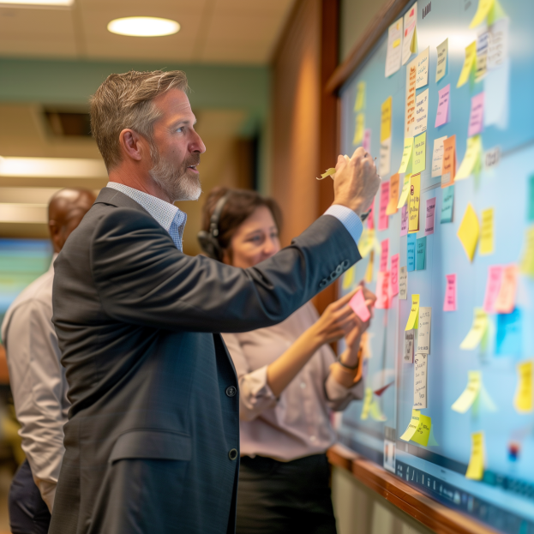
Mid-Size Team
The most common proposal size; shift to more classical proposal management but with some writing
Focus on event organizing and facilitation: brainstorming, reviews, just-in-time training, lessons learned
Track progress via in-process reviews and daily stand-ups; formal agendas are useful but not required
Monitor workflows and version control
Manage tasks like issuing/tracking of data calls and assignments
Control compliance due to “writer’s drift”
Leadership tasks include championing decisions, getting SMEs and authors to talk, and finding the right information
Overcommunicate with the team and individual authors, especially on virtual proposals
Write an executive summary and polish the entire proposal, making up for holes and poor writing

Slide 36
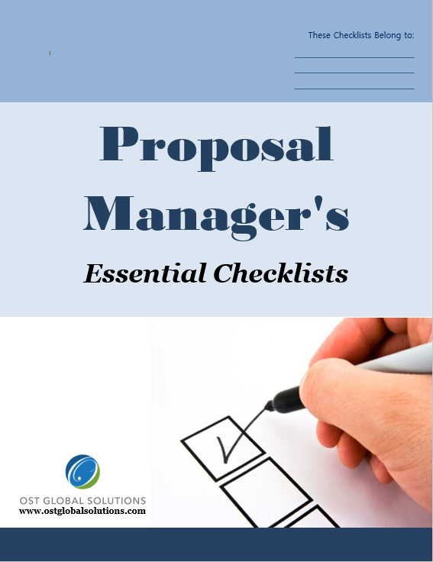
Tools Examples for Mid-Size Pursuits Management
Tracking Matrixes
Checklists

Slide 37
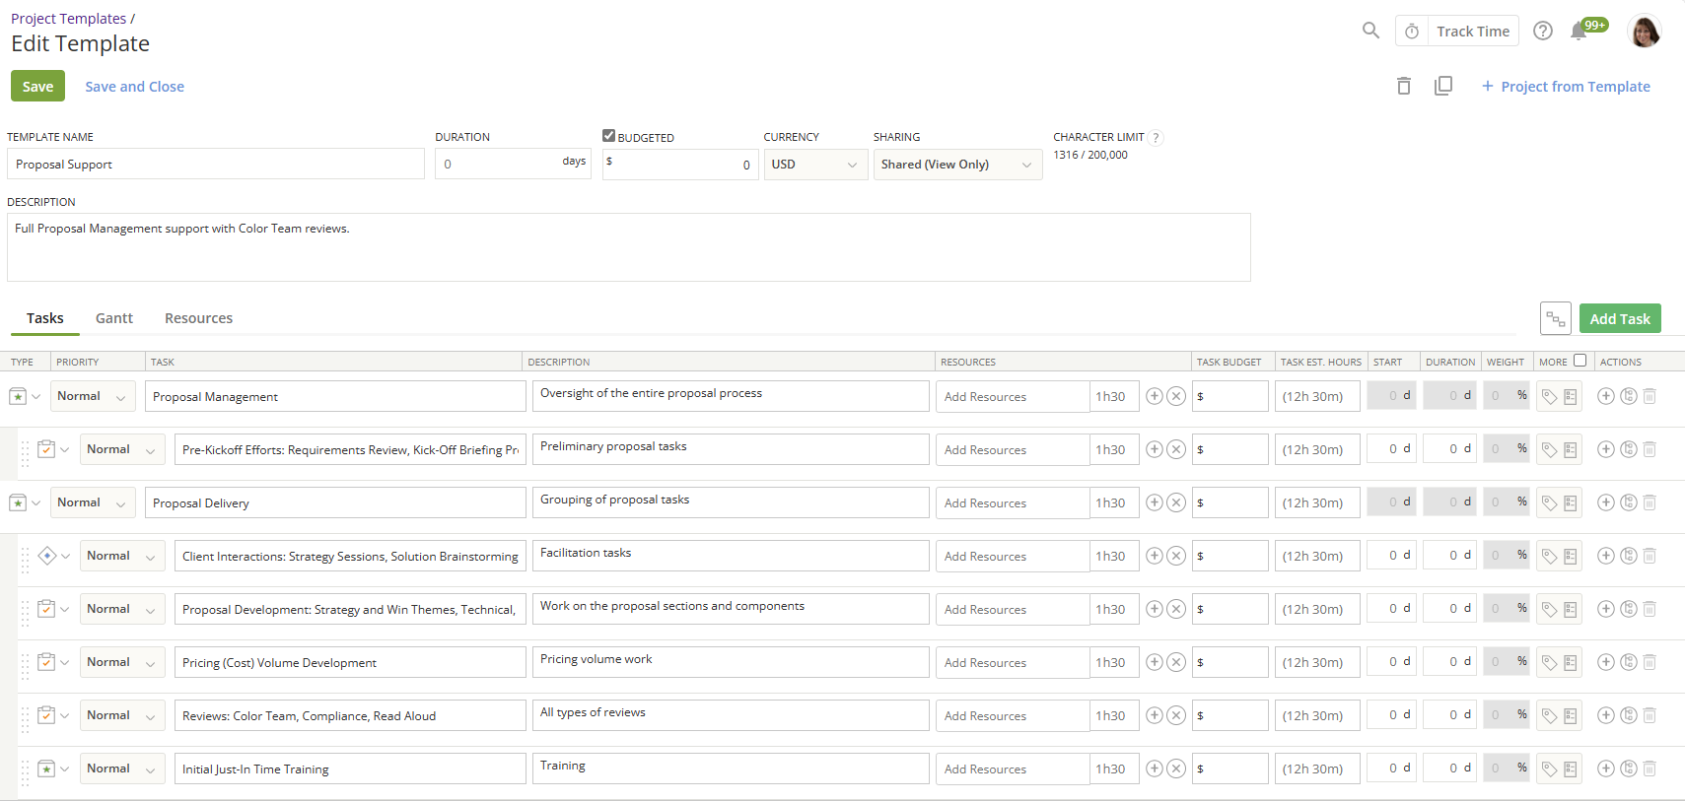
Large Teams
Tracking progress becomes labor-intensive – proposal manager is mainly the project manager
Organization is complex: Proposal Manager has a coordinator and book bosses/volume leads
There may be additional hierarchy with section leads and individual authors
Usually 2-3 standups a day: 1 for management, 1 for the team; evening standup possible
Formal work package/storyboard process requires pre-building and extensive JIT training
“Wall” is indispensable to get visual status
Tools include progress and resource tracking (team planner) in MS Project or productivity/project management tools

Slide 38

Plan for Just-In-Time Training Sessions
JIT Training provides skills most appropriate for a specific proposal stage; plan for 1–3-hour sessions throughout the lifecycle; adapt timing to your process
At or immediately after Proposal Kick-Off:
  How to work with an annotated outline or prepare storyboards/Work Packages
  Proposal evaluation and compliance
    Basics on how to read the RFP
    How to brainstorm (prequel to speed-writing)
  Getting the most from AI
  Proposal persuasion techniques
  Graphics Conceptualization
    Conceptualizing proposal graphics
    Graphics management process
    How to use the collaboration tools

Slide 39

More JIT Training
Put together your JIT slide decks and keep updating and reusing them for each proposal
Prior to the first draft (one writing cycle before the Pink Team):
  How to write compliant and compelling proposal sections
  How to turn a work package into the first draft
  Speed-writing and AI
  Section flow and 8Ws
Around the Red Team:
  Editing order
  Editing and proposal language
  Editing using AI
At status meetings – as needed:
  A reminder of naming conventions, posting locations for the files, management and review processes, refresher of the information shared in the formal JIT sessions, and so on

Slide 40
Module 5 Quiz
A great proposal kickoff should:
  Only focus on reading the RFP aloud
  Be a speedy assignment issuance session
  Set the psychological tone for the entire proposal process
  Be an informal meet and greet
What is the primary purpose of Just-In-Time (JIT) training sessions in proposal management?
  To provide social time for the team
  To deliver necessary skills appropriate for a specific proposal stage
  To postpone the kickoff meeting
  To generate content for the proposal
For a large team, having two to three stand-ups a day is considered excessive and unnecessary.
  True
  False
The level of formality and detail in a proposal kickoff should vary depending on the size of the team and the nature of the proposal.
  True
  False
Notes:
A great proposal kickoff should:
c) Set the psychological tone for the entire proposal process
Explanation: A successful proposal kickoff meeting is designed to set the tone for the entire proposal process. It’s an opportunity to align the team’s focus, clarify roles and expectations, and energize everyone for the work ahead. Merely reading the RFP aloud or issuing assignments would miss this critical aspect.
What is the primary purpose of Just-In-Time (JIT) training sessions in proposal management?
b) To deliver necessary skills appropriate for a specific proposal stage
Explanation: Just-In-Time (JIT) training sessions are intended to provide the team with the specific skills or knowledge they need right when they need it, particularly for the stage of the proposal they are working on. This ensures that the team is prepared to handle specific tasks and challenges effectively.
For a large team, having two to three stand-ups a day is considered excessive and unnecessary.
b) False
Explanation: For large teams working on complex proposals, having two to three stand-ups a day can be beneficial. Frequent check-ins, including separate status meeting for the proposal management team without the broader team present, help ensure everyone is aligned, issues are addressed promptly, and progress is monitored closely, especially as deadlines approach.
The level of formality and detail in a proposal kickoff should vary depending on the size of the team and the nature of the proposal.
a) True
Explanation: The formality and detail of a proposal kickoff should indeed be tailored to the size of the team and the complexity of the proposal. For smaller teams or less complex proposals, a more informal and brief kickoff might be enough, whereas larger or more intricate proposals may require a detailed and formal approach.

Slide 41
Module 6: Orchestrating a Great Proposal Kickoff

Slide 42

Advanced Techniques for Reaching the Nine Kickoff Goals
Recap of 9 Kickoff Goals:
  Build a team
  Set the right tone
  Manage expectations
  Obtain management buy-in
  Communicate proposal roadmap and plan
  Integrate and issue proposal assignments
  Educate your team about the opportunity
  Train your team to develop great text and graphics
  Get the ball rolling

Slide 43

Step 1 – Build a Team
Mandatory attendance in person/on camera, ice-breakers, introductions, fun facts, food, and proper contact information are key; but you can go beyond that
Step into a role of a leader: provide direction, structure activities, share information, encourage participation, promote positive relationships, and support and encourage members
Announce competition and simple prizes for:
  Turning in high-quality section the earliest
  Conceptualizing the most impactful and customer-centric graphic
  Going beyond the call of duty
Use humor to set a positive atmosphere
Use team building meals or games

Slide 44

Landmine 5: Losing Credibility with Your Team
Not keeping promises and confidential information
Lack of confidence in expressing direction, being dogmatic instead of self-assured, being closed to discussion, or being gullible
Lack of positive and optimistic encouragement, not complimenting team members' achievements, not offering encouragement and assistance when performance is low, and forgetting to express optimism that “we will win”
Not finding and using common ground, forgetting to focus on points of agreement when trying to influence others
Failing to manage disagreement, making rash decisions instead of seeing both sides of an argument
Forgetting to coach, being the enforcer
Not appreciating team members' perspectives by not checking if they agree with decisions, the obstacles they encounter, their dissatisfactions, their needs and the interpersonal problems
Not sharing key information that only you can get

Slide 45

Team Building Principles
You must serve as the team’s catalyst for better performance
Articulate a vision: Energize the team through ambitious and exciting vision of beating the competition, to engender passion which fuels creativity, hard work, and heroics
Set goals: To prevent overwhelm, explain how they can tackle work through smaller goals – concrete and manageable (use JIT Training and coaching)
Encourage constructive debate: Don’t succumb to groupthink and censoring of dissent – some task-focused conflict is constructive – if the team fails to debate, play devil's advocate
Encourage initiative: Whenever any member of the team takes the initiative to direct work activities, give them credit for initiative, and encourage it while ensuring their direction are in line with the process

Slide 46
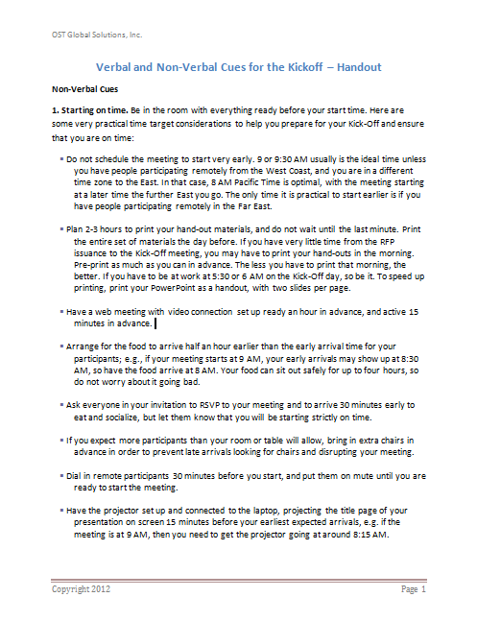
Step 2 – Set the Right Tone
Your goal is not only to tell the team what the plan is, but to ensure that it is followed; you need to be taken seriously for the team to follow your directions
Exude confidence to inspire the team to:
  Persevere through working long hours
  Meet aggressive deadlines
  Find scarce information; tap into creativity
  Overcome writer’s block
Kick-Off non-verbal cues:
  Starting on time, being prepared
  Presenting with confidence
  The right clothes and body language
Kick-Off verbal cues are:
  Speaking loudly, with good pace and clarity - avoiding monotonous delivery
  Knowing the next steps and everyone’s responsibilities
See file Module 6 Verbal and Non-Verbal Cues for Setting the Tone.docx

Slide 47

Steps 3-5 – Recap
It is tough to manage a proposal without proper management backing
Step 3: Manage Expectations
  Discuss your management style
  Explain your proposal process
  Tell how you will track status
  Provide all the logistical information
Step 4: Obtain Management Buy-in
  Require that your management attend
  Address upfront all pieces that require their support to provide resources
  Build confidence, not overconfidence
Step 5: Communicate Proposal Roadmap and Plan

Slide 48
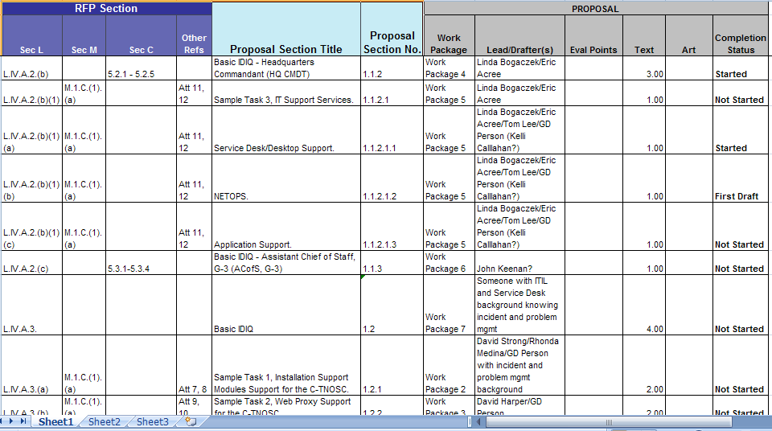
Landmine 6: Not Integrating Your Proposal Upfront
One of the worst directions one can offer to the proposal team is to issue a list of assignments with compliance tracked against them, and tell them to go write
Key problem – presenting the outline as the compliance matrix and sending writers to “go figure out” what goes inside the sections and paragraphs
Receiving good inputs in response to writing assignments is a key challenge for proposal managers worldwide
Storyboards that used to cause a wasted effort can now be turned into AI prompts that bridge section plans and drafts
Bad idea to use as the only outline

Slide 49
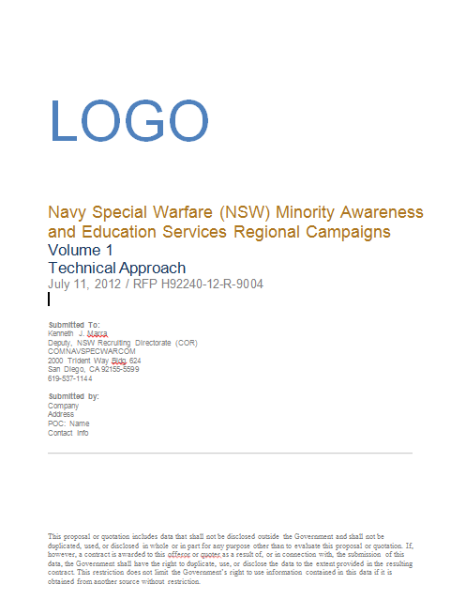
Step 6 – Integrate and Issue Proposal Assignments
Assignments must be issued AT THE KICKOFF, or you will lose the momentum
Determine the scope and type of integration:
  Annotated outline (small to mid-size effort) – with sections handed out to authors
  Storyboards or Work Packages (large effort) – part of the Foundations of Proposal Management course
All include special directions to the authors and information collected earlier
Must be prebuilt, which takes time
AI-assisted outline development can save significant time
See file Module 6 NSW Minority Awareness and Education Services Vol 1 Tech Approach Outline.docx

Slide 50

Steps 7-9 Recap
Do not assume that everyone knows about the opportunity and has proposal skills – ensure that every single team member is on the same page
Step 7: Educate or Refresh Team’s Knowledge Regarding the Opportunity details, customer hot buttons, and win themes
Step 8: Train Your Team – assess the current skills and use JIT Training to refresh or impart knowledge
Step 9: Get the Ball Rolling by recapping the handouts and expectations, and telling what is the schedule and tasks for the next 1-3 days

Slide 51
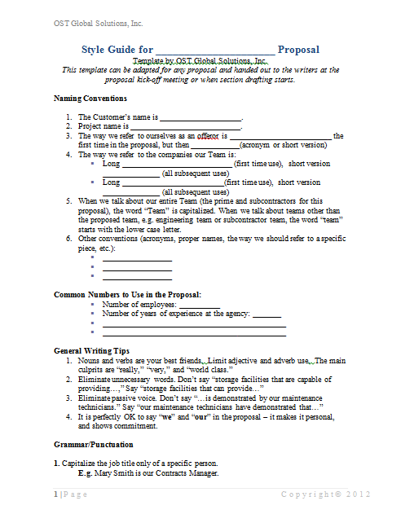
Preparing Kickoff Handouts for Best Communication and Team Integration
Required Handouts:
  Your Kickoff PowerPoint with all the key information
  Assignments:
    Compliance matrix/outline with assignments (may be inside the brief)
    Annotated outline (preferably cut into sections or whole)
        or
    Work packages (storyboards)
Optional Handouts:
  Style Guide (useful for writers and AI)
  Draft Contact List
  Proposal Cross-Reference Matrix/Status Checklist
  Any background materials
See file Module 6 Proposal Style Guide.docx

Slide 52

Module 6 Exercise
Determine correct and incorrect courses of actions as applicable to the following scenario regarding proposal resources; use AI to gather ideas
Aspirent, Inc. is an 8(a) going after a $1 billion IDIQ requiring a written proposal with the main approach and 3 sample tasks, and an orals presentation. It is Aspirent’s first competitive proposal. Aspirent sort-of knows the customer but hasn’t done much capture as they don’t know how to run capture. But one of the teammates knows the customer very well.
Aspirent’s team includes 12 companies, 10 small businesses and two large companies. One of the two large businesses is one of the top five federal contractors.
Aspirent is deciding how to budget and plan for the opportunity. It has $400K in reserves, and a business developer with experience working on teammates’ proposals. It also has some program staff and senior management to help write the proposal.
How should the company plan its proposal and resources?
What mistakes should Aspirent avoid?

Slide 53
Module 7: Driving the Team to Produce Winning Content
Step 1. Become an “Expert” in Your Proposal’s Subject Matter

Slide 54
Where We Are in the Process
Predecessor: Capture Process
Read RFP
Prepare for Kick-Off
Conduct Kick-Off to Reach 9 Goals
Develop Work Packages
Prepare Draft
1
Conduct Pink Team
Prepare Draft
2
Prepare Draft
N
Conduct Red Team
Prepare Final Draft
Read-Aloud
Print,
Check, Deliver
Implement Post-Delivery Win Strategy, Orals, FPR
Update Lessons Learned
Annotated Outline
Assignments
Work Packages
Compliance Checklist
Style Guide
Background Materials
Briefing
Pink Team Recovery
Outline Frozen
Red Team Recovery
Decision to proceed
Award
Make Bid-No-Bid Decision
Brainstorm & Research
In-Process Review(s)
In-Process Review(s)
DTP, Edit
DTP, Edit
Conduct Gold Team
Collect Lessons Learned
Attend Debrief
Integration Phase
Planning Phase
Writing Phase
Polishing Phase
Production
Phase
Post-Proposal Phase
Successor: Project Delivery Process that Includes Capture of Additional Scope and Projects

Slide 55








Landmine 7: Focus on Merely Administering the Process
Old belief: If you do all the steps of the process right and have the right SMEs – it will result in a great proposal
Claiming to be “all about compliance”
Staying out of the “weeds” and running proposal like a project
  Thinking in blocks of text and graphics
  No delving into content, intricacies and nuances, and customer messaging
Proposal managers turn into proposal coordinators

Slide 56
Six Steps to Claim Leadership Over the Proposal Content
Facilitate solution development to coax better approaches from SMEs
Drive the content to a winning quality
Roll up your sleeves, interview SMEs, and fill the graphics and text gaps yourself
Play to win
Result:
  Growing into a higher-end proposal professional
  Win rate going up
1. Become an “expert” in your proposal’s subject matter
2. Initiate and facilitate solution development sessions
3. Give ample direction and help to SMEs
4. Run in-process reviews
5. Tell good content from bad content
6. Fix yourself whatever isn’t working
Notes:
This session covers the steps with the exact how-to techniques to help proposal managers take charge of influencing proposal outcomes to a much greater degree. It also covers key success ingredients for becoming a proposal ace.

Slide 57

Step 1: Become an “Expert” in Your Proposal’s Subject Matter
Become an expert at becoming an “overnight expert”
  It is easier than it seems
  It is an actual process
  Used by many professions:
      Journalists
      Navy Seals
      007 types
      Proposal consultants that don’t specialize in one industry
Notes:
How to become an expert in a new subject in a matter of days? How to coax winning CONOPS out of subject matter experts? How to master the art of an interview and other content generation methods? What are the tricks to get the most from your proposal team in the shortest possible time? And, how to tell good content from poor content?

Slide 58
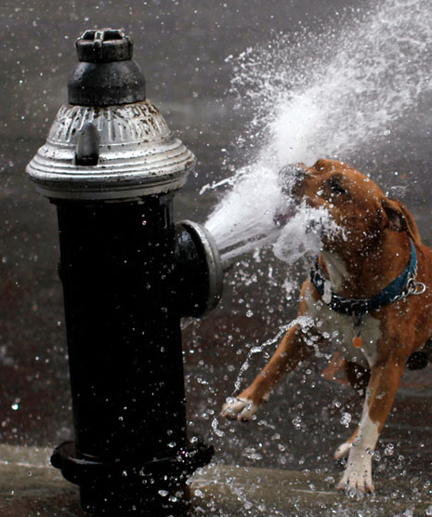
Absorption Phase
Suspend panic and insecurity about learning a new subject
  It is expected you won’t understand much right away
  It is all about finding your Zen while drinking from a fire hose
Your task is to absorb as much as possible, and as quickly as possible
Key skill is to relax while paying attention as the information flows through you
In the absorption phase, your mind is acquiring passive vocabulary
The hardest part: as your attention starts to wander, force yourself to focus back

Slide 59

Research to Accelerate Absorption
Become a sponge: read everything you can about the subject to prepare for brainstorming
Start with the front of the SOW
Draw or export into a mind map the tree-like representation of the SOW – the Work Breakdown Structure
Research documents that show different facets of the program and subject matter
  First understand what's in the document and then jump to the most useful parts
  Do not read every part of every document – use AI to distill it
  If a subject is completely new, ask AI to explain it “like to a 12-year-old” and/or find a primer on websites such as Wikipedia
Write out key terminology and look up acronyms and concepts – it is just like learning a foreign language

Slide 60

Read Materials Quickly
Preview the whole material: titles, structure, organization, key landmarks
Decide what you could gain from each item
Isolate necessary information into sections – decide what you will read in detail vs. skim
Decide what questions you want to answer – use AI to help
Preview for main ideas and key words using AI
Read and take notes
Organize information the way it would be useful for the proposal

Slide 61
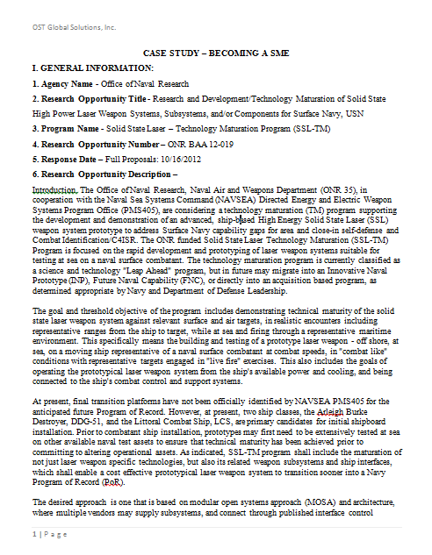

Module 7 Exercise 1
Read the text quickly, applying the techniques you just learned, including AI
Determine what the text is all about
Highlight the key terminology, and look it up
See file Module 7 Case Study for becoming an expert - Laser Weapons.docx

Slide 62

Active Listening Phase
Ask questions (use a brainstorming checklist), and listen to the SMEs discuss the subject matter
Pick out the words you know, and focus on things that currently make sense
When your mind drifts yet again, forcefully direct it back to the material or discussion
Take detailed notes
Ponder the meaning behind each point
Focus on each person who is talking, and make eye contact
Maintain attentive posture
Repeat some of the points they make, clarify them, and paraphrase

Slide 63

“Play a Game” Phase
Pass yourself for a “junior expert” – do not readily confess your newness or ignorance in the field
Play a game to keep yourself on your toes by commanding respect from experts as a peer
Get a mild adrenaline rush from being put on a spot: “OK, I got this part right – how much longer can I pass for an expert?”
“Fake it till you make it,” playing along until you start comprehending
Keep in the back of your mind that you can always go back to a failsafe excuse: “I am not an expert in the field, I am a proposal manager”

Slide 64

Participate and Process
Ask questions on things you can relate to
Questions that work:
  Did I hear it right? You said that …
  “Who is this?” or “What is this?” (if it’s not in the Capture Plan and is not distracting from the main conversation)
Learn the difference between questions:
  Is it an annoying question that would distract the group and destroy my credibility?
  Is it a helpful question for the group while being a helpful one for me?
Filter everything consciously through your understanding
The goal is to get to a contextual understanding, you don't have to understand every term

Slide 65
“Related Fields” Phase
Focus on:
  Acronyms, terms, concepts you don't understand
    Isolate the obstacles to comprehension: often there is something that you don't understand and that causes your brain to stall
  Things you do understand
    Each time you encounter a familiar concept, think about it in detail
    Relate the unknown material to what you know
    Figure out what the system/service/ product does, translated to a common language
    Deduce what the customer wants in a nutshell and why – use AI to help
Truisms
Anecdotes and related stories
Other subject matters
Old training, movies, other points of reference
Things you heard or learned that were “just information” before but now make sense
New Material

Slide 66
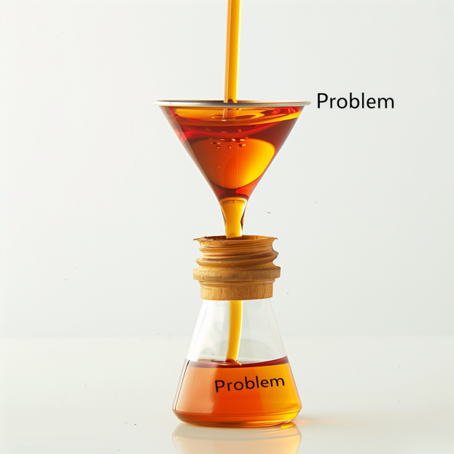
Simplify
Picture yourself as the customer or user who needs this system, service, and/or product, and not a provider
Translate everything technical and complex in the simple, practical terms with the help of AI:
  What is the customer’s problem?
  What are the biggest challenges?
  What are the day-to-day struggles?
It is all about simplifying
If you still can't figure it out yourself, ask AI to explain it to you as if you were a fifth-grader

Slide 67
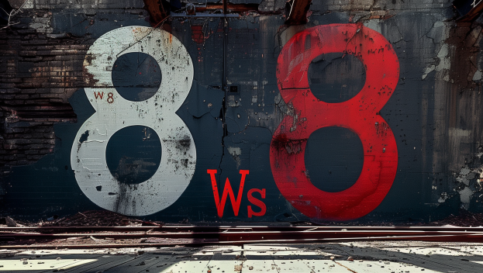
Sorting Phase
Sort the disjointed information into “buckets”
Ask questions to figure out the 8Ws about each main topic:
  Why
  What
  Who
  How
  When
  Where
  Wow
This focuses the SMEs and helps them fill the gaps

Slide 68

Start Seeing Patterns
As you stay with the subject matter, patterns will emerge
Prompt AI with your vague thoughts and check for sanity
Figure out what are the most important parts necessary to win this proposal
Push the SMEs to develop innovative solutions
Keep pointing the SMEs to what’s needed to win this proposal
Stress benefits to the customer from the customer’s standpoint – AI is great at providing ideas for benefits

Slide 69
Module 7 Exercise 2
Apply the “related fields” techniques
Simplify
Sort into the Ws you can already identify
WHY
WHAT
WHO
HOW
WHEN
WHERE
WOW
See file Module 7 Case Study for becoming an expert - Laser Weapons.docx

Slide 70
Module 8: Driving the Team to Produce Winning Content
Steps 2 – 6 of Claiming Leadership Over Content

Slide 71

Step 2: Initiate and Facilitate Solution Development Sessions

Slide 72

Initiate and Facilitate the Brainstorming Process
Make sure all the right SMEs are present
Don’t let the session become shapeless:
  Start with the annotated outline requirements phrases walk-through
  Move to what the customer needs to see/hear
  Prepare for session by generating questions for SMEs using AI to stimulate the discussion
  Stick to what you need to know to write in a section and move other discussions to “parking lot”
Based on the brainstorming flow, assess what you know, what you don’t know, and what can be done about it now
Determine the gap: how to get to what the customer needs
Remember – you cannot turn back time – but sometimes a little mid-proposal capture catch-up can make a difference

Slide 73

Use Solution Development Checklists
To cut down on brainstorming time, create or use checklists for:
    Management:
      Organization
      Staffing
      Transition
      Other
    Technical
      Common technical questions
      Industry-specific solutions
Use templates and process for the rest:
    Past Performance
    Resumes, plans, cost, etc.
Attend the Advanced Capture Management course for examples of checklists

Slide 74

Master the Art of the SME Interview
Coach your SMEs to write as if they were just talking in a conversation, processing through AI, and post-processing
Prepare all the solicitation requirements phrases and figure out with AI’s help what questions you need to ask
Transcribe the interview as you may miss information when typing notes
Ask all the 8Ws and make note of actions and decisions that need to take place
After getting through the facts, prompt them to talk about their feelings on certain subjects to get to the stories and anecdotes
    It must have been hard to…
    What would be particularly challenging here?
    What would happen if someone just starting in the field would try to do the same job? Where could they possibly fail?

Slide 75
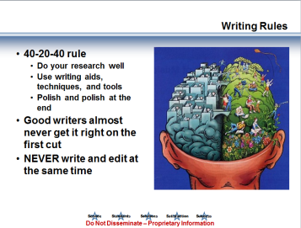

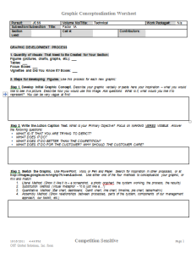
Step 3: Give Ample Direction and Help to SMEs
Just-in-time training sessions, including AI
Redirection of resources
Annotated outline or detailed work packages
Interviewing, transcribing, feeding through AI, post-processing with the SME
Timely information and boilerplate/examples retrieval
Meetings facilitation to encourage collaboration and peer reviews
Facilitation of action items completion to eliminate upstream and downstream bottlenecks for SMEs
Mid-process coaching

Slide 76
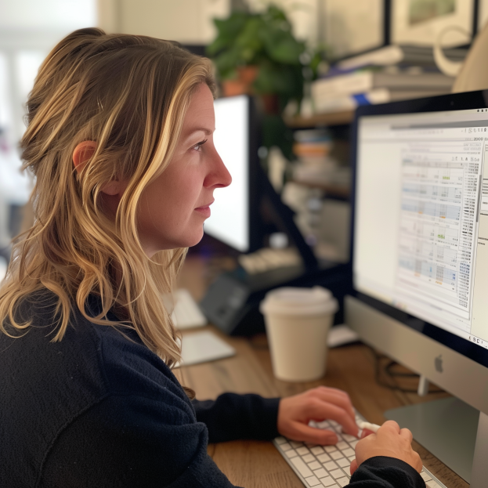
Step 4: Run In-Process Reviews
Proposal Manager’s tool to track progress in addition to status meetings
Done every 1-3 days
No time lost for writers
Prevent writers’ drift and
offer timely directions
No surprises or embarrassment during “Formal” reviews
A rolling review – work doesn’t stop
Use AI review capabilities to speed up the process, if content is dense
Track changes and use comment function in MS Word

Slide 77

Step 5: Tell Good Content from Bad
Read every proposal section to check if the content is “rotten”
Don’t get stuck on writing quality – look for substance above all
Spot the usual offenders:
    Cut-and-paste
    Off-topic writing
    Bland fillers and lack of substance
    AI-produced content without post-processing
    Missing “how”
    Lack of benefits language
    Lack of proof points from past performance
ID specific gaps: AI recommendations, 8Ws, checklist questions, compliance items
Devise a recovery strategy

Slide 78

Step 6: Fix Yourself Whatever Isn’t Working
Forget about principles of good management – your end goal is winning
Fill the gaps, refine benefits, redo weak approach write-ups and graphics (have the AI and/or SMEs vet the accuracy)
Put your personal “stamp” all over the proposal
Go over every word, including tables
Read the document out loud after the editors have finished the proposal
Check the cost volume to make sure it matches the technical proposal
Leave nothing to chance

Slide 79
Quiz
The key to initiating solution development sessions is to:
  Have a structured session with the right SMEs present.
  Allow the session to be open-ended without guidance to foster creativity.
  Only include management staff in the sessions.
  Limit the session to technical discussions without including what the customer needs to see or hear.
Mastering the art of the SME interview involves only focusing on the technical facts and avoiding subjective feelings and stories about one’s experiences.
  True
  False
List the six steps to claim leadership over proposal content.
Notes:
The key to initiating solution development sessions is to:
a) Have a structured session with the right SMEs present.
Explanation: A successful solution development session requires structure and the involvement of the right Subject Matter Experts (SMEs). These sessions need clear guidance and objectives to ensure that the solutions developed are aligned with the customer's needs and the proposal’s goals. Open-ended or unstructured sessions might lead to a lack of focus, wasted time (especially for valuable SMEs who are in high demand and are billable on projects), and incomplete or irrelevant solutions.
Mastering the art of the SME interview involves only focusing on the technical facts and avoiding subjective feelings and stories about one’s experiences.
b) False
Explanation: While technical facts are important, a well-rounded SME interview often benefits from understanding the subjective experiences and stories of the SME. These insights can help to humanize the solution and provide valuable context that can make the proposal more compelling and aligned with the customer’s expectations.
List the six steps to claim leadership over proposal content.
The six steps are:
1. Become an "expert" in your proposal's subject matter: Deeply understand the proposal's content and context to lead effectively.
2. Initiate and facilitate solution development sessions: Organize and guide sessions to develop strong, customer-focused solutions.
3. Give ample direction and help to SMEs: Provide clear guidance and support to SMEs to ensure their contributions align with the proposal’s goals.
4. Run in-process reviews: Regularly review content during development to ensure quality and adherence to the proposal strategy.
5. Tell good content from bad content: Evaluate the content critically to distinguish between what works and what doesn’t.
6. Fix yourself whatever isn’t working: Take initiative to correct issues in the proposal content, ensuring it meets the highest standards.

Slide 80

Day 1 Recap
Let’s go over today’s material
What are the seven landmines you have learned about today?
How will you scale the proposal process up and down?
What kinds of just-in-time training needs to be provided at each proposal stage?
What are the nine kickoff goals?
What is the process of becoming a SME in a previously unknown field?
What is your biggest take-away from today’s class?

Slide 81



Contact Us!
7361 Calhoun Place, Suite 560
Rockville, MD 20855
Phone: 301-384-3350
service@ostglobalsolutions.com
Improving Our Country Through Better Proposals!™
www.ostglobalsolutions.com
Copyright © 2024 OST Global Solutions, Inc. All rights reserved. This material may not be reproduced, distributed, transmitted, or used for any commercial purpose without the express written permission of OST Global Solutions, Inc.

