Slide 1
Advanced Proposal Management
Bid & Proposal Academy Course
Day 2
COPYRIGHT © 2024 WWW.OSTGLOBALSOLUTIONS.COM

Slide 2

Module 9: Overseeing the Development of Winning Volumes and Sections
Cost Proposal and Orals

Slide 3
Where We Are in the Process
Predecessor: Capture Process
Read RFP
Prepare for Kick-Off
Conduct Kick-Off to Reach 9 Goals
Develop Work Packages
Prepare Draft
1
Conduct Pink Team
Prepare Draft
2
Prepare Draft
N
Conduct Red Team
Prepare Final Draft
Read-Aloud
Print,
Check, Deliver
Implement Post-Delivery Win Strategy, Orals, FPR
Update Lessons Learned
Annotated Outline
Assignments
Work Packages
Compliance Checklist
Style Guide
Background Materials
Briefing
Pink Team Recovery
Outline Frozen
Red Team Recovery
Decision to proceed
Award
Make Bid-No-Bid Decision
Brainstorm & Research
In-Process Review(s)
In-Process Review(s)
DTP, Edit
DTP, Edit
Conduct Gold Team
Collect Lessons Learned
Attend Debrief
Integration Phase
Planning Phase
Writing Phase
Polishing Phase
Production
Phase
Post-Proposal Phase
Successor: Project Delivery Process that Includes Capture of Additional Scope and Projects

Slide 4

Landmine 8: Deciding That Cost Proposal is Not Proposal Manager’s Responsibility
Make cost volume one of your top priorities given how important it is in getting a higher Pwin
Few proposal managers:
  Believe it is their job…
  Are trained on cost and know what goes into the cost proposal
  Know how they can help develop better cost volumes
  Are familiar with intricacies of various cost strategies
Those who win focus on the whole offer!
You cannot ignore the ultimate deciding factor between winning or losing

Slide 5
Cost Volume Process
Predecessor: Capture Process, including PTW
Have Cost Team read RFP and collect questions
Prepare for Kick-Off
Conduct Kick-Off with Cost Team’s Participation
Develop “Should” Cost and Pricing Model
Develop WBS, Labor Staffing Mix, Org Chart, Schedule
Pink Team
Continue collecting assumptions
Prepare Draft n
Red Team
Prepare Final Draft
Read Out Loud the Narrative
Print, Check, Deliver
Implement Post-Delivery Win Strategy
Update Lessons Learned
Ensure Cost Team’s buy-in to proposal plan, and have them participate in the Kick-Off
Tweak technical solution if needed
Collect assumptions
Pink Team recovery
Apply strategies to bring price to the PTW (down)
Red Team recovery
Management approval and decision to proceed
Award
Involve Cost Team in a Bid-No-Bid Decision
Brainstorm & Research
Send data calls to subs and track submissions
Prepare Draft 1 of the Cost Narrative and BOEs
Prepare Draft 2 of the Narrative and Price
Validate Price Strategy
DTP, Edit
Conduct Gold Team
Collect Lessons Learned
Orals
Attend Debrief
Integration Phase
Planning Phase
Writing and Final Pricing Phase
Polishing Phase
Production
Phase
Post-Proposal
Phase
Run the cost volume in conjunction with the technical narrative, and not at the later half of the proposal; take Developing a Winning Cost Volume course
Successor: Project Delivery Process that Includes Capture of Additional Scope and Projects

Slide 6

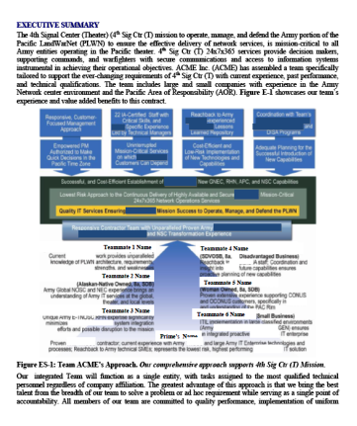
Landmine 9: Not Treating the Cost Proposal as a Sales Document
With technical and management volumes mostly equal (true even for small businesses) and may become more equal with the advent of generative AI, cost volume narrative becomes your core differentiator
Although widely recognized as a best practice, competitive labor rate analysis and Price-To-Win (PTW) calculation are still not a common practice
The most basic task is often failed: to make sure that technical and cost volumes agree
Cost volume is full of boilerplate cut and pasted from proposal to proposal
Basis of Estimate (BOE) is a missed opportunity to use as a ghosting technique for low-ballers, even in the LPTA environment
and (!)
Take the Competitive Analysis: Black Hat & Price to Win (PTW) course

Slide 7

How to Avoid the Landmine
More than 85% of the “best value” awards are made to the lowest bidder
Get serious about developing the PTW and Price Strategy to get to the Price to Win
Assign a cost volume lead early
Get technical staff involved in tweaking the solution to achieve lower price
Treat the narrative as you would the rest of the proposal
  Follow the process instead of completing the cost volume last at the last minute
  Include a cost volume-specific executive summary
  Infuse benefits in the cost narrative
  Consider including BOEs even if not requested if the competitors are likely to low-ball or it’s an LPTA where you may not be the lowest-priced offeror

Slide 8
Landmine 10: Mismanaging the Simultaneous Orals and Proposal Processes
Govt.
Draft Solicitation
Final Solicitation Issued
Response/Slides Submitted
Orals Day
Kickoff
Develop Slide Deck Outline, Mockups, and Draft Slides
Develop the Correct Flow of Talking Points
Develop Slides
Refine Slides
Through Practice & Finalize
Present
Slides
Phase 1
Phase 2
Phase 3
Phase 4
Solution and Planning
-Conduct Kickoff
-Develop win themes and solution
-Develop schedule that integrates all the orals elements
-Rehearsals and Orals logistics discussion
Speaking Points Refinement
-Develop talking points that support the speaker
-Craft messages
-Mock up and draft individual slides
-Check for consistency with the written proposal
-Pink Team: no presentation – talk through the slides
Presentation Skills Coaching
-Assess each presenter
-Coach on speaking skills
-Mitigate nervousness
-Integrate anecdotes and benefits
-Conduct in-process slide reviews between Pink and Red Teams
-Red Team: review slides with presentation
Refinement of the Delivery
-Rehearse with video and coach feedback
Build a cohesive team
-Generate Q&A/Sample task and practice
-Finalize logistics for Orals Day
Refine opening and closing remarks
Mock Panel, Final Dress Rehearsal
Rehearsals
Pink Team
Red Team
Gold Team
White Glove
Written Proposal
Integration Phase
Planning Phase
Writing and Final Pricing Phase
Polishing Phase
Production
Phase
Post-Proposal
Phase
Optional: Script
Brainstorm on the Solution
Use Slide Content as Outline of Script Content
Read the Script Aloud, Have Speakers Practice and Tweak the Language to Sound Natural and Conversational
Refine and Finalize the Script
Coding Challenge or Sample Problem Issued in Advance
Take the How to Develop and Coach Winning Oral Proposals on-demand course

Slide 9
Module 9 Quiz
What is the primary responsibility of a proposal manager during the Cost Volume development process?
  To ensure the technical narrative is compelling.
  To ensure compliance with the solicitation.
  To oversee the development of pricing strategies and ensure cost volume integration with the technical narrative.
  To prepare Basis of Estimates (BOEs).
The success of oral proposals is solely dependent on the content of the slides.
  True.
  False.
How do you avoid preparing the Cost Volume at the last minute?
Notes:
What is the primary responsibility of a proposal manager during the Cost Volume development process?
c) To oversee the development of pricing strategies and ensure cost volume integration with the technical narrative.
Explanation: The proposal manager’s primary responsibility during the Cost Volume development process is to ensure that the pricing strategies are aligned with the technical narrative. This involves integrating the cost volume with the proposal's overall strategy and ensuring that it supports the story being told in the technical narrative. The proposal manager must work closely with the pricing team to ensure consistency and compliance.
The success of oral proposals is solely dependent on the content of the slides.
b) False.
Explanation: While the content of the slides is important for compliance and visual accompaniment of the presentation, the success of oral proposals largely depends on the presenter’s delivery, ability to engage with the audience, and responsiveness to questions. Factors like how well the proposal team communicates, how they address concerns, and the overall impression they leave as a team are equally crucial. The content on the slides is just one aspect of a successful oral proposal.
How do you avoid preparing the Cost Volume at the last minute?
Answer: To avoid preparing the Cost Volume at the last minute, it is essential to:
Start early in the proposal process to develop a detailed schedule that includes milestones for cost volume development.
For the proposal manager, to engage with the pricing team early to understand any potential challenges or requirements.
Regularly review progress against the schedule to ensure that the cost volume is being developed in parallel with the technical volume.
Conduct in-process and color reviews the same way the tech proposal is developed, to catch and address any issues promptly.
Maintain clear communication among the proposal team members to ensure that all elements are aligned and progressing as planned.

Slide 10
Module 10: Overseeing the Development of Winning Volumes and Sections
Going for the “Gold” in Past Performance

Slide 11

Landmine 11: Not Going for the Gold in Every Area of the Proposal
Avoiding weak areas is a natural tendency, but any score is better than zero
Missing focus on the entire portions of the proposal
Inherent focus on interesting portions of the proposal:
  Technical approach
  Management approach
Lack of focus on the “boring” sections such as the past performance and resumes
Unless there is someone assigned to the “boring” sections during color reviews, they go un-reviewed
Relying on teammates to deliver subject matter expertise and not managing the process
Reluctance to spend hours brainstorming on risk
Managing such highly specialized tasks as orals yourself instead of getting an orals coach or attending orals training

Slide 12

Past Performance
Going for the Gold in Every Area

Slide 13

Experience vs. Past Performance
  These distinctions are important to understand so that you can provide exactly what the customer requested
Past Performance:
  How well we did on similar projects
  The results: performance on schedule, and budget, award fees, and positive outcomes
Relevant Experience:
  Similar experience to the current requirements
  Similar actions as experience of the organization as a whole or its employees bid on the job
Corporate Experience:
  A section that can cite larger number of past performance contracts from the whole corporation, with lesser detail

Slide 14

Past Performance Mistakes
Past performance now has become equal or greater in weighting with technical, management, and cost
Mistake #1: Past Performance is a low-priority proposal task
  “We can just repackage the material from other proposals or use AI for repackaging it without thorough post-processing”
Mistake #2: Not pre-calling each reference, not pre-filling questionnaires, or pre-filling questionnaires incorrectly
  “We know our customers, and are doing great and they know how well we did, so we assume they will give us a great reference and take their time and effort to fill the questionnaires”
Mistake #3: Not using past performance information throughout the proposal to substantiate claims
  “There is a dedicated past performance section, and the evaluators can find it all there in one place”

Slide 15

More Mistakes
Often, the government allocates up to 50% of weight to past performance
Mistake #4: Letting reviewers get away with a cursory review of past performance sections, as an afterthought
  “We have more important sections to review – we just ran out of time”
Mistake #5: Ignoring the impact of what’s published in the CPARS
  “We have “Satisfactory” for our past performance but don’t spend much effort on writing a compelling narrative”

Slide 16

What If You Don’t Have Past Performance?
  This may be the case with companies just entering the market
If you don't have past performance or submit less than the number of past performances required, you will not be downgraded
  You will be scored "NEUTRAL“ (or get a “PASS” in an LPTA source selection)
  If your competitors have past performance and you don't, then they will simply outscore you
In a small business, principals’ individual past performance may count, as well as key personnel’s bid on the project
  It doesn't necessarily mean resumes – it means projects they performed on, if the customer can remember them and give them a reference
  It doesn't count as highly as your company's past performance, if at all
Joint venture or a Contractor Teaming Arrangement (CTA) is a solution when only the prime’s past performance counts

Slide 17
Past Performance Data Call Template Example
  At the CONOPS stage or immediately after the solicitation issuance before the template has been built, you may want to review your teammates past performance early to ensure suitability
Team,
We are beginning the selection process for [number] of our team’s most impactful past performance references. Please read the attached instructions carefully. At this stage, we're only gathering essential data that you likely have at hand (“canned” past performances), plus a bit of extra input. This initial collection aims to streamline our selection process and ensure we only delve deeper into the most promising references. Please, fill out the attached template for your candidate past performance reference(s).
Submit your information by [Time] [Time Zone] on [Weekday], [Date]. Please post your responses in the following folder: 05 Drafts -> 02 Canned Past Performances or directly via this link: [Link].
I understand this is an expedited request, and I appreciate your prompt cooperation. Should you have any questions or need assistance, I am available at [Cell Number] or [Email Address].
Your prompt response is important to our next steps, so thank you in advance for your attention to this matter.
Best regards,
[Your Name]

Slide 18
Past Performance Data Call Table Example
  The most important point to remember is to ask about what kind of reference would they believe they would get from their customer
1. Program Name
2. Government Agency (Prime), or Sub and include Prime’s Name and Government Agency
3. Awarded and final price/cost (rounded to the nearest million if necessary – this will help us judge the size)
4. Period of performance (This will help us determine how recent is this project, and whether you have been performing long enough)
5. Is this project being/was delivered on schedule, budget, and within technical requirements? (We will need to figure out whether there were any schedule or other sorts of problems encountered. Ideally we would like a program without any slippages or problems).
6. In your own words, why do you believe this past performance is relevant to [the name of the current pursuit]?
7. In your own words, why do you believe this is a great past performance to use in this proposal and why should we pick it over all the other references?
8. Do you have a highly rated CPARS record or will this customer give you a glowing reference on this past performance project when filling out the questionnaire?
9. Please, insert or attach whatever “canned” narrative you already have for this past performance for us to learn more about this reference.

Slide 19
Building a Past Performance Template
When developing past performance solution in advance of the RFP, use the same contracting office’s typical structure for past performance template
Present your past performance in a table
  It usually this allows for a smaller font so you can fit more information if page-limited
  At the very least, organize all the customer information in the table, with the rest as a narrative
Tailor this table exactly to what the RFP requires
If the RFP requires agency name, contract dollar amount, contract type, period of performance, Contracting Officer's name, contact information (phone, email, fax), this is exactly what the table cells should include
The next part is project summary and relevancy

Slide 20
Another Template Example
This template is more explicit in showing areas of relevancy specific to the new solicitation’s Statement of Work
It also explains how and why you should describe the problems on the project because:
  Many are reluctant to discuss negative aspects of the project
  Others just have trouble thinking right away of something that was hard or caused customer upset because of simple memory lapses or a subconscious desire to forget an unpleasant situation
Explicit problems description and how you resolved them is an opportunity for a “turnaround”
  Mistakes of the past become valuable lessons learned
  Reminders of how you have saved the day show your dedication and customer focus

Slide 21

Filling Out the Template
Embed instructions to the writers in the template to ensure consistency and compliance
Display your advantages:
  Organize in accordance with the solicitation requirements
  Explicit relevance above all
  If a project is only relevant to a couple of RFP areas, don’t list all RFP areas and say "not relevant"
  Reuse this new RFP’s terminology, not your project references’ synonymous terms
  State explicitly why it is relevant or good: "Our experience on this project is highly relevant to this RFP because..."

Slide 22

How to Make Your Past Performance Sizzle
Here is how you go for the gold in the past performance area and outdo your competition
Showcase:
  Technical and program management skills
  Unique capabilities, facilities, products that are relevant to the new bid
  Resourcefulness in tackling challenges and mitigating risks
  Innovations and improvements that resolved problems
  Superstar key personnel that you are also bidding in the new proposal
Use direct quotes from award fee letters, awards, commendations, customer “thank you” emails, and even verbal quotes if you are confident the customer will give you a positive reference and corroborate those quotes
Include such graphics as Award Fee Improvement Curve (Award fee % over time)

Slide 23
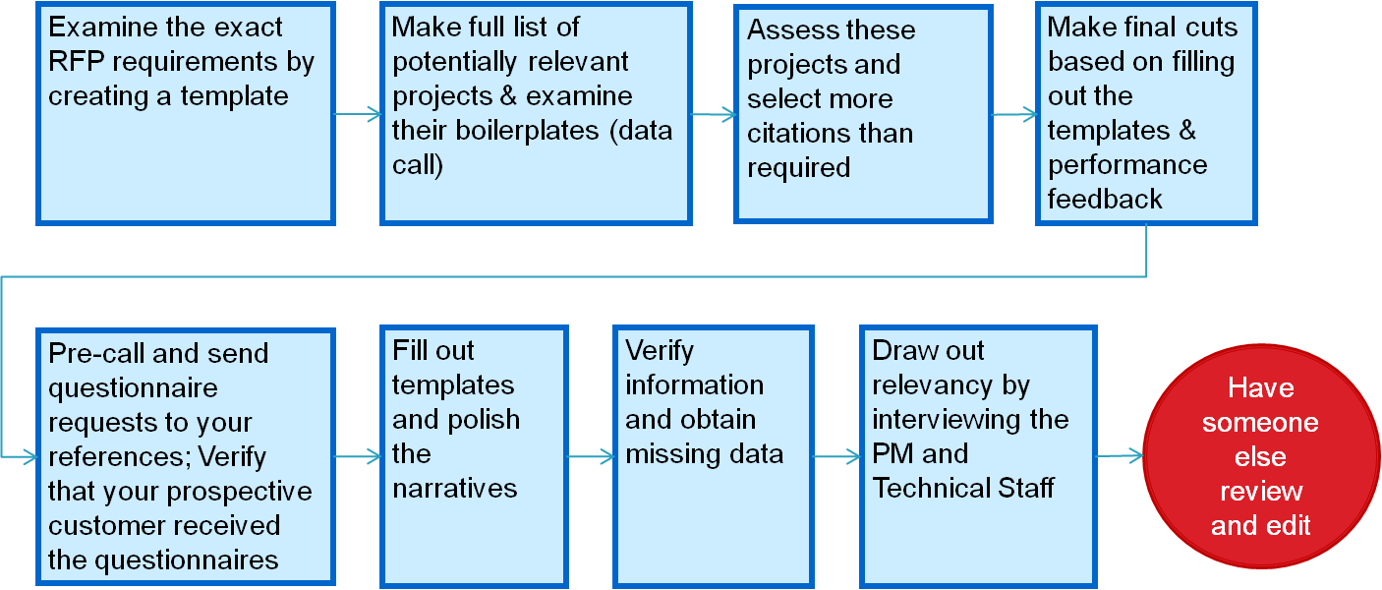
Past Performance Development Process
There are nine steps in the past performance development
May be step 1
early on
Use AI extensively:
  In past performance initial selection using semantic searches based on relevance
  In assessing the canned projects
  In generating questions to project managers to draw out relevance
  In creating and filling out templates

Slide 24

Preparing the Government References for Answering Questionnaires
Never ever, even if you are an incumbent, skip the step of asking your references for a permission to contact them
Contact the reference early
  If you call them too late, the reference could be traveling or otherwise busy, and fail to offer you the referral and fill out the past performance questionnaire if it's required
  Contact the reference at least 10 days before the deadline
Call the reference and ask them about their feelings about your performance on the project
Discuss problem areas and their view of how you plan to respond/write about those
  Do not get defensive
  Be ready to offer a plan of action to resolve a negative

Slide 25

Government References
There is a bit of an art in requesting a reference, maximizing the positives, and averting potential problems
Plant positives – remind them of the specific things you have done for them well
If a questionnaire is required, ask if they would like you to pre-fill the questionnaire
  The administrative part
  The narrative portion to remind them of what has been discussed, to make their job easy
DO NOT pre-fill the part that scores the performance – this is their job alone

Slide 26

Last Past Performance Tips
Instead of treating past performance as an afterthought, take the opportunity to produce a stronger more persuasive section
Plant positives with the customer before the RFP
  Develop your list of strengths and accomplishments
  Emphasize those strengths and accomplishments in talking to the customer prior to them preparing CPARS and when commenting on the CPARS
Establish an internal database of boilerplate past performance data, and update it frequently
Use AI to select past performances and proof points for technical and management volumes
Keep a list of contacts for each project handy – not only the PMs, but also the technical personnel

Slide 27
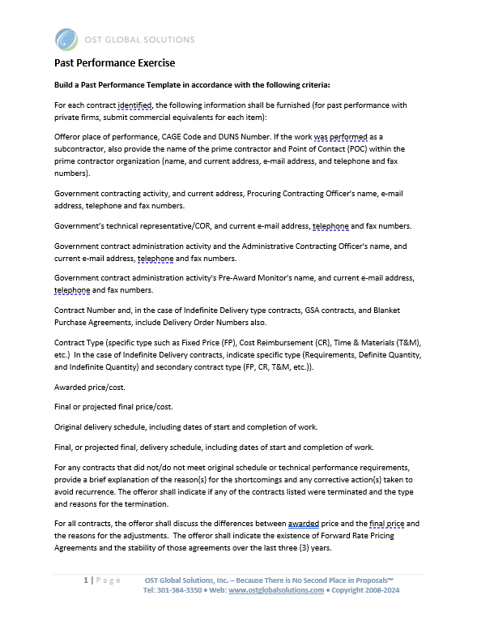
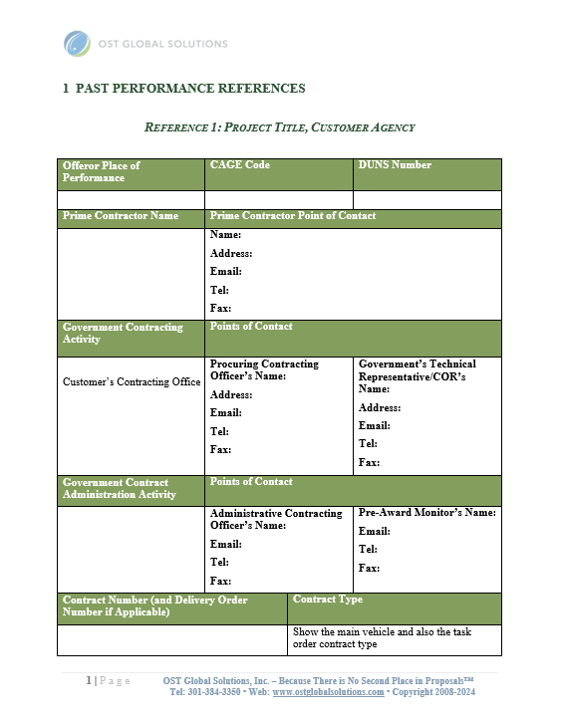
Module 10 Exercise
This exercise will help you understand compliance in past performance templates and uses for AI
Build a Past Performance Template using AI and the provided instructions
Post-process to ensure you do not miss any requirements
Compare your results against the answer key using AI
Use files Module 10 Past Performance Exercise.docx and Module 10 Past Performance Exercise Answer Key.docx

Slide 28
Module 11: Overseeing the Development of Winning Volumes and Sections
Going for the “Gold” in Resumes

Slide 29
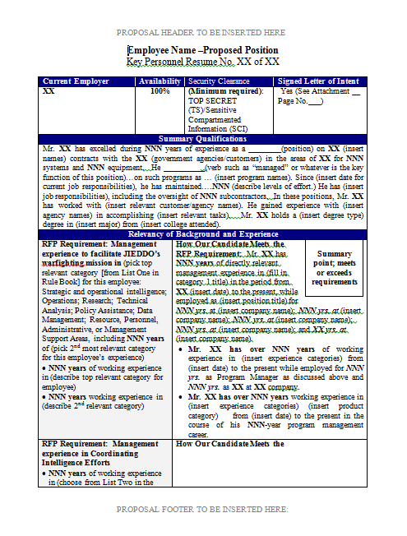
Resume Preparation
Resumes take a long time because you start with general and broad capabilities and seek to make them narrow and specific to the proposal at hand
It typically takes 4-8 hours per resume to prepare it the right way
All resumes are initially incomplete unless you bid on highly similar types of projects
  Be prepared to do more work with “bad” writers, and less work with “good” writers
  DON’T take an existing “canned” resume and lightly “pepper” it with RFP requirements and jargon
Use creative license to tie a person’s experience more closely to the requirements, but avoid exaggerations and lies
Always run the altered resume by the author to preserve accuracy

Slide 30
Resume Preparation Process
This 11-step process helps sequence your activities correctly
Select Key Personnel from across the team
Collect “canned” resumes
Review and make staffing decisions
Consider interviews of the teammate key personnel candidates
Develop a matrix for each person’s credentials against RFP requirements and check with the cost personnel to ensure salary fits within the cost model
Take a critical look at the resumes to identify potential compliance issues
Have people develop first draft linking experience to requirements
Polish and expand the information in the proposal resume format – interview authors if necessary
Have each resume edited and checked by someone else or AI
Add photos to the resumes if you decide to do so
Abide by the broader proposal review schedule – Pink Team, Red Team, and Gold Team

Slide 31
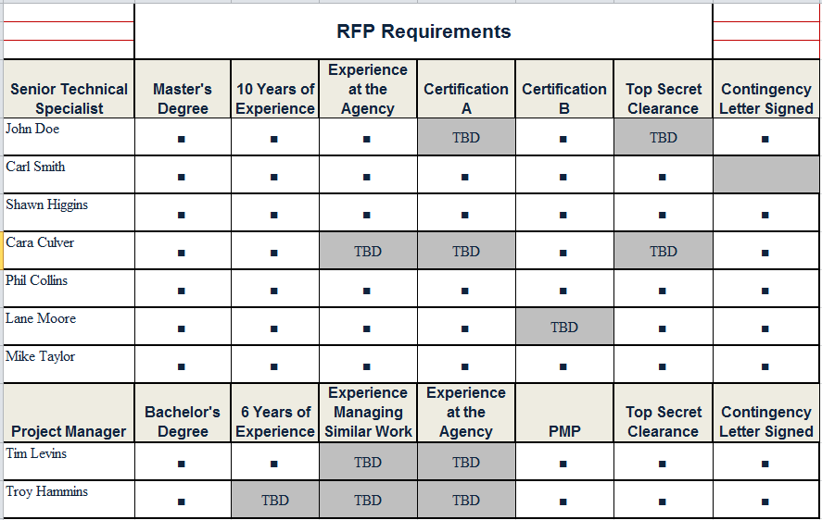
The Hardest Task: Selecting Key Personnel
Ensure personnel are selected correctly prior to preparing resumes

Slide 32
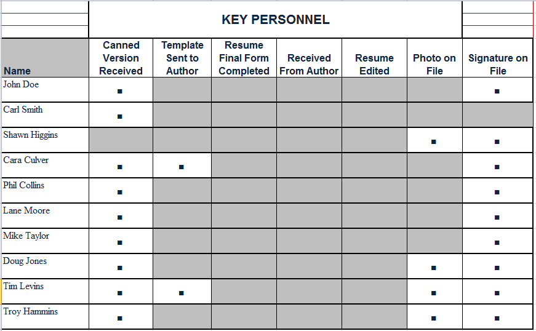
Resume Workflow
Use the workflow to track exactly where each resume is completion-wise

Slide 33
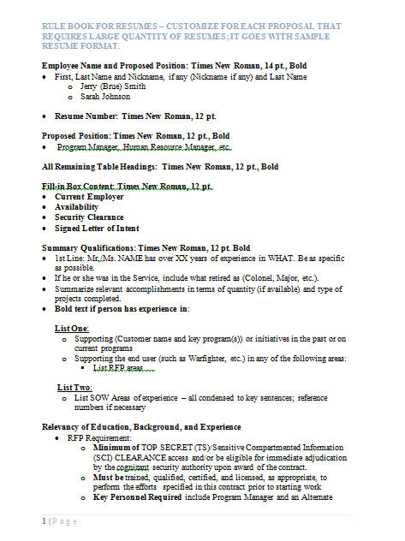
Important Resume Tips
Resumes require a level of consistency and standardization to send a message that you are trustworthy; create a rule book to use with AI
Use requirements language in the resume – same terms as the solicitation
In the Summary paragraph, highlight the areas most important to “sell” in each position
The summary paragraph is personal (Mr. Johnson has experience in…), but exclude all personal names and pronouns from the rest of text
Professional experience starts with the most recent job, with duties and quantified technical/management/cost reduction accomplishments, tied to the requirements
Tie everything to the exact position requirements and statement of work by calling those out for ease of evaluation

Slide 34
Resume Table Example

Slide 35
Resume Template with Detailed Instructions
Detailed instructions help make your resumes more consistent, and help create accurate AI prompts

Slide 36
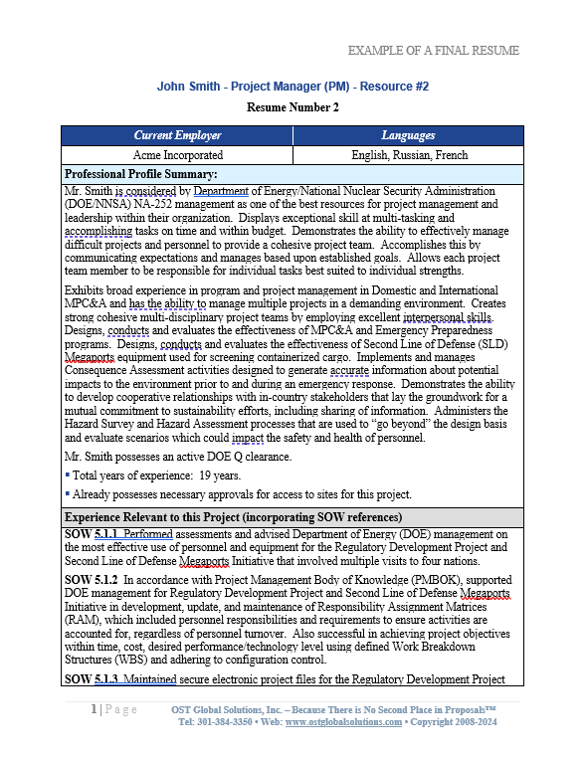
Module 11 Exercise: Compare Resumes
This exercise will give you an appreciation for how much work a resume may require
Compare the initial and final resumes using AI:
  Can you reverse-engineer the resume – where would you have allocated the initial information?
  Match information on the source resume and the proposal one
  What new information would you have had to get?
Use Module 11 John Smith Resume - Initial Material.docx and Module 11 John Smith Completed Resume.docx

Slide 37
Module 12: Proposal Leadership

Slide 38

Landmine 12: Not Knowing Where Your Proposal is and Who is Doing What at Any Given Moment
Lacking situational awareness is like a ticking time bomb
Ignoring the following can cost you dearly:
  Who is doing what with whose help, specifically
  How are they doing respective to where they should be schedule-wise
  What are their specific struggles
  Who is charging to your proposal budget and how much
  How is your proposal progressing overall, section by section
On a typical length proposal, need situational awareness by the hour

Slide 39
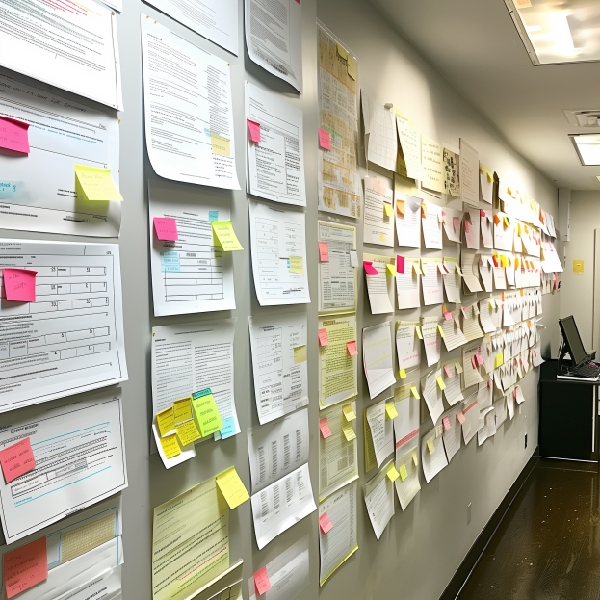
Tracking Volume, Section, and Graphics Progress
The main tasks of proposal management are all about communication, situational awareness, and not missing any details or steps
Five methods to keep track:
  Daily Status Meetings
  In-Process Reviews
  Constant conversations with team members
  Get copied on all email
  Automatic digests from collaborative workspace, if available
If available, proposal “wall” used for visual status and in-process reviews
Virtual or physical “Wall of Truth” section used for team communications
Notes:
a wall with 8.5x11 proposal pages arranged in four rows with post-its on top of some pages like in this photo

Slide 40
Daily Status Meetings
Agenda part 1
Have a written agenda for mid-size (optional) and large (always) proposals
Agenda is necessary for:
  Section and action item status tracking
  Peer pressure
  Succinct delivery
  Better message retention
  Time management
  Informing those who missed the meetings
Agendas get posted on the wall and in the collaborative workspace
You can take notes on the agenda during meetings to update it live for complete status
Proposal Status Meeting Agenda
Today’s Date
General Organizational
  These are the organizational issues that concern the entire team
  xxx
Schedules
  Next milestone is …
Leadership Team Announcements/Issues
  We are working from the following workspace: LINK
    Post your work daily in the following folders:
      xxx
    Post your graphics concepts in the following folder and notify xxx by checking the “Notify” box and check boxes next to their names:
      04 Graphics
        02 To The Artist – Graphic Concepts

Slide 41
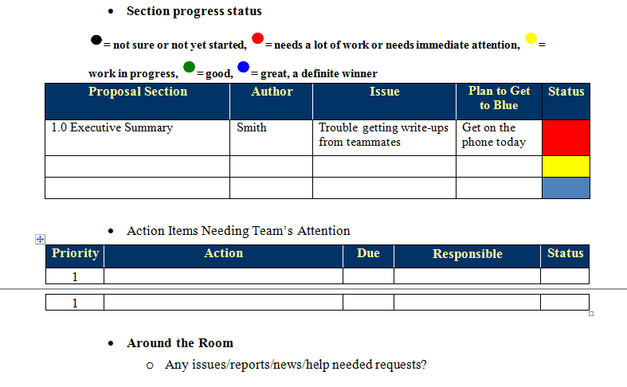
Agenda Part 2 – the Most Important Part (Managing Section Status)
Agenda part 2
This part is used for status tracking and peer pressure

Slide 42
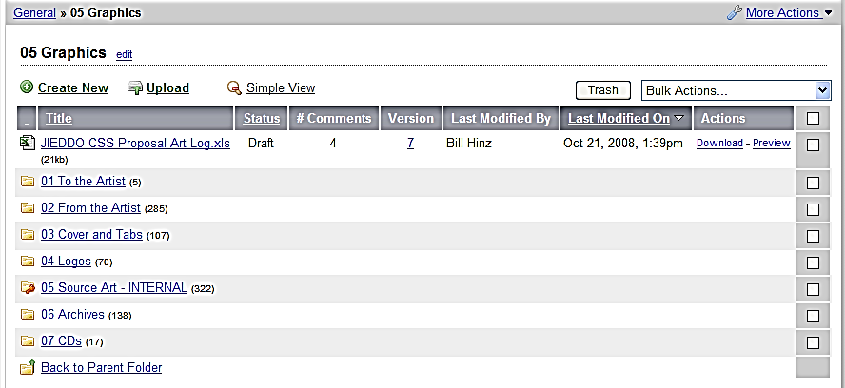
Managing Graphics
Set up a folder structure where your authors can communicate effectively with the graphic artist

Slide 43
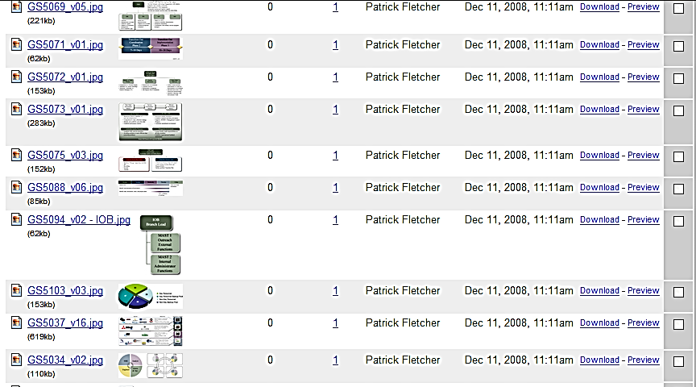
From the Artist
Every graphic should have a number and a version number both in the file title and on the graphic itself

Slide 44
Tracking – Art Log
This log keeps track of each graphic’s number, title, version, status, author, and section where it belongs Proposal Art Log
Legend: Gray - No Longer a Graphic We Plan To Use; Red - Not Yet Conceptualized or Raw; Yellow - Conceptualized But Not Rendered; Green - Rendered, But Needs Redlining and Refining; Blue - Final
Art # | Exhibit Title | Author | Section # | Status | Readiness Status
001 | Proposal Cover |  | n/a |  | v.X
002
003
004
005
006
007 |  |  |  |  | Not used
008
009
010

Slide 45
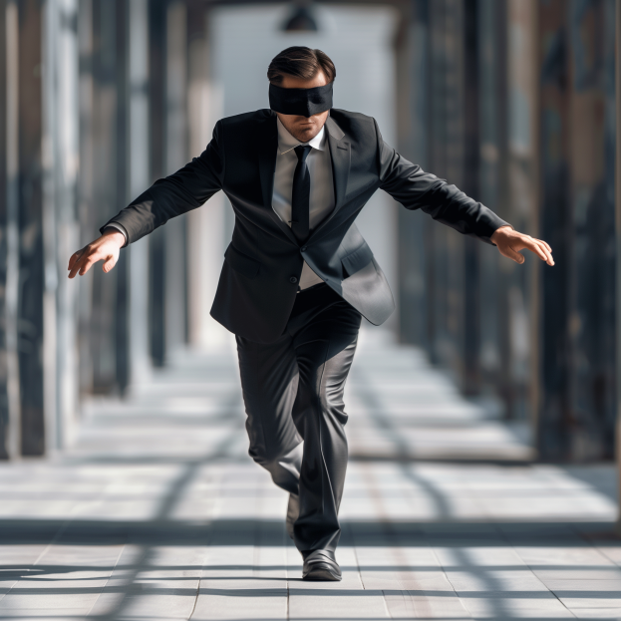
Landmine 13: Hoping Your Writers Do Their Job
Hoping the proposal will be written somehow if you assign the sections
Not training or coaching the writers on how to write and develop graphics
Lack of in-process reviews
Believing that although you haven’t seen the section, it does exist

Slide 46
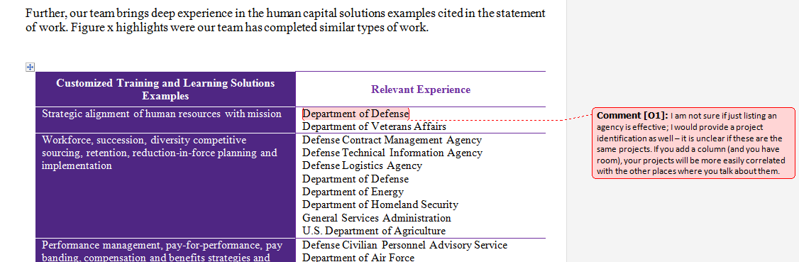
In-Process Reviews
In-process reviews prevent writer’s inertia and drift, encourage accountability , and improve content quality
For large proposals, volume leads do it, with proposal manager doing it less frequently
Provide detailed, constructive, and actionable comments
Writers are not allowed to delete the comments until they are addressed
Remember – if you haven’t seen the section or graphic, it doesn’t exist!

Slide 47

Stay Plugged into the Proposal Battle Rhythm
Stay aware of what is going on through walking or calling around, and getting the digests of who posts what, and how the items are sent via email
Talking is easiest when collocated
  Water cooler talk and hallway conversations remove the need to turn conversation into an errand that can be postponed
In a virtual proposal, use the chat module such as a Teams channel or Slack
Don’t always start with section status: ask about personal issues as well
Identify those who struggle but don’t admit it
Check on issues, requests, resources needed, trouble areas, energy level, and so on
Stay plugged in with email copies – it takes seconds to review instead of longer time running down the status

Slide 48
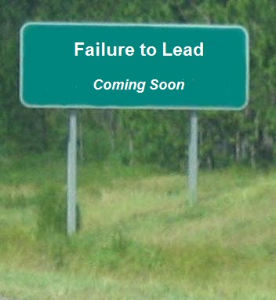
Landmine 14: Poor Management and Leadership
Proposal managers who relegate themselves to “cracking the whip” and treating professionals like petulant children will disenfranchise the team
There is much more to proposal team leadership and management than issuing a schedule and running status meetings
Enforcing the deadlines is not a one-dimensional whip-cracking job
Failing to deal with people where they are and figuring out their individual issues may lead to failure to deliver
  Lack of training/skills
  Lack of management support
  Limited time
  No motivation or incentives
Treat adults with respect, but need to provide extra aids for better retention and understanding

Slide 49

Key Management Skills that Distinguish Great Proposal Managers from the Rest
This list can go on – but a great proposal manager should know how to get almost anyone to produce in challenging scenarios
High Emotional Quotient (EQ)
The ability to follow-through on objectives – ability to complete a superb proposal by the deadline
Ability to delegate properly and get superior performance from the team
Being able to work with all types of people while facilitating cooperation
Communicating clearly, often, and enthusiastically
Keeping the excitement, motivation, and momentum for the proposal team

Slide 50

Methods of Effective Communication with the Proposal Team
Count on people not doing what they are supposed to do and compensate for the general lack of diligence; expect to be pleasantly surprised by those few who follow directions the first time.
Ensure that you communicate the same message at least six times, in six different ways to ensure it sticks
  Status and other meetings (verbal)
  Written agenda, notes, and videos posted and/or sent out and attached to meeting invites
  Wall or whiteboard sign (announcement)
  Proposal collaboration workspace bulletin board (announcement)
  Email reminder (written)
  Conversation in person, videocall, or by phone
If you said something once, count on most not following your directions
Don’t count on anyone reading anything just because it’s been provided

Slide 51
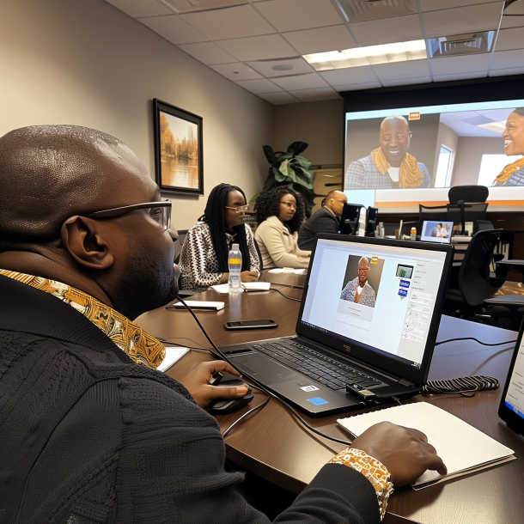
Promote Proposal Team Cohesiveness
Small and mid-size proposal teams are naturally easier to manage; it gets trickier with large proposals; most teams are not cohesive and are committees, which are at their worst when unmanaged and unruly
Subdivide groups larger than 12 into smaller teams (by volume or major section)
Promote a perception that being part of your proposal team is an honor to make people feel special through describing the toughness of the task and their importance to the business and those who work there
Gather the team in a dedicated room or building wing if proposal is not virtual to promote intra-team interaction; create a dedicated channel in a virtual space
Give specific groups assignment in a form of a challenge requiring cooperation for success to get team to pull together and rely on each other
Remind of the competition to emphasize the team's identity and the members' interdependence
Reward the team, less so the individual members, to highlight interdependence and reinforce cooperation
Focus on the team's successes – success engenders cohesiveness

Slide 52

Additional Team-Related Tasks for Proposal Manager
Facilitate Tasks
  Provide process and how-to for the tasks assigned (through JIT Training)
  Fetch and disseminate information, get answers to team’s questions
  Direct efforts back to the task
  Review work and provide feedback
  Monitor performance and replace non-performers
  Track progress against schedule
  Enforce the process and procedures
Build Relationships
  Mediate conflicts
  Relieve tension with humor or other diversions
  Challenge inappropriate interpersonal exchanges
  Empathize with proposal team members
  Exude enthusiasm and encourage others

Slide 53

Recognize and Deal with Proposal Personalities
Each type of the proposal team member requires an individualized approach to get the best results
People who are already juggling one or two full time jobs and now are assigned to support your proposal
  The Murphy’s Law of proposals states that your full-time people will be no good, and your good people will be in high demand already, because they are so good
Team members, subcontractors, and vendors who possess the subject matter expertise, but are unavailable or unresponsive in one way or another
    Will send you either cut-and-paste stuff or other unusable information; if they can get away with it, they often won’t respond on time
Remote SMEs with full-time day jobs at a customer’s site
  They often don’t have the time to keep up with proposal developments or status meetings or to participate in any daytime proposal activities, but you have to rely on their good graces on nights and weekends, when they don’t get paid

Slide 54

More Challenging Personalities
Talented individual performers who are unproductive or uncomfortable in a collaborative setting
  Like to drag their section(s) away into a quiet space and disappear until they feel inspiration; Won’t share their work until they are finished with it; They give you reassurances that they are working hard and that you must trust them to produce a high-quality finished product
Busy executives who assign themselves an important section but underestimate the work it takes
  Get overwhelmed with their actual jobs or pop-up management emergencies they have to address; may occasionally surprise you, they usually produce a piece that comes in too late or is substandard writing they did in a hurry
Talented rebels who feel that the whole proposal process is an artificial, cumbersome, and unnecessary imposition
  Would rather you let them write; they abhor reviews and passive-aggressively sabotage everything they disagree with
  Prima-donnas who always know better and secretly believe that this whole proposal stuff, with you included, are way below their levels of intelligence

Slide 55

And More Personalities to Keep You On Your Toes
People who worked with other proposal managers or managed proposals themselves, who use a different method to which they are married
  Second-guess you or your process, and wonder whether you know what you are doing if you are doing it differently; May undermine and challenge you
People who are brand new to the company; assigned to proposal because the company has not yet won a new project where they can charge directly
  Don’t have the background in developing this company’s solutions, have never read old proposals, don’t know the company’s capabilities, have not done proposals ever, and do not feel empowered to make key decisions
People who are smart and are experts on the subject but believe they cannot write, or actually cannot write
  Both types need to be identified correctly and need a lot of handholding, inspiring, training in transcribing and AI usage, and/or pairing with others

Slide 56

And More…
Employees whose entire goal in life is to get the most for doing the least. They can talk a good game, but they never have what they promised
  The work is always in progress, there is always a great status report, until you see that they actually recycled text from other proposals and threw their sections together at the last minute
Your management people who think you should spend nearly nothing to win everything, since it is a slam dunk anyway, or since they simply do not have the budget
  Usually underestimate how hard it is going to be, or how much you have to do; may understand that you do not have anyone assigned to half the sections, but hope that somehow you will manage like you always have
Long-suffering, overworked, all-knowing, and highly competent production department managers who are perpetually angry at you for getting stuck on the receiving end of your missed deadlines
  They are masters of the impossible; if you keep them constantly annoyed with you, they may one day teach you a lesson, which is never pleasant

Slide 57

Culling Disruptive Meeting Behaviors
Rambling on
and excessive talk
Negativity
Lateness
Sidebars
Off-topic
discussions
Non-participatory
silence
Questioning
Argumentativeness

Slide 58

Providing Feedback
Use the OILS formula when providing feedback and addressing conflict:
  Observation – present and clarify the issue; focus on the issue, not the person; address the behavior
  Impact – how it has impacted you and/or the team
  Listening – allow the other party to confirm or correct, and deeply listen to them to understand
  Solution – determine how to move forward and summarize the conversation

Slide 59

How To Work Effectively With Remote Participants
Most proposals are now virtual – you can benefit from more flexible work hours, lower overhead, and around-the-clock productivity by compensating for natural virtual teams pitfalls
Understand that working with a remote team requires extra management and accountability measures – set an expectation that your team must “make their work visible”
Over-communicate and set up extra check-ins
Avoid “uneven meetings” – where some are in the proposal room while others are virtual – make everyone virtual to get on an even footing; alternatively use high-quality equipment for hybrid engagement
Enforce collaborative document development in a shared space – get off email
Use chat and video to replace hallway talk (set the expectation at kickoff that people should be on camera)
Master remote collaboration tools such as the Microsoft Whiteboard, Miro, Trello, and breakout rooms feature for brainstorming

Slide 60
Mastering Data Calls
Data calls, from logos to a variety of statistics, become more onerous if you don’t have the boilerplate, and if you don’t track the inputs
Variety of data calls covered in the Foundations class
Have standard data call text for each – to modify as needed
Create data call Outlook signatures to stamp it quickly into your email body and modify
Key is to provide a clear deadline, and format in which to receive inputs
Track who has provided inputs and who hasn’t

Slide 61

Module 12 Exercise
Everything from kids’ games to specific team building exercises goes
Get a suggestion using AI or share a team building game or contest for team building you have experienced that worked well
What team building activities could be accomplished virtually?
At what proposal stage could you employ it?
Notes:
Try OST suction gun

Slide 62
Module 13: Getting the Most from Proposal Color Review Teams

Slide 63

Landmine 15: Botching the Reviews
Reviews are a ripe area to mess up; but when done right – they are indispensable
Not issuing invitations on time
Inviting the wrong people (too many managers, too few SMEs)
Not training the reviewers on what’s required from them, including compliance
Not using AI
Lack of clear review agenda, reviewer assignments, and questions
Failing to tell the reviewers to roll up their sleeves and fix stuff
Leaving the reviewers to run the show, instead of being in charge (challenging to fix if company culture/process doesn’t allow it)

Slide 64

Rules of Thumb for Selecting the Right Number and Types of Reviews
Hold at least one review, no matter how short is the proposal
Have a rolling review if the timeframe is too short
Pink and Gold Teams may be sacrificed for proposals under 10 days, the Red Team and Read-Aloud should not
Peer Review is usually the most useful review
Adjust the review goals per the readiness level and specific proposal needs
If the proposal timeframe gets longer, don’t let your proposal go un-reviewed for longer than 7-10 days
Can add additional reviews – the color doesn’t matter, the goals do

Slide 65

Setting the Right Tone for the Review Regardless of Your Company’s Review Process
The reviewers should work for the proposal manager, not the other way around
Train the reviewers on how to comment – which comments are welcome, and which aren’t
Give the reviewers work: have them fix the problems they find instead of telling you to go fix them
Prevent unconstructive comments from the start
Tell the reviewers that copy-editing comments will be ignored (unless it’s the Read-Aloud review or the Gold Team)
Ask for help and give assignments at the review kickoff to answer specific questions
Tailor comment sheets using the specific questions you want answered
Ask the reviewers to avoid disenfranchising your team

Slide 66

Various Methods for Conducting Reviews and Their Suitability for Your Proposal
Simultaneous review in a portal such as SharePoint or Google Docs
In-person review where each reviewer gets a copy of the proposal
  Print and number copies (or proposal sections), and log them for proposal security
  Print a couple of RFP copies; provide red pens, post-its, and comment sheets
In-person review where one copy is put on the walls, and each reviewer starts at a different point in the proposal
  Only one section is marked up, consolidating and de-conflicting comments automatically
  Natural limit on the number of reviewers
Virtual review (synchronous)
  Virtual review kickoff, followed by the simultaneous virtual reviewers’ caucus and author debrief (could be at the same time as reviewers’ caucus)
Asynchronous or rolling virtual review
  Proposal is sent for comments and change tracking, simultaneously or in pieces – and reviewers return their review results when ready

Slide 67

Techniques for Quickly Integrating Reviewers’ Input Into Your Proposal
Use automated tools or single copy review to avoid manual integration work
Decide if the proposal manager will address and delete comments or the authors will
Integrating Word redlines and comments
  Glance through and merge the first two documents with the most changes; look over the conflicts
  Integrate the rest by hand to avoid overwrites
Collating physical inputs:
  Start with comment sheets
  Put all the page 1s together, then page 2s, etc.
  Issue to authors to integrate changes one by one

Slide 68
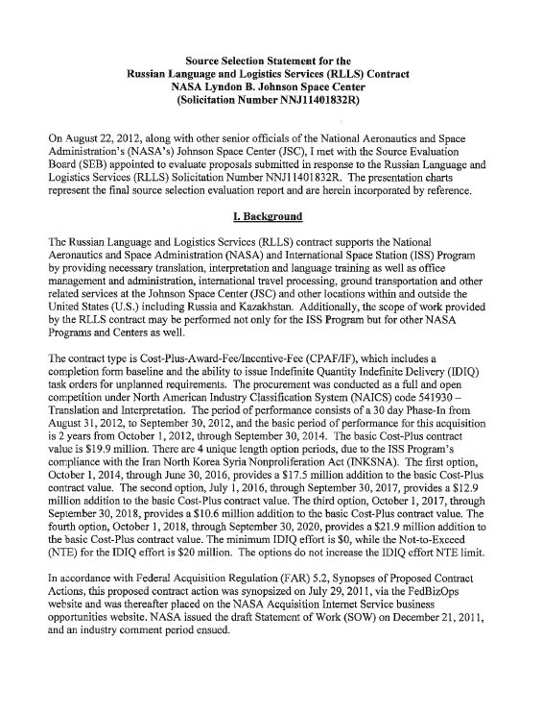
Module 13 Case Study
Review the evaluation debrief
What are your conclusions from the perspective of the losing companies?
Can you apply any lessons learned to your proposals?
Use file Module 13 Debrief Case Study.pdf

Slide 69
Module 14: Improving Proposal Performance

Slide 70

Navigating Through Difficult Proposal Interfaces
Interfaces are most susceptible to breakdowns
Failure 1: Transitioning from capture to proposal team
  Valuable capture knowledge is lost if not properly documented
  Capture manager doesn’t continue involvement in the proposal
Failure 2: Transitioning from storyboards to draft
  Work gets wasted
  Writers just start to write something else instead of continuing to mature the storyboard content
  Failure 3: Writers’ drift
  Writers start telling their own story instead of following the proposal manager’s instructions in the outline
Failure 4: There is a disconnect between sections and volumes
  Cost volume and technical volume
  Technical, cost, and orals
  Sample task orders

Slide 71
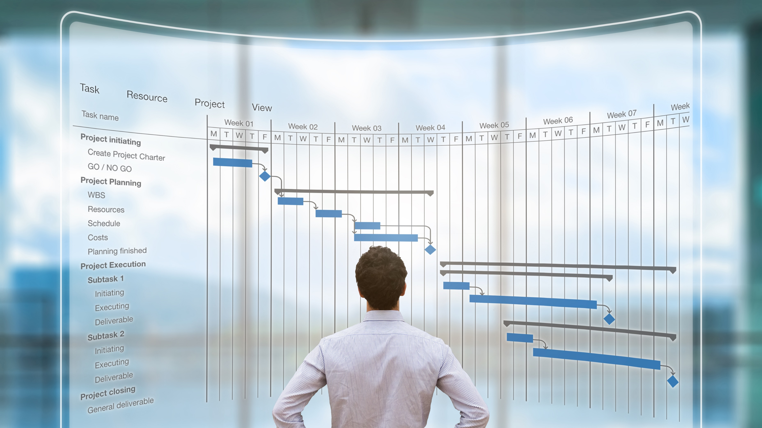
Scaling the Proposal Effort Up and Down
Understand the natural proposal cycle to allocate and manage resources
Very intense during the kickoff preparation period (proposal manager works up to 12 hours/day or more to integrate everything)
Drops off to 40-50 hours per week between the reviews
  Depends on how much writing the proposal manager needs to do
  Hours go up if the proposal manager needs to do more than management, or the proposal team/effort is large and complex
Review days require late work meeting with the team after the review, integrating the inputs, and issuing directions to writers
Work picks up during polishing and production phase up to 10-12 hours per day
Writers normally come in at kickoff and drop off after red team recovery
Desktop publishers need to set up proper templates, and pitch in around Red in some cases, and definitely after the Red team
Graphic artists normally start right before or after pink team

Slide 72
Effective Management of Proposal Budget
Use tracking matrix to take the hours into consideration
Proposal Member | Role | Sections Assigned | Estimated Speed, with assumptions | Hours Estimated | Hourly Rate | Actual Hours Week 1 | Actual Hours Week 2 | Actual Cost | Actual Speed | Productivity Notes and Lessons Learned
 |  |  |  |  |  |  |  |  |  | Perform analysis, asking such questions as: Were the assumptions correct? Did this resource perform extra work, resulting in the increase of their hours? What was the overall quality of the work?

Slide 73
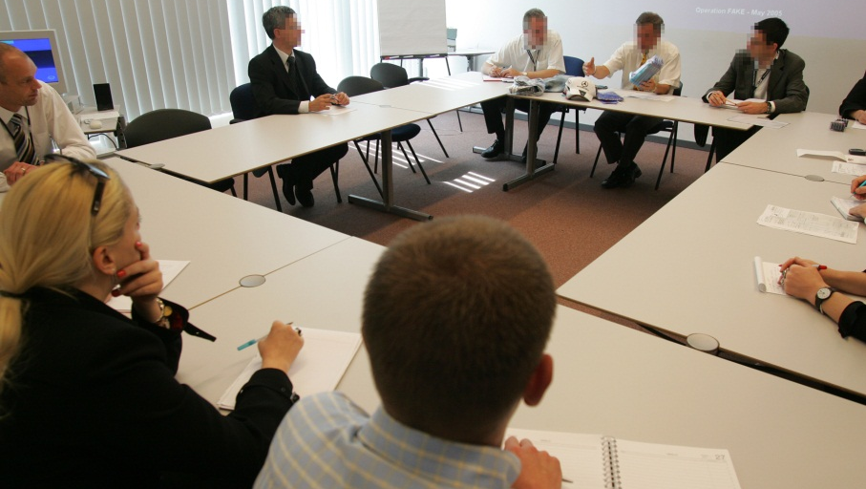
After-Award Debriefs
Debriefs are a fishing expedition and a relationship-building task
Always request a debrief immediately (within 3 calendar days) – whether you won or lost
Always keep a positive attitude and put the
government at ease
Ask, ask, ask in the spirit of learning
Unless protest is your win strategy,
don’t bring a lawyer
This is your opportunity to collect lessons
learned and continue building the relationship

Slide 74

Lessons Learned is the Most Common Best Practice Not Followed
This leads to mistakes repeated
You must:
  Document your lessons learned after the proposal and again after the debrief
  Upload your lessons learned document to a common access area
  Review the file prior to the next proposal

Slide 75

Prepare Lessons Learned Brief and Spell Out the Rules First
Be candid and honest but remember the “amygdala hijack” effect
Don’t get personal, name names, criticize, point fingers, and play a blame game as it is NOT the purpose of the exercise
Do offer constructive suggestions, comments, feedback, and solutions
Take the work seriously, but not yourself
Be open-minded, and remember why we are conducting the lessons learned session in the first place (it is not to find the guilty – it is to improve our process)

Slide 76
First Set of Questions: Deliverable
What is the quality of the final proposal?
Does it have enough graphics? (Remember, the desired proportion is a graphic every other page or even every page)
Does the proposal read well and doesn’t have errors and typos?
Does it send the right message to the customer via:
  Clear value proposition
  Proposal-level and section-level win themes
  Professional look and feel
  Well-integrated message
  Techniques of persuasion
  Substantiated claims
  The right personnel and past performance selection?

Slide 77
Second Set of Questions: Process
How much capture did we do, and how successful were we? Did we build a successful:
  Customer Relationship
  Intelligence gathering process
  Win Strategy
  Competitive Analysis
  Team
  Solution
  Handoff from the capture to the proposal team
If not – why? What were more successful aspects, and less successful aspects of capture?
Was there a Program Manager involved in the proposal process?

Slide 78
Third Set of Questions: Process
How well-prepared were we for each proposal review?
What were the results of each review and why?
What could we have done better to prepare for the reviews?
Was the proposal schedule realistic in the circumstances? How could we have done it differently?
Did the team work together effectively, or what could be improved?
How well did the proposal management team communicate with the proposal team – were the instructions and expectations clear?
What problems came up during proposal preparation? Were they avoidable – and how can we avoid them in the future?
Was there any waste in graphics, hours, rewrites, meetings that ran too long – and how could we avoid it in the future?
What were some positive aspects of the proposal, and what were the things that didn’t work well?

Slide 79
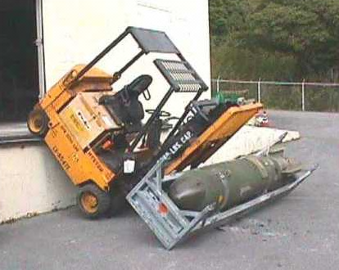
Lessons Learned is a Team Building Effort
Use humor, such as funny photos of “lessons learned”
Feed your team whether it’s virtual or in-person (full is happier, hungry is grumpy)
  Set aside a budget for virtual team to get reimbursement for lunch
  Order good food (not the regular office fare) for in-person meetings
Don’t expect much team enthusiasm initially, so keep explaining what is the purpose of the session, and how to keep things honest but positive
More driver training? Better load balancing?

Slide 80

Personal Proposal Processes Optimization
Develop your own toolset if your company doesn’t have one:
  Templates
  Checklists
  Boilerplate text and graphics
  AI prompts
  How-to documents
  Personal lessons learned
Create instructions for each tool: write down how you did something because you will forget!
Develop a standard proposal set of folders
Add signatures to Outlook
Cultivate a proposal library
Periodically re-read training manuals as a refresher

Slide 81

Organizational Proposal Processes Optimization
Create a well-documented proposal process and a toolset that’s custom to the types of vehicles you are going after
Train the staff
Develop a set of business development metrics that are not contradictory across the functions and ranks, and provide meaningful results
Create a repository of proposal collateral integrated with AI
Frontload the process so that you do capture to shape the requirements and specifications
Institutionalize such processes as collection and review of lessons learned

Slide 82

Day 2 Recap
Let’s go over today’s material
List the landmines you have learned about today
Can you list some of the 11 steps in the resume development process?
Name the ways you could hold proposal reviews
What is your take-away from dealing with difficult personalities?
What is your biggest take-away from today and this class?

Slide 83



Contact Us!
7361 Calhoun Place, Suite 560
Rockville, MD 20855
Phone: 301-384-3350
service@ostglobalsolutions.com
Improving Our Country Through Better Proposals!™
www.ostglobalsolutions.com
Copyright © 2024 OST Global Solutions, Inc. All rights reserved. This material may not be reproduced, distributed, transmitted, or used for any commercial purpose without the express written permission of OST Global Solutions, Inc.

