Slide 1
Five Ways to Streamline Capture and Boost Win Rate in the Current Environment
15 April 2025

Slide 2
About OST
We've Won Our Clients Over $27 Billion in Government Contracts Since 2005
BUSINESS DEVELOPMENT, CAPTURE, AND PROPOSAL CONSULTING
Build Portfolio of Indefinite Delivery Vehicles
Develop Opportunity Pipelines
Capture Opportunities
Win Proposals
Optimize Your Processes
REGISTERED APPRENTICESHIP IN GOVERNMENT BUSINESS DEVELOPMENT; 18 COURSES IN ALL ASPECTS OF FEDERAL BUSINESS DEVELOPMENT
SBIR/STTR Proposal Lab for Maryland and Alabama SBA FAST Grant
Certified Business Developer
Certified Capture Manager
Certified Proposal Manager
Certified Proposal Coordinator
Certified Proposal Writer

Slide 3
Five Recommendations
Understand direction of procurement (situational awareness)
Double down on pipeline basics and 5x your pipeline
Focus on the customer engagement aspect of capture
Invest in On-Contract Growth (OCG) – position yourself for success by securing sole-source awards or adding scope to existing vehicles
Fully implement AI to significantly increase capture and proposal activities

Slide 4
Understand Direction of Procurement

Slide 5
Market Implications
The Heritage Foundation’s Project 2025 is being implemented.
Government’s shifting acquisition landscape: consolidations of IDIQ vehicles, potential rewrites of the FAR, canceled competitions, and moves toward product-centric buys.
Major primes now chase smaller opportunities they traditionally ignored, and everyone is “crowding” the live opportunities.
Agencies are seeing staff cuts and in-progress contract reductions, with funding being reprogrammed or put on hold. If thousands of contracting officer positions are eliminated or left unfilled under a hiring freeze, agencies will have fewer staff to write RFPs, evaluate proposals, and administer contracts.
Executive Order 14210 of February 11, 2025: Pursuant to the Presidential Memorandum of January 20, 2025 (Hiring Freeze), the Director of the OMB shall submit a plan to reduce the size of the Federal Government’s workforce through efficiency improvements and attrition (Plan). The Plan shall require that each agency hire no more than one employee for every four employees that depart.
Executive Order 14222 of February 26, 2025: Each Agency Head shall complete this process within 30 days of the date of this order and shall not issue or approve new contracting officer warrants during the review period, unless the Agency Head determines such approval is necessary.
Procurement Administrative Lead Time (PALT) – the time from solicitation to award – could increase significantly.

Slide 6
Consolidating Federal Procurement in the GSA and Other Changes
EO 14240 of March 20, 2025: Consolidating Domestic Federal Procurement in the GSA
(a) Within 60 days of the date of this order, agency heads shall submit to the Administrator proposals to have GSA conduct domestic procurement with respect to common goods and services for the agency.
(b) Within 90 days of the date of this order, the Administrator shall submit a comprehensive plan to the Director of OMB for the GSA to procure common goods and services across the domestic components of the Government.
(c) Within 30 days of the date of this order, the Director of OMB shall designate the Administrator as the executive agent for all Government-wide acquisition contracts for information technology. The Administrator, in consultation with the Director of OMB, shall defer or decline the executive agent designation for Government-wide acquisition contracts for information technology when necessary to ensure continuity of service or as otherwise appropriate. The Administrator shall rationalize Government-wide indefinite delivery contract vehicles for information technology for agencies across the Government, including as part of identifying and eliminating contract duplication, redundancy, and other inefficiencies.
GSA Federal Supply Schedules and GWACs like Polaris, Alliant 3, 8(a) STARS III, VETS 2, and OASIS+ may see more task orders
Other IT related GWACSs such as NASA SEWP VI and NIH CIO-SP4 could be consolidated under GSA
We may also see renewed interest in Other Transaction Authority (OTA) agreements, especially in defense and R&D, to bypass the FAR’s most cumbersome requirements.

Slide 7
Potentially Fewer SB Set-Asides
Contract Consolidation and Fewer Small-Business Set-Asides:
In the name of efficiency and cost savings, Project 2025 will likely encourage consolidating contracts into larger bundles.
This could mean more agency-wide or government-wide contracts rather than many separate bureau-level procurements.
One implication is a probable decline in small business set-aside opportunities.
Large consolidated contracts are often full-and-open, or if they are set aside, only a portion may go to small businesses.
A recent SBA proposed rule (in late 2024) – which a new administration appears poised to finalize – would apply the “Rule of Two” to multiple-award contracts, requiring agencies to set aside task orders for small businesses only if at least two small contractors on that vehicle could compete​.
Agencies can easily structure their contracting vehicles to sidestep this rule by using separate “tracks” for large and small businesses or by claiming only one small awardee is capable​.
Anticipate more competitions open to all vendors (including large integrators) and a potential drop in the volume of dedicated small-business solicitations.
SBs need to consider JVs, MP JVs, all small teams, and/or partnering with larges – this trend disadvantages new market entrants and niche small firms, while benefiting established contractors that can cover broad requirements.

Slide 8
Commit to and Invest in your Pipeline

Slide 9
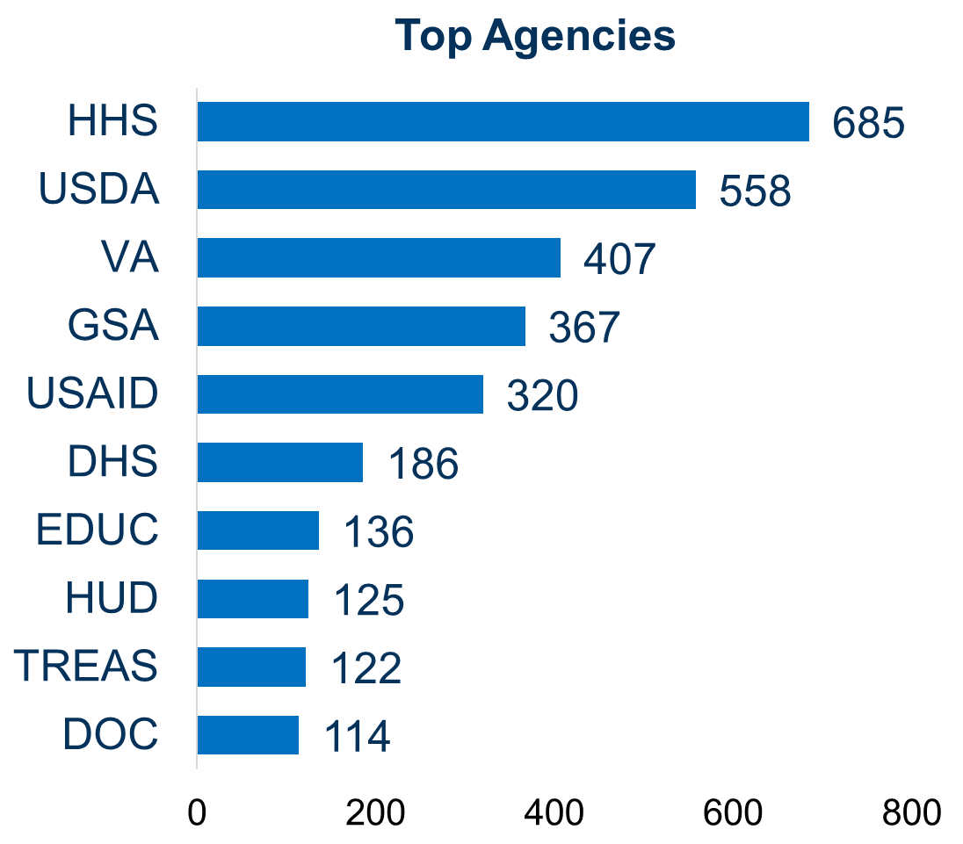
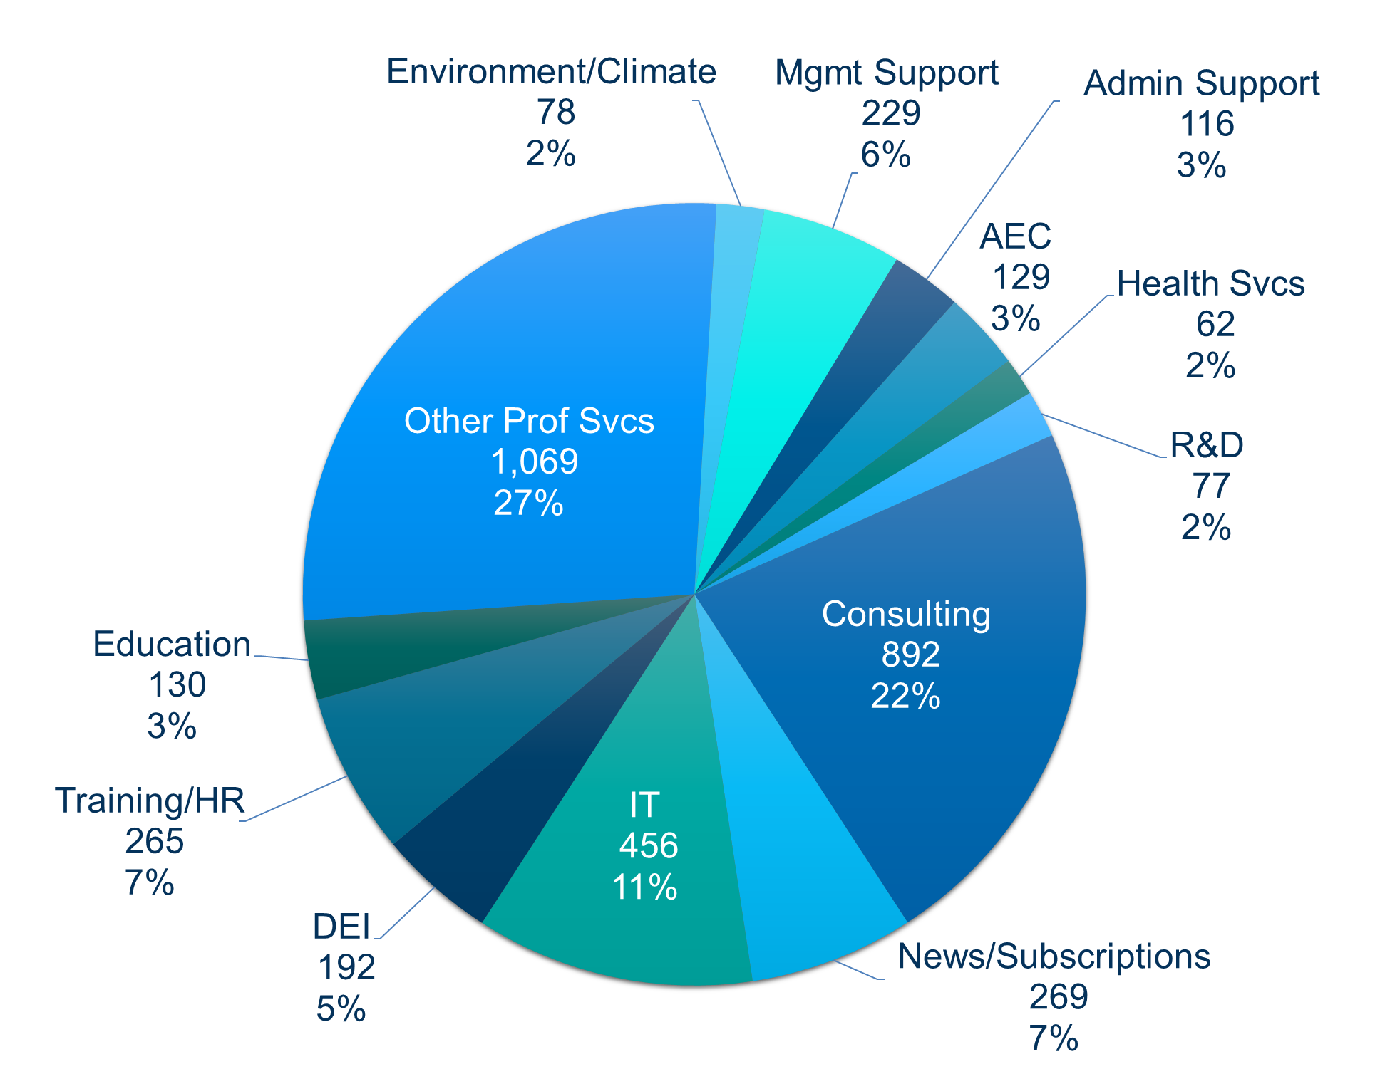
Diversify Your Pipeline
Adding to your core capabilities, adding adjacent capabilities, breaking into new agencies
DHS, Dept. of Ed, USAID, and GSA FEDSIM either have been or are in the process of being eliminated
Significant cuts to State and HHS
DoD and DOJ will receive the various components of DHS
DOGE Contract Terminations
(Jan 20-Mar 20)
Source: Deniece Peterson, Senior Director, Federal Market Analysis, Deltek

Slide 10
Opportunities Pipeline Basics
Increase your pipeline from 2-3x to 4-5x of growth targets
Fill and update your pipeline at least weekly with:
Long-term opportunities issued from 1 up to 5 years from now (next re-compete)
Mid-term – 6 months to 1 year
Short-term – from imminent to those in the next 2-5 months
Ensure opportunities are real
Rank opportunities in the order of priority
Clean and edit the pipeline regularly
If a company is not bidding constantly, it is not growing fast enough
Universe of Opportunities
Gate 1
Identify Opportunities
Interest/No Interest
Pursue/Don’t Pursue – Opportunities enter the Capture phase requiring resources to position your company to win
Gate 2
Qualify opportunities
Preliminary Bid/No-Bid – Decide if you should continue to pursue the opportunity and expend resources
Capture Opportunities
Gate 3
Prepare for Proposal
Gate 4
Bid/No-Bid – Check for deal breakers; use Bid-no-Bid Calculator to confirm Bid
RFP Release
Proposal

Slide 11
Bid Enough to Survive and Thrive
Use more than 2-3 methods to identify opportunities
Leverage your “rainmakers” in conjunction with a trained Business Developer or train them properly
If you are not bidding monthly on multiple projects that are perfect for you, you are not growing fast enough
Commit to a “blitz” campaign to build up your pipeline, and then do regular upkeep
Average number of bids submitted per year by small, mid-tier, and large government contracting businesses per the APMP U.S. Bid & Proposal Industry Benchmark Report, 2019

Slide 12
Focus on Customer Engagement

Slide 13
Lead with Empathy
Federal employees are under intense pressure; many fear layoffs, reorganizations, or abrupt role changes.
With rapidly shifting requirements and fewer government experts, organizations that help shape or re-scope a solicitation—or offer quick, targeted white papers—end up guiding the acquisition.
Agencies are focusing on “data + cost”, you must prove ROI: e.g., how many labor hours you’ll save, how effectively you’ll reduce cost or risk, how your approach aligns with the mission.

Slide 14
Capture is More Important Now Than Ever Before
Capture is pre-proposal preparation that takes place from deciding to pursue an opportunity to the Draft or Final RFP issuance, and beyond
1. Customer Engagement
6. Solution Development
2. Intelligence Gathering
Larger companies are starting to pursue smaller opportunities that they never would have gone after before.
Capture is the key to winning in fierce competition.
5. Teaming
3. Win Strategy
OST CAPTURE PROCESS
4. Competitive Analysis

Slide 15
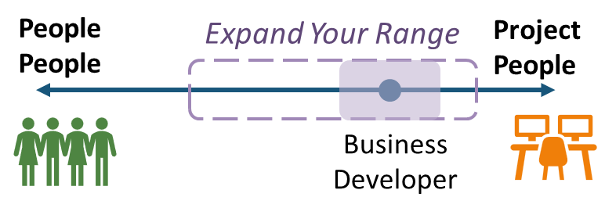
Find Your New Customers
Finding the new customers and reaching the government requires calling a lot of people, a lot
There is a spectrum of natural work preferences which makes some BDers reluctant to “cold call” the government
Some don’t know what they can ask for
Others run into lack of responsiveness and doubt someone will ever want to see them
Yet others feel they don’t have the credibility to deal with government people at a certain level
Some don’t know how to talk to government officials and feel stiff and nervous
Many call or visit but don’t know how to continue the conversation beyond presenting a capabilities statement
Some get discouraged by the notorious government dislike of sales and business development people

Slide 16
Become a Trusted Advisor
You are squeaky clean honest and trustworthy
You are honest, ethical, and you play by the rules – but you are not sticking with the strictest interpretation of every rule
You care about our country, the Government, and the project more than yourself or the company
You honestly believe that your company is the best possible contractor to get the work done
You understand that this Government servant is important to the agency’s mission, and you appreciate their exact impact
You are there to help and to solve their problems
You will always give them the best deal
You respect them a great deal – you listen but you are never dismissive of the Government even if they are
You also recognize they are a human being

Slide 17
Maintain Close Communication with Agency Customers
Stay close to your customers (program managers, contracting officers, contracting specialists)
Our customers are dealing with new rules, DOGE team input, and possibly staffing issues. Be empathetic and solution-oriented in all interactions. For instance:
If a contracting officer is struggling with the new justification system, offer to provide contract reporting data in a format that makes their job easier to justify your invoices. Little assists like that can build goodwill.
Check in regularly about any changes in priorities or funding – you may learn early if your contract’s scope might be narrowed or if there’s interest in expanding it because in-house staff left, which will allow you to adapt quickly (e.g. propose a logical expansion or extension to cover a gap).
Educate new officials: Many political appointees and DOGE team leads might be unfamiliar with the details of certain programs. Without being political, ensure they understand how your work directly supports the administration’s goals. For example, if a DOGE Team Lead is reviewing contracts, you or your government champion can highlight that “Contract X provides critical IT support that has enabled 20% efficiency gains in processing claims” – tie it to efficiency or cost savings to speak their language.
Influence Requirements Early:
As agencies shift towards GSA vehicles and possibly combine needs, engage in industry outreach and RFIs actively.
GSA is likely to host industry days as it formulates its consolidated contracts plan. Participate and provide feedback – for example, if you’re concerned that too few winners on a vehicle could harm competition, articulate how a larger pool (with many small biz) could still deliver savings.
While the administration’s decisions are top-down, the acquisition workforce still cares about getting it right. Your input might shape solicitations to be more favorable or at least fair.

Slide 18
Invest in OCG

Slide 19
Helping Program Staff Overcome the Reluctance to Sell
OCG does not solely benefit the company or maximizes revenue, but supports the mission and ensures project success
It is needed so that:
The project can be implemented smoothly without unforeseen risks
You stay informed about potential needs and address them proactively
There is time to carefully plan and execute the program, avoiding rushed decisions that could lead to poor results
You are not “selling” in the traditional sense
You are identifying and solving problems the customer may not even realize they have
You are offering well-thought-out solutions that will make their mission easier to accomplish

Slide 20
Clarify for Staff How OCG Aligns with Mission Outcomes
Identifies and implements improvements, innovations, and expansions
Fosters trust and collaboration by aligning our initiatives with the customer’s priorities
Aligns company’s growth efforts with customer’s evolving needs
Mission
Anticipates and addresses challenges proactively
Ties our contributions to mission-critical measurable outcomes
Drives continuous improvement

Slide 21
OCG Process
1
2
3
Cross-Functional Collaboration
Customer Engagement
Process Documentation, Knowledge, & Tools
Enabling
Confirm & Capture Growth Leveraging Integrated Project, BD, and Technical Teams
Develop, Update, & Share Standard Processes, Resources, & Templates
xx
Understand Needs & Challenges, Identify Growth Opportunities
4
5
6
7
Culture of Innovation & Flexibility
Training & Development
Incentives & Recognition
Performance Monitoring & Feedback
Supporting
Encourage Teams to Adapt to Changes and Propose New Ideas
Build and Expand OCG Skills & Knowledge
Motivate All Personnel to Engage in OCG Activities
Drive Continuous Improvement

Slide 22
Fully Implement AI

Slide 23
AI Advantages in Government BD
Provides strategic advantage in analyzing vast amounts of opportunity, pursuit, proposal, past performance, resume, and financial data.
Allows precision by providing insights into patterns and trends, and offers predictive analytics results that may escape the human eye.
Currently increases productivity at least 30%, and results in 20% higher win rates and 25% labor cost savings.
Helps identify risks and devise proactive mitigation strategies that save time and resources.
Companies who masterfully integrate and AI will – be the ones who remain.
Art: DALL-E

Slide 24
How to Integrate AI in the BD Lifecycle
Analyze good opportunities you no-bid or lost for requirements you couldn’t fulfill
Devise strategies to obtain these missing credentials
Strategy development
Metrics development and analysis
Portfolio analysis
“Must Win” opportunity identification
Priority-based B&P budget allocations
Agency deep-dives
Market landscape trends research and analysis
Competitive analysis
Other market research tasks associated with data analysis
Begin Business Development Process
Build capacity by investing in new capabilities
Conduct Strategic Business Development Planning Session
Perform Market Research
AI is transforming government BD, capture, and proposal development workloads in every step of the BD lifecycle.
1.0
2.0
3.0
Account plan development
Multitude of uses for marketing purposes: white paper copy development, case study development, web pages, press releases, cap statement tailoring, etc.
Market to Target Agencies & Partners
Enough Info to Make Decisions?
Yes
No
4.0
Map out and manage stakeholder engagement
Compile and analyze performance data from the current project to use as part of the evidence of past performance in future bids
See capture and proposal tasks lists
Yes
Analysis of expiring and new opportunity announcements
Opportunity fit analysis for interest/no-interest decision
Budgets/appropriated funds analysis
Perform Business Development During Project Execution
Build the Opportunities Pipeline
Check for Strategic Fit
9.0
RFX analysis
Schedule/proposal plan development
Compliance matrix/outline
Brainstorming, drafting, writing, editing
Past performance, resumes
Graphics conceptualization
Reviews
5.0
Customer hot buttons analysis
Researched data analysis
Win themes/strategy development
Competitive analysis
Teaming analysis
Solution development
“Top-Down” capture research
Granular analysis against search criteria, “deal breakers”
Old, draft, or related RFX analysis
Prepare Proposal
Conduct Capture
Qualify Each Individual Opportunity
8.0
7.0
6.0

Slide 25
Split Complex Tasks into Simpler Ones and Error-Check
Break down the complex task into its fundamental elements or a workflow:
“Create a proposal cross-reference matrix with nine columns labeled Section Number, Section Title, Proposal Instructions, Eval Criteria, SOW, Other, Author, Pages, Actions, Status.”
“Fill out the matrix columns Section Number and Section title with the proposal outline provided in the attached file.”
“Fill out the Proposal Instructions column with the relevant Section L instructions.”
“Fill out the Eval Criteria column with the relevant Section M instructions.” …
Error-check in stages:
After each subtask, prompt AI to check for errors or inconsistencies before proceeding.
2.1 “Verify the accuracy of the outline language against the attached proposal before moving to adding evaluation criteria to the cross-reference matrix.”
3.1 “Verify the accuracy of the proposal instructions requirements language against the RFP Section L before moving to adding evaluation criteria to the cross-reference matrix.”
4.1 “Verify the accuracy of the eval criteria requirements language against the RFP Section M before moving to adding relevant SOW requirements to the cross-reference matrix.”

Slide 26
Split Large Documents into Bite-Size Pieces
Tackle extensive documentation by summarizing parts and then combining the summaries:
“Please, summarize Section 1 of the old proposal.”
“Please, summarize Section 2.”
“Please, combine summaries for a comprehensive overview.”
Develop complex narratives piecewise:
“Context: we will use the “Why, What, Who, How, When, Where, and Wow framework for proposal section development step by step.
As step 1, please, draft the “why” introductory paragraphs of the technical approach by focusing on the highest risk inherent in the solution provided as a capture plan reference, and mitigation of that risk due to our 10-step approach provided as a reference.”
“As step 2, please, develop the “what” paragraphs of the technical approach by detailing the benefits of our 10-step approach.”
“As step 3, please, create a sentence with a placeholder for names of “who” will be doing all the work, with roles based on our 10-step approach reference.”
“As step 4, please, develop the “how” paragraphs for step 1 of our technical approach that dive into the details of the implementation. Make assumptions of what is applicable from our 10-step approach reference to the reference SOW paragraphs.” …

Slide 27
Next Steps
& Resources

Slide 28
Next Steps & Resources
We provide market analysis, BD strategy, pipeline management, opportunity qualification, and other capture support.
Corporate training for OCG:
Federal Business Development Corporate Training | DC, MD, VA | Corporate & Individual
Sign up for our Master AI to Enhance BD, Capture, & Proposal Processes:
Master AI to Enhance BD, Capture, & Proposal Processes - Updated to Include the Latest AI Developments (Live Class) | OST Global Solutions, Inc.
Schedule time to discuss your business development needs:
https://calendly.com/ostglobalsolutions/bdconsulting?month=2023-09
Upload your capabilities for opportunities in our subcontractor portal:
https://www.ostglobalsolutions.com/teaming-partner-match-portal/
We regularly publish updates to major contracts through our newsletter and blog:
Blog: https://www.ostglobalsolutions.com/blog/
Newsletter sign up: https://www.ostglobalsolutions.com/tag/email/
Sign up for our newsletter and schedule an appointment

Slide 29
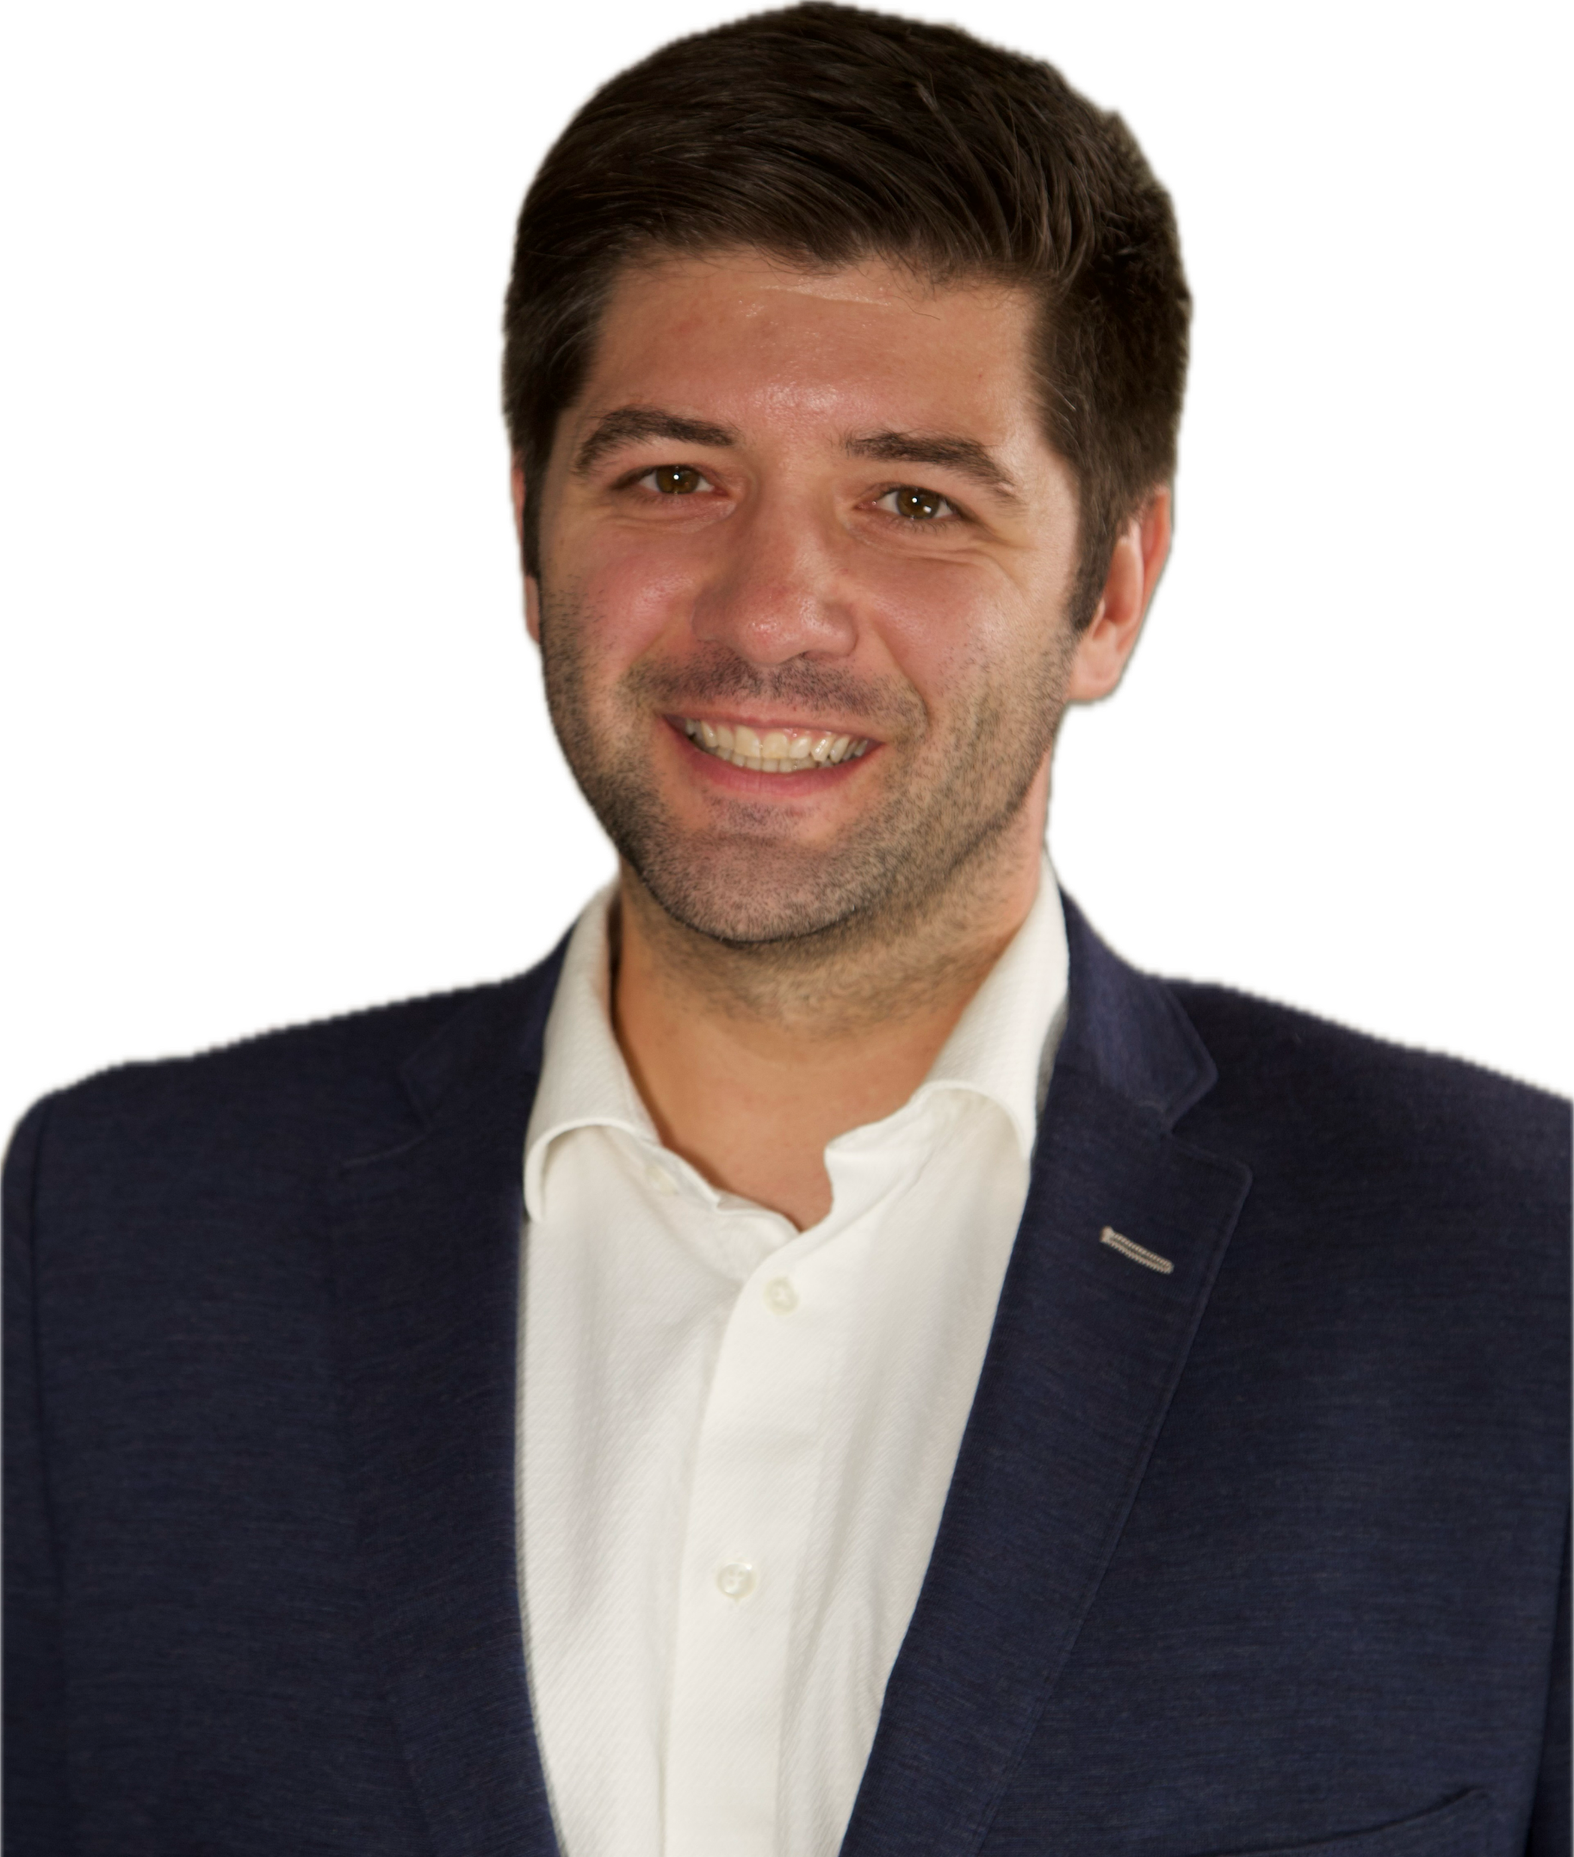
Let’s Partner in Winning Business
David Huff
CEO
c: 513.316.0993
o: 301.769.6602
e: dhuff@ostglobalsolutions.com
www.ostglobalsolutions.com

